Slide 1
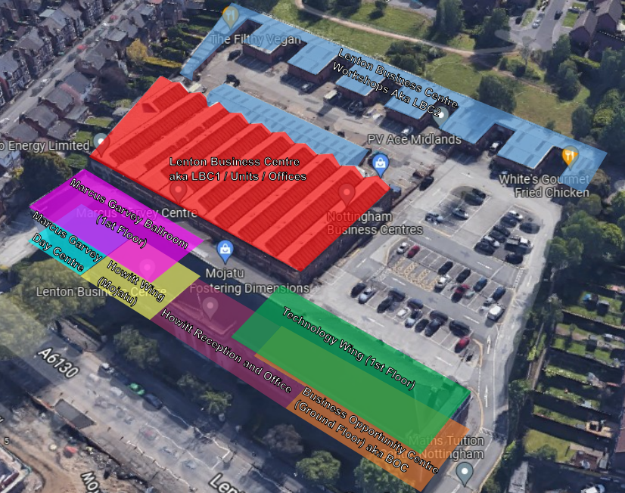

Lenton Business Centre
  Site comprising of 66,000 sqft of office and light industrial accommodation over 4.5 acres.
  The Grade II Listed "Howitt" building comprises of 23,321 sq ft, incorporating Marcus Garvey Ballroom and Adult Day Centre (multi-colour);
  The “LBC1” Building comprises of 21,258 sq ft of office and storage space (red);
  The adjacent LBC workshops consist of 21,352 sq ft of 54 light industrial units (blue);

Slide 2
Occupation Statistics:
Existing position:
154 lettable units
110 occupiers
152 Licenses with 28 days termination notices
1 x expired historic lease from 1984;
1 x “Tenancy at Will”
Impact of closure:
36 units to vacate from 1 March 2025
64 units to vacate from 4 March 2025
Of those:
6 are charity occupiers
Circa 67 commercial occupiers
37 occupiers unaffected

Slide 3
Background – Why now?
In 2024 the Council put a Corporate Landlord Services Model into operation which centralises all aspects of property management including health and safety.
Corporate Landlord Vision
“The aim of Corporate Landlord Services (CLS) is to provide a strategic overview of the Council’s assets, ensuring that the Council’s property portfolio is effectively managed, enables services to meet the needs of our residents, delivers a financial return to the Council and contributes to the effective place making of the city…….enabling a more strategic approach to managing our property estate and, in doing so we will put Health & Safety and Risk Management at the core of everything we do, and it will be consistently applied across portfolios.”

Slide 4
Background – Why now?
23rd January 2024 - Fire Risk Assessment (FRA) undertaken by external expert – this did not cover entire building so a second FRA was requested.
9th August 2024 - Second FRA completed 9th August 2024.
11th September 2024 FRA made available to the Building Manager.
19th September 2024 Building Manager wrote to all tenants to request copies of individual FRAs.
4th October 2024 - Occupiers received followed up email requesting copies of FRAs.
15th November 2024 – FRA for the ballroom completed from tenants was received by NCC.
16th November 2024 – Upcoming events were considered high risk due to the significant numbers of attendees and Asset Management requested confirmation that all Ballroom events had been suspended.
19th December 2024 – Mitigation measures put in place – staff on site at busy periods and no use of kitchen or ballroom areas.
24th December 2024 – Briefing note presented to Corporate Leadership Team.
22nd December 2024 – Inspection of the site by Building Services/FM (Qualified Fire Officer).
21st January 2025 – Fire escape survey completed.
22nd January 2025 – fire door survey commissioned, quote for compartmentation survey received but not commissioned. External Fire Escapes.
24th December – Day centre activity ceased.
27th January 2025 – tenants notified of intention to close the Howitt and LBC1 buildings.
31st January 2025 first tranche of notices served to tenants.
4th February 2025 second tranche of notices served to tenants.

Slide 5
NCC FRA Risk Assessment (Howitt Building/LBC1 exc Ballroom)
9th August FRA identified several actions with 6 actions having been completed. The outstanding actions are detailed below:
Risk | Action Plan Requirement
1) No evacuation procedures/equipment for disabled or impaired building users. Some adults using the day centre have complex needs with cognitive impairments. | Supply and fit evacuation chairs and update evacuation plan to reflect all users of the building and undertake training/drills.
2) Fire doors are inadequate. | Fire door survey completed. Majority of fire doors (172/183) require replacement or remedial work.
3) Fire compartmentation is inadequate. | Undertake compartmentation survey to establish the works which need to be completed to slow/stop the spread of fire – quote for survey received but not commissioned.
4) Condition of external fire escape in disrepair. Requires further survey to establish condition and remedial works required. | Survey has been completed and remedial works identified.
5) FRAs for individual units (Tenants responsibility) not provided. | Obtain all FRAs and review in the context of the overall and compile action plan as required. Two FRAs remains outstanding.
6) Mobility scooters and batteries stored in unit in LBC1. | Remove lithium batteries into remote storage facility. This can be rectified.

Slide 6
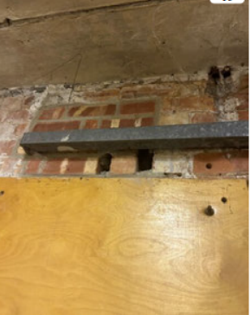
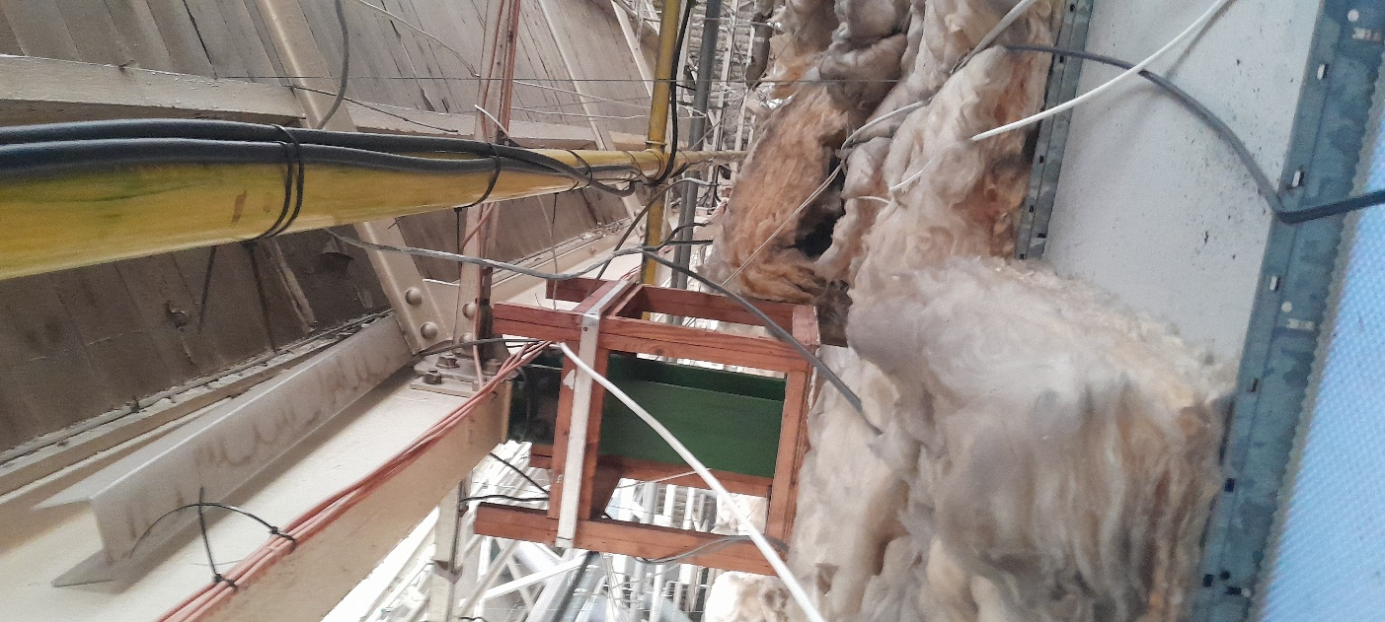
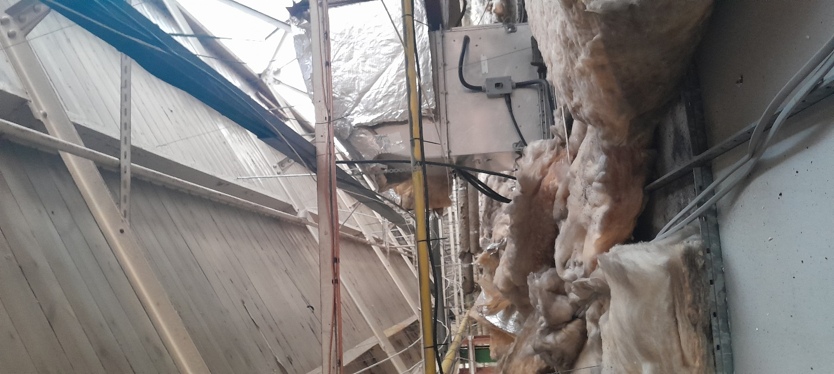
Issues with compartmentalisation
  Open space above LBC1 will not prevent/contain the spread of fire.
  Holes identified in brickwork and around pipework which will allow the spread of fire

Slide 7
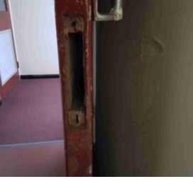
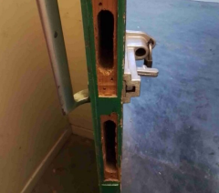
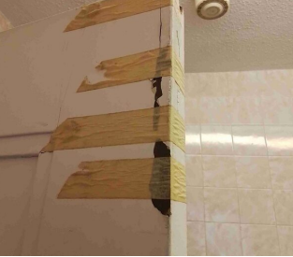
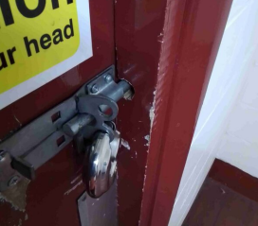
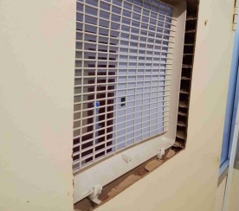
Issues identified with 172 out of 183 doors in the Howitt/LBC buildings.
Issue include:
  Holes in doors.
  Gaps around doors which will allow smoke to move through the building.
  Doors taped and locked.
  Non fire rated panels/ineffective panels.
  Inadequate door hinges for fire doors.

Slide 8
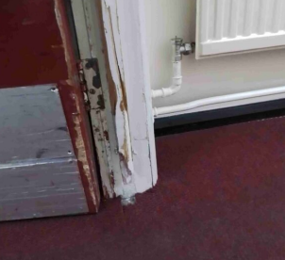
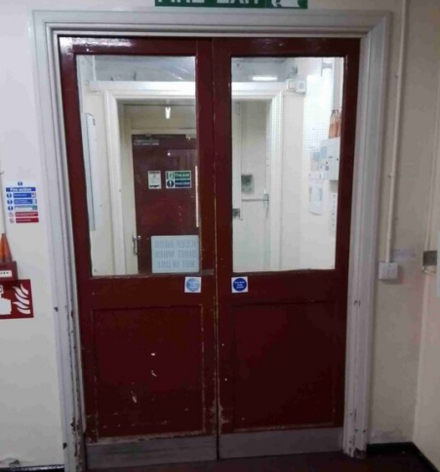
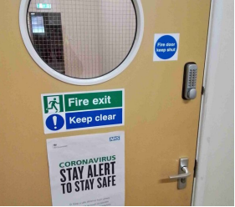
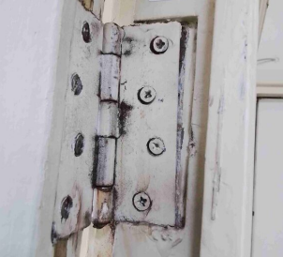
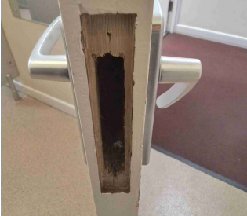
Issue with fire doors – glass doors, holes in doors, non-compliant issues.

Slide 9
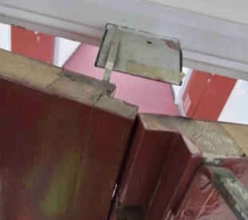
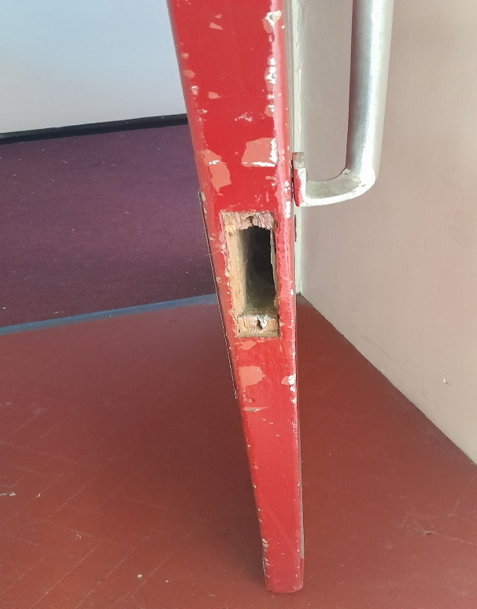
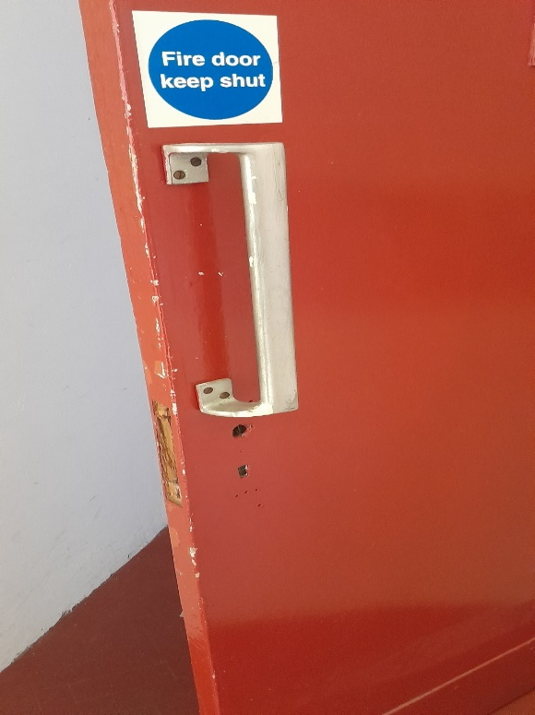
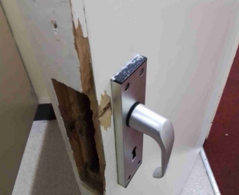
Issues with doors – holes in doors, doors not closing

Slide 10
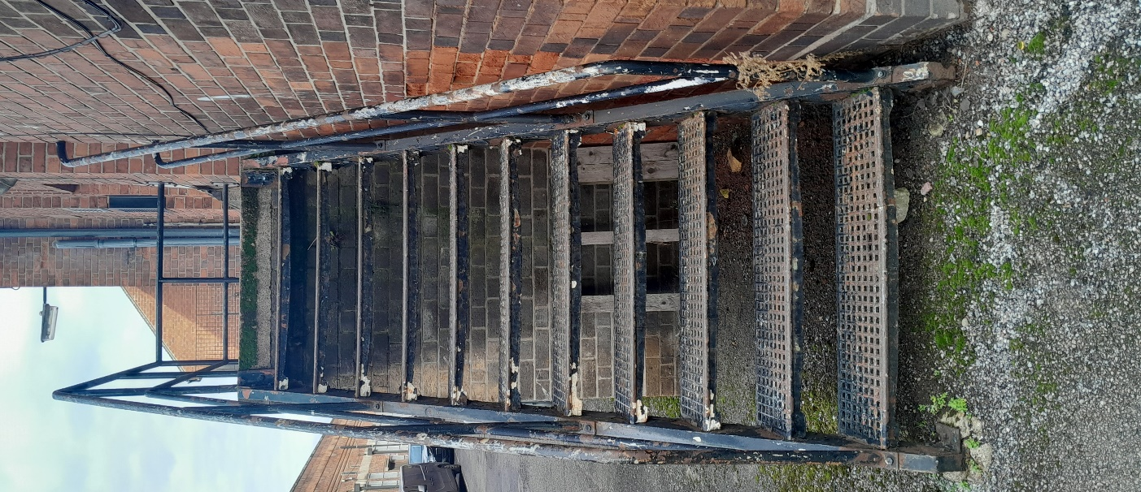
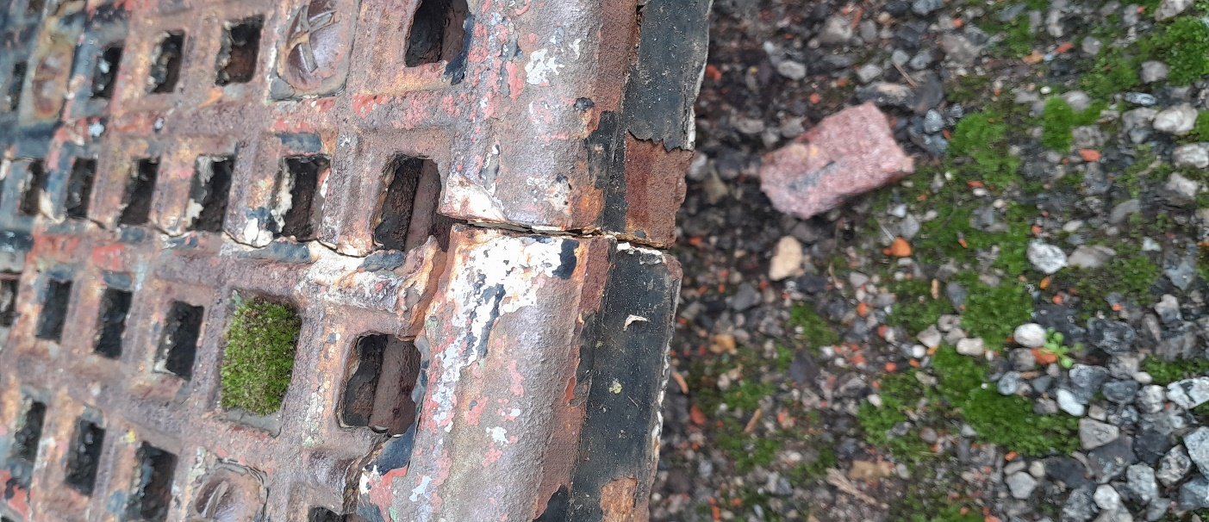
Issues identified with the external fire escape

Slide 11
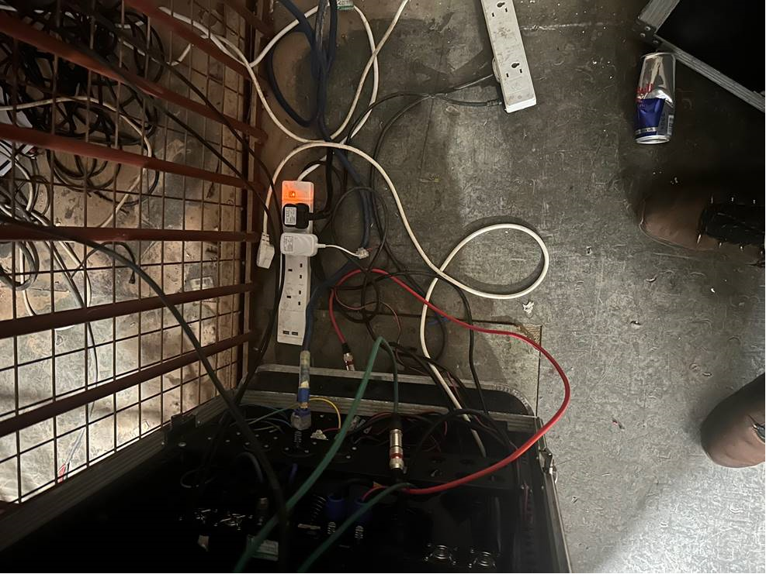
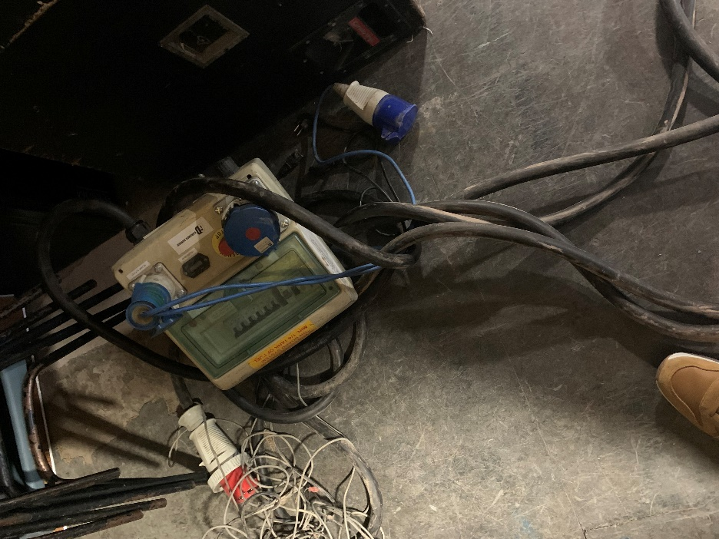
Photos from Officer Inspection
Overloaded sockets and exposed electrical wires in area behind the stage.
Consumer unit/Fuse box on floor and connected to appliances. Should be mounted in a safe position.

Slide 12
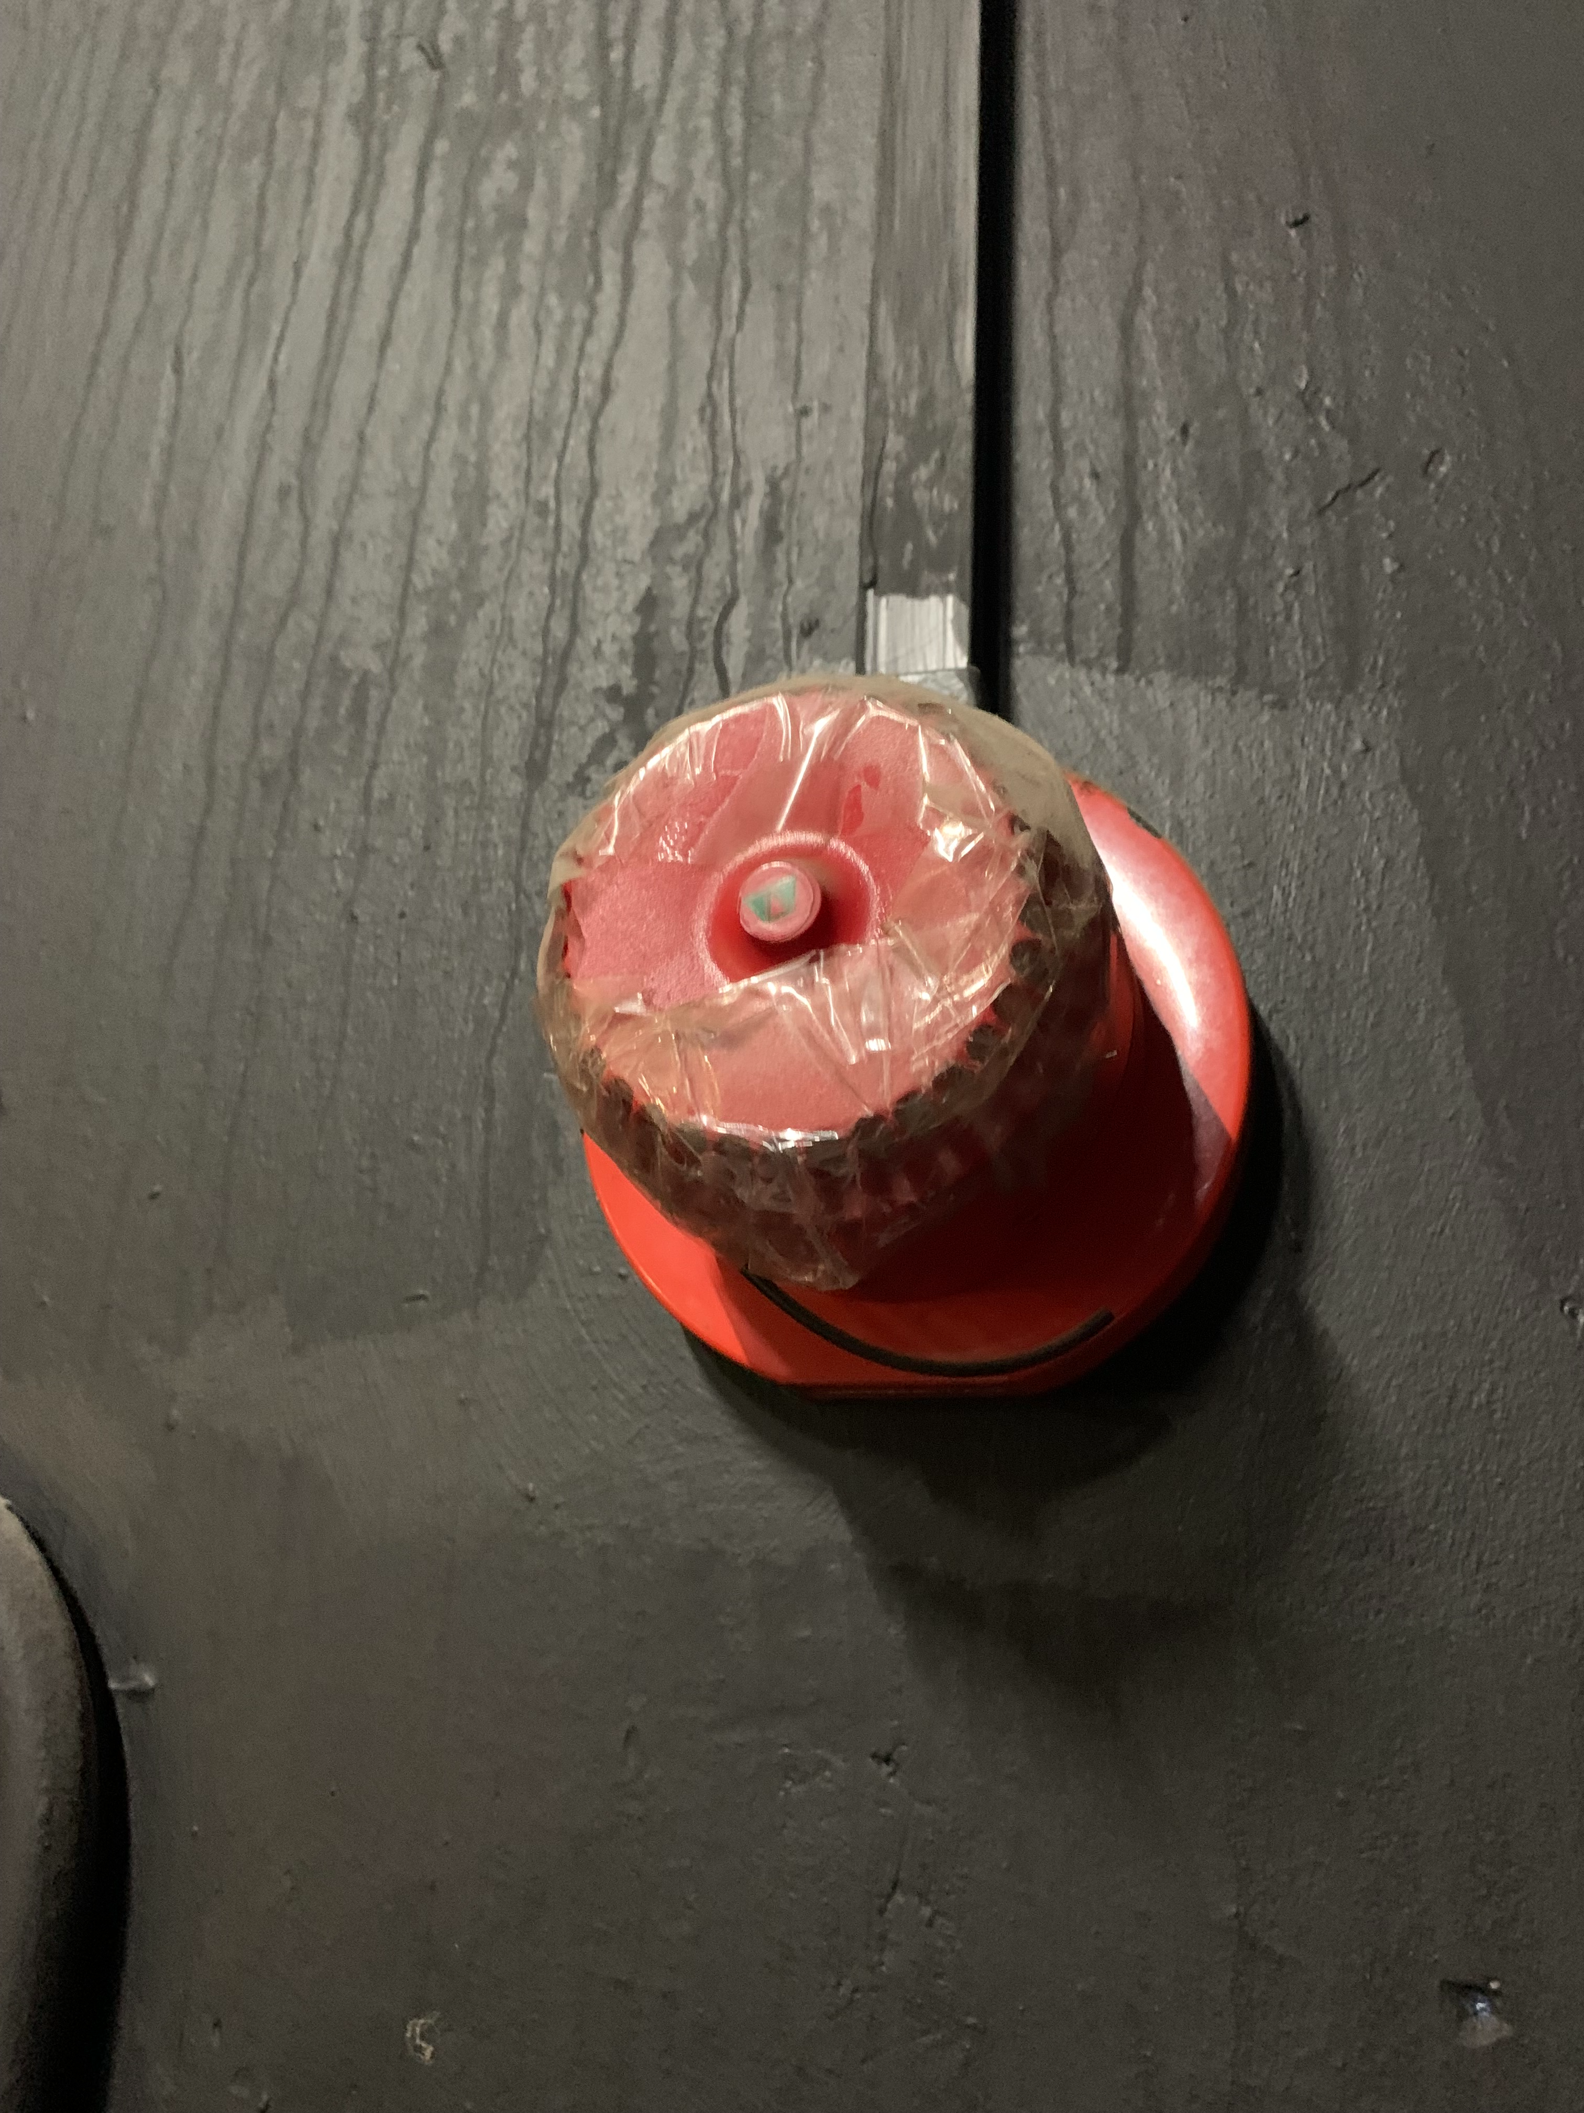
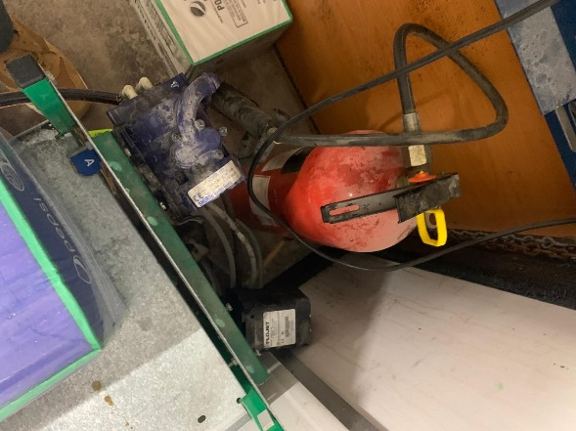
Photos from Officer Inspection
Smoke detector covered in tape
Fire extinguisher inaccessible

Slide 13
Financial Appraisal – Income/Expenditure
Expenditure on site maintenance/repairs since 2016 is £520K
  £257K spent on LBC1
  £78K spent on the Howitt Building
  £123K spent on Marcus Garvey (tenant has contributed towards boiler and triple glazing).
  £61K spent on the workshops
 | PPMs / Repairs / Maintenance Costs |  |  |  |  |  |  |  |  |  |  | TOTAL
 | 2016 | 2017 | 2018 | 2019 | 2020 | 2021 | 2022 | 2023 | 2024 | 2025
LBC - Business Opportunity | 20665.22 | 20456.17 | 33527.58 | 87091.68 | 13157.79 | 28080.27 | 21621.92 | 19432.81 | 13447.21 | 0.00 |  | £257,480.65
LBC - Howitt | 22074.45 | 1791.27 | 7962.91 | 422.81 | 730.17 | 2699.08 | 12897.38 | 13169.82 | 16800.79 | 182.64 |  | £78,731.32
Marcus Garvey | 6491.17 | 16892.38 | 14807.31 | 12648.74 | 20258.87 | 12184.45 | 16892.20 | 16601.35 | 6400.37 | 0.00 |  | £123,176.84
Workshops | 1131.53 | 4338.33 | 2609.33 | 6143.87 | 4968.89 | 7286.96 | 25109.60 | 7753.48 | 538.20 | 1182.65 |  | £61,062.84
 | £50,362.37 | £43,478.15 | £58,907.13 | £106,307.10 | £39,115.72 | £50,250.76 | £76,521.10 | £56,957.46 | £37,186.57 | £1,365.29 |  | £520,451.65

Slide 14
Rationale for Closure
The closure of parts of the Lenton Business Centre has been taken on the grounds of health and safety only and no decision regarding the long-term future of the site has been made.
This is a direct result of Fire Risk Assessments undertaken in 2024 and an inspection by Council Officers qualified in Fire Health and Safety (NEBOSH/MA MCIOB).
The issues with the fire doors and compartmentation potentially present a significant risk to life should a fire break out, particularly in a highly populated area such as the ballroom during an event.
If a fire were to start its spread would not be contained or slowed due to the inadequate/non-compliant fire doors and gaps in the compartmentation.
If a fire were to break out during an event in the ballroom area the fire doors or compartmentation would not prevent the spread of fire, the means of escape is also inadequate, and the FRA identified that no staff or responsible persons are trained in the use of fire extinguishers therefore presenting increased risk of significant or fatal harm.

Slide 15
Rationale for Closure
The issues presented in the FRA are now known and documented. Therefore, taking no action or delaying action is not an option.
The Council and more specifically the Responsible People within the Council (Director of Economic Development and Property/Corporate Director for Growth & City Development/Chief Executive) can face prosecution under Corporate Manslaughter if they have failed to take appropriate action.
The Fire Risk Assessment and inspection by Officers presented significant concerns in relation to the fire doors and fire compartmentalisation within the Howitt and LBC 1 Buildings and Property Managers and the Director of Economic Development & Property were advised to close the building as soon as possible with mitigation measures being put in place whilst the closure was enacted. An immediate closure was not deemed necessary as mitigation measures were put in place.
Mitigation measures included:
  Asking for large scale events to be stopped with immediate effect - high risk activity such as large events in the ballroom, use of the day centre and kitchen were ceased with immediate effect. These mitigations allowed lower risk activity to enable the appropriate action to be taken to close.
There has been no change to the building which would enable us to reverse this course of action.
Therefore, as Responsible Persons under the Fire Safety Order the Council has no option but to continue
with the closure of the buildings.

Slide 16
Consequence of not acting:
Corporate Manslaughter – When a company is found responsible for a fire safety failure that results in death, prosecuted under the Corporate Manslaughter and Corporate Homicide Act 2007 and Regulatory Reform (Fire Safety) Order 2005.
Gross negligence – Considered a manslaughter offence related to fire safety, the breach of regulations must be considered ‘gross negligence’ meaning a serious and reckless disregard for safety that led to a fatal outcome. Health and Safety a Work Act 1974.
Examples of Failures:
Failing to maintain fire safety equipment like detectors or extinguishers
Ignoring building code requirements regarding fire exits or extinguishers
Not conducting a proper fire risk assessments or neglecting identified hazards
Failing to provide adequate fire safety training to employees or residents
Consequences – significant fines or imprisonment.

Slide 17
Summary of Support Offered by Economic Development/Growth Hub
One to one business support advice offered to support businesses in relocation.
Growth Hub dedicated inbox set up and email address provided to tenants;
Provision of an information sheet outlining general services offered by the Growth Hub.
Only 6 businesses have contacted the team to date.
Support offered by Strategic Assets & Property
1-2-1 meetings have taken place with tenants regarding vacating the site.
Details of Property Managers with available space in locations such as the John Folman Business Centre have been provided
Links to the Council’s property website provided.
To date no tenants have followed up on potential relocation space.
Gedling Borough Council have offered assistance on relocations.

Slide 18
Next Steps
Share the FRA with Members and via FOI requests.
Continue to secure vacant possession of the Howitt Building and LBC1 and ensure the buildings are safe and secured.
Ask Nottinghamshire Fire & Rescue to undertake an inspection of the site.
To date there has been no decision on the future of the site. A full options appraisal will be undertaken.
The options appraisal will consider the impacts on the community and the users of the building as well as the financial feasibility.

