Slide 1
Emollients – risk of severe and fatal burns

Slide 2
Medicines & Healthcare products Regulatory Agency
Executive Agency of the Department of Health and Social Care
UK regulator for medicines, medical devices and blood products
Ensures these meet acceptable standards of quality, effectiveness and safety

Slide 3
Key learning objectives
What are emollients?
What is the risk?
Mechanism of the risk
Scope of the risk
Size and nature of the risk
Population at risk and risk factors
Options for minimising the risk
Advice for healthcare professionals
Know where to find resources to support the safe use of emollients

Slide 4
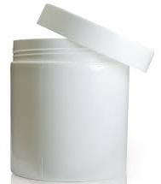
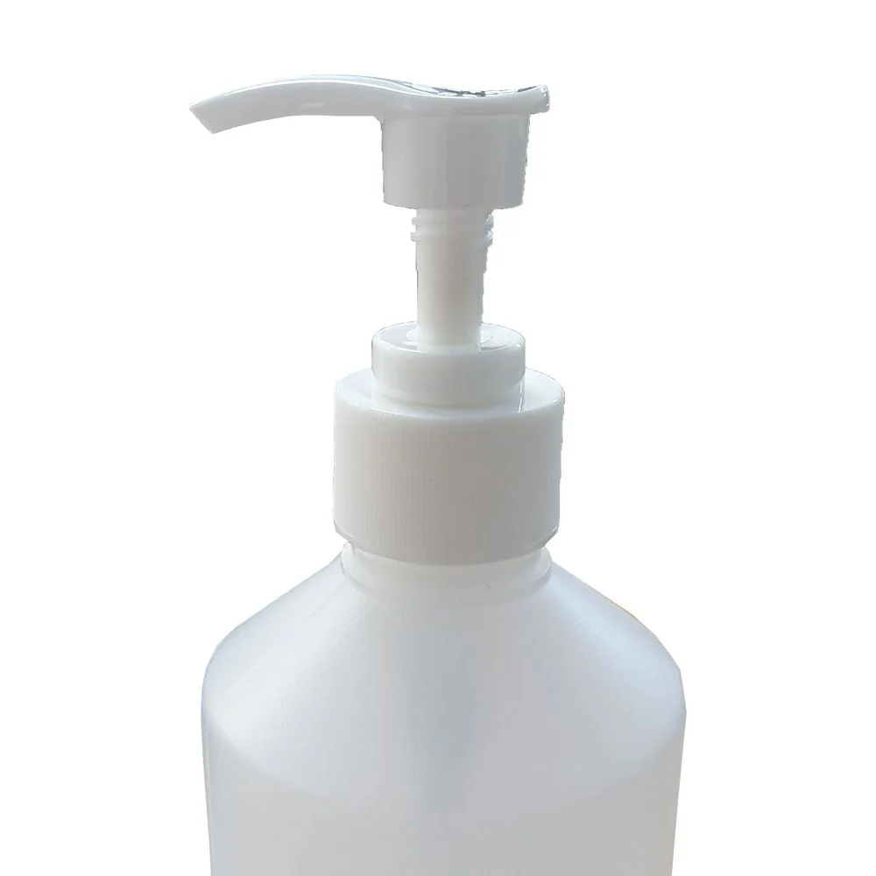
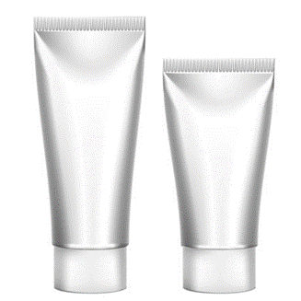
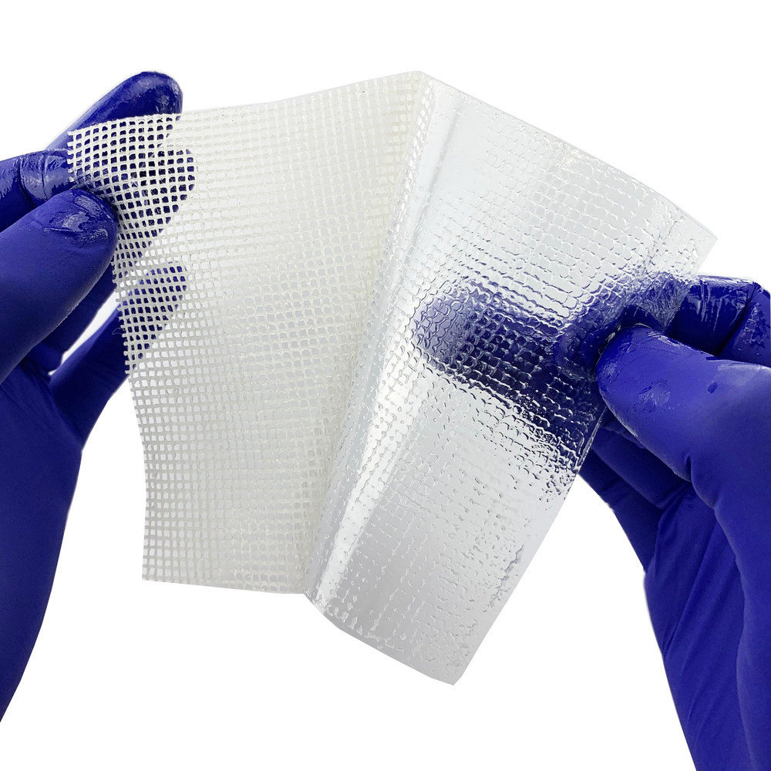
Emollients
Important and effective moisturising treatments
Widely used to maintain the skin barrier, restore skin suppleness, prevent dry skin and itching and reduce the number of flare-ups in dry skin conditions (eg, eczema, psoriasis and ichthyosis)
Available as ointments, creams, lotions, gels, sprays
Leave on, wash-off, bath and shower products
Contain paraffin, lanolin, colloidal oatmeal, mineral oils, fruit/nut/seed oils or butters
Once applied to the skin, may be covered by a bandage
Some dressings and bandages may come with paraffin already on them (eg, used to promote wound healing, including burns)

Slide 5
Risk of severe and fatal burns
Emollients can transfer from skin onto clothing, bedding and bandages
When fabric with dried-on emollient comes into contact with an ignition source, the resulting fire burns more quickly and intensely (hotter), and is harder to extinguish than a clean fabric fire
The speed of development and intensity of the fire means there are just seconds to react before serious and life-threatening burns are sustained
The risk increases with:
  use of greater amounts of emollient
  more frequent application
  greater surface area of application

Slide 6
Understanding the mechanism of the risk
Emollients are not flammable in their raw state or in their container*
Emollients are not flammable on the skin
Emollients act as an accelerant, increasing the speed of ignition and intensity of the fire, when fabric with emollient residue dried on it is ignited
There must be fabric or other wicking material and an ignition source present for the accelerant effect of emollients to occur
* Some spray emollients come in pressurised containers with flammable aerosol propellants (eg butane, isobutane, propane). These spray products are highly flammable, but it is the aerosol propellant not the emollient which makes them flammable.

Slide 7
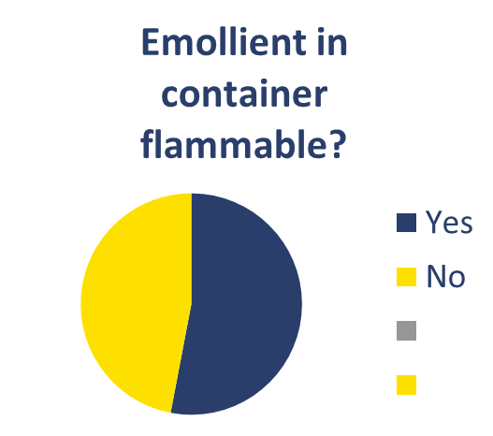
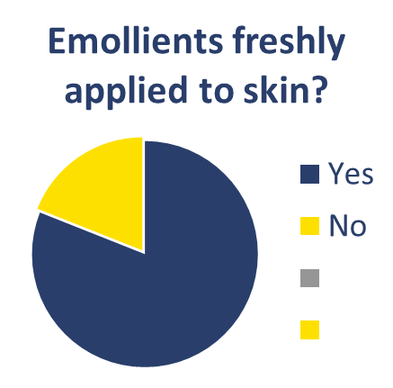
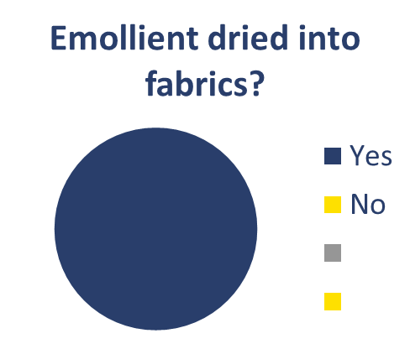



Misunderstanding the risk – survey of pharmacists
150 pharmacists were asked whether emollients are flammable in 3 different states: in the container; when they are freshly applied to the skin; and when dried into fabrics?
Correct answer: No
Correct answer: No
Correct answer: Yes
Correcting misunderstanding is important as it can lead to difficulties in delivering risk prevention messages and confusion about what the effective risk minimising actions are. eg, Putting the cream away in a cupboard will not mitigate the risk, because the products themselves are not flammable.
Survey conducted by West Yorkshire Fire & Rescue Service

Slide 8
Scope of the risk – which emollients have this risk?
Initially it was thought that there was a risk only with emollients containing >50% paraffins (NPSA Alert, 2007)
Since 2007
MHRA received reports of fatal fire incidents suspected to be related to emollients containing <50% paraffins
Laboratory fire testing conducted by Anglia Ruskin University demonstrated that, when dried on to fabric and an ignition source is introduced:
  emollients containing as little as 6% paraffin act as an accelerant
  paraffin-free products act as an accelerant
There is a risk with all emollients, including paraffin-free emollients
NPSA – National Patient Safety Agency, now NHS Improvement

Slide 9

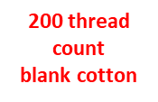
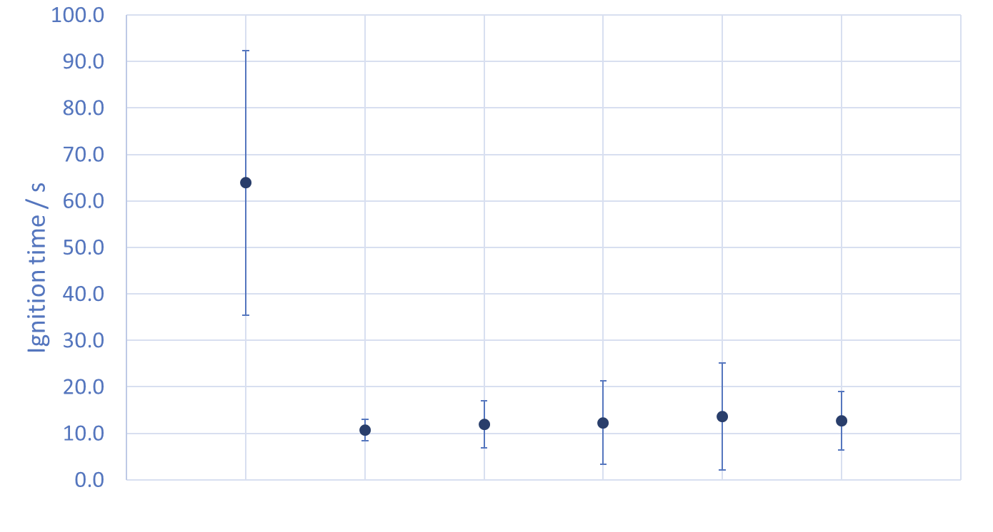
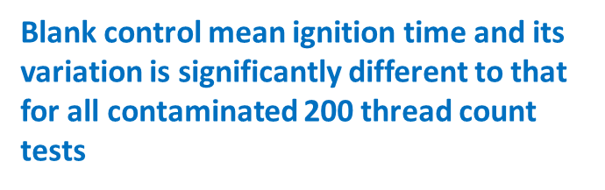
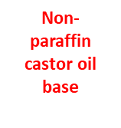
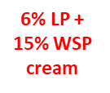
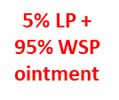

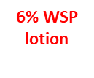
Research conducted by Anglia Ruskin University¹
Time to ignition results on cotton (200 thread count) with skin product (contaminant) left for 24 hours
All paraffin base emollients (containing from 6% to 100% paraffins) AND the paraffin-free products (castor oil or oatmeal base) significantly reduced the time to ignition from ~65 seconds to 10-15 seconds
WSP – White soft paraffin; LP – Liquid paraffin

Slide 10

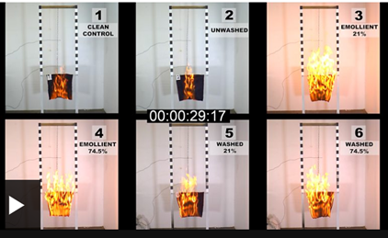
Fire Tests conducted by West Yorkshire
Fire & Rescue Service
The videos are paused 29 seconds after ignition with a naked flame
Time to ignition and spread of fire are significantly quicker with the emollient contaminated fabric (vs control)
Washing the fabric had little effect in reducing the accelerant effect of the 21% paraffin emollient (picture 5) or the 74.5% paraffin emollient (picture 6)
Credit: WYFRS. Still images taken from video recordings of WYFRS fire tests conducted as part of investigations into fatalities

Slide 11
Size and nature of the risk (UK data)
15 fatalities reported to MHRA by Coroners or via the Yellow Card Scheme (as of July 2020)
> 50 fatal fire incidents reported by fire and rescue services in England since 2010 in which emollients were known to have been used by the victim or were present at fire premises
risk is very rare given extensive use of emollients over many years, but
has devastating and fatal consequences
likely to be under-recognised and under-reported
Yellow Card Scheme – the UK system for collecting reports of suspected side effects to medicines and adverse incidents (AIs) with medical devices. The scheme is run by MHRA (www.yellowcard.mhra.gov.uk)

Slide 12
Population at risk and risk factors
Amongst the 15 cases reported to MHRA, the following factors were present in most cases:
  Age >60 years
  Smoking = source of naked flame for ignition (eg, lighter, lit match etc)
  Impaired mobility, bedbound
Additional factors (3 cases):
  Use of an airflow mattress or cushion

Slide 13

Real life case study: Pauline Taylor
74-years old
Lived alone in a 2 bedroom ground floor flat, daily visits from carers
Visited frequently by her daughters
Fire alarm system linked to a CarePhone facility (monitored 24hr)
Regular smoker – she didn’t want to give up
Had psoriasis for many years
Emollient (Zerobase, 11% paraffin) applied daily
Had recently become increasingly immobile and was bedbound
Used a dynamic airflow mattress
Photo courtesy of Pauline’s family
Notes:
(Real life) Case study – Pauline Taylor , 74 years old
Lived alone in a 2 bedroom ground floor flat
Had a loving family. 2 daughters who visited her regularly
Fire alarm system linked to a CarePhone facility (monitored 24hr)
Regular smoker – she didn’t want to give up - she always believed/joked that if there was an accidental fire, the fire service would rescue her
Longstanding skin condition (psoriasis )- daily applications of emollient containing 11% paraffin (Zerobase)
Significant recent change – had become increasingly immobile – bedbound
Now using a dynamic airflow mattress
Smoking cessation had been discussed by the care company and by her daughters but Pauline continued to smoke in bed. Fire retardant bedding had been issued but wasn’t used.
Numerous daily visits by care workers and district nurses and her daughters
On the night in question, she had been visited late in the evening and was left alert and in a settled condition just before midnight.
At 4.10am the alarm system activated.
By the time the fire service attended the property, Pauline’s family were also present outside the property, having been alerted by the CarePhone system.
The attending crew entered the property; the black, acrid smoke was already at floor level. Sadly, Pauline was found in her bed showing no signs of life.
West Yorkshire Fire & Rescue Service fire investigation team found that the fire:
Had developed rapidly
Was localised around the bed area
Was most likely the result of a match or cigarette coming into contact with her bedding
Evidence was heard at the Coroner’s inquest that Pauline’s lighter had failed to work and a care worker had gone to the shops and bought some matches.
Cigarettes and spent matches in bedside ashtray
Burn patterns confirmed the fire started on the bed
Likely events - Pauline had been smoking in bed and had accidentally dropped a lit cigarette or match onto combustible items.
Items smouldered until reaching flaming ignition. This process was probably intensified by use of emollient creams, which had dried onto her dressings, clothing and bedding. The fire had burned down into the bedding and caused the airflow mattress to leak air. The escaping air would have intensified the fire until the electricity supply to the pump was isolated.
The conclusion of the inquest was accidental death. Pauline died due to smoke inhalation and burns.

Slide 14
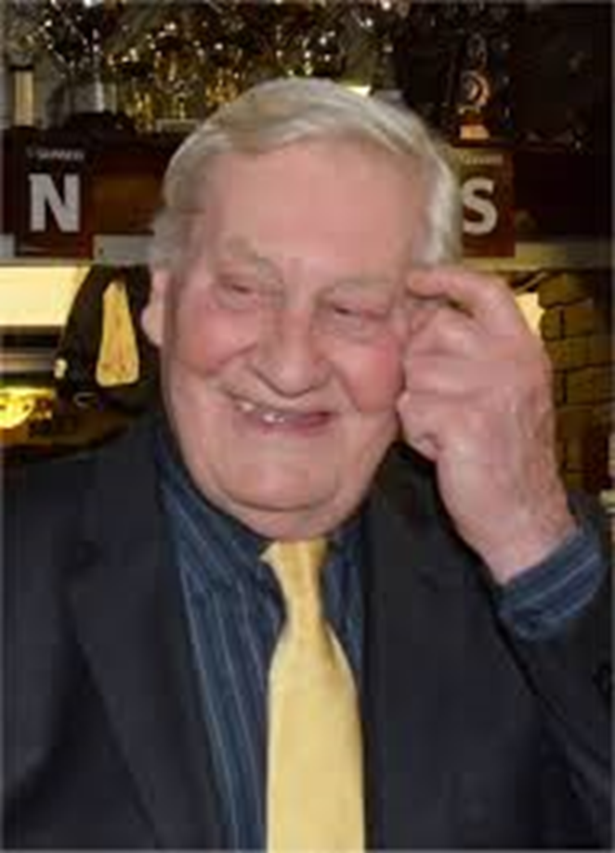
Real life case study: Brian Bicat
82 years old, retired academic
Well known on the local jazz scene
Living at home with his wife
Fully mobile
Regular smoker
Skin condition – had used emollients (Hydromol, Diprobase) for 30 years or more
New treatment for ulcer on lower leg
Preferred Hydromol ointment and applied 3-4 times a day
Also washed with Hydromol in the shower
Used his dressing gown to pat himself dry after shower
Photo courtesy of Brian’s family
Notes:
Case Study - Brian Bicat (Brian’s surname is pronounced “Bee Car”),
82 years old. Retired academic.
Well known on his local jazz scene
Lived with wife in privately owned 1st floor flat.
Mobile/ambulatory
Regular smoker, ‘safe smoker’ – used ash tray to put out cigarettes etc
Long term skin condition –using various paraffin-based skin products for 30 years or more – Diprobase and Hydromol
But recently being treated for ulcer on lower leg
Preferred Hydromol ointment and applied 3-4 times a day. Also washed with it in shower. Used his dressing gown to pat dry his skin after a shower as it was softer than towels.
On the morning in question, Brian’s wife had gone out for her daily walk – 20 minutes or so.
Brian was sitting on the balcony. He was wearing his dressing gown. He went to light a cigarette after breakfast but dropped the lit match. The lit match caught his dressing gown which set alight very quickly.
Brian jumped up out of his chair and made his way to the bathroom to find water to douse the flames.
His journey from balcony to bathroom took seconds but his dressing gown was well alight.
From the balcony through to the bathroom Brian struggled to undo his dressing gown because the belt had been double knotted.
Once in the bathroom he managed to get into the bath and showered to put out the remaining flames although by this time there was little left of his dressing gown.
After he’d showered himself Brian went through to his bedroom, sat on the edge of the bed and applied more cream to the extensive burns on his body. It’s at this point Brian’s wife returned from her walk. He was able to tell her what had happened. She rang for an ambulance and he was taken to hospital where he sadly died 12-hours later, having suffered 71% burns.
Coroner’s verdict – accidental death. Emollients had contributed to the speed and intensity of the fire

Slide 15
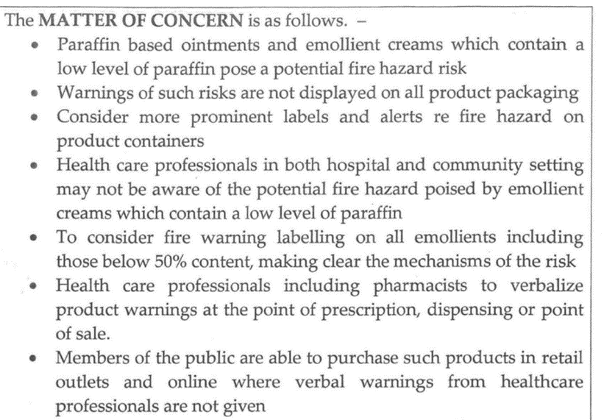
Brian Bicat – Coroner’s Report
Coroner’s Regulation 28 Report to Prevent Future Deaths (PFD)
“..products… which contain a low level of paraffin…pose potential fire risk”
“Healthcare professionals….may not be aware of the potential fire hazard…”
“more prominent labels and alerts…making clear the mechanism of the risk”
https://www.judiciary.uk/wp-content/uploads/2018/10/Brian-Bicat-2018-0277_Redacted.pdf

Slide 16
Options for minimising risk
  Washing may remove some emollient build up on fabric, but even at high temperatures does not completely remove it
Mitigation primarily about behaviour change
  Not to smoke, cook or get too close to open fires or other heat sources (eg gas, halogen, or electric bar heater) if there is any chance that clothing, dressings or bedding have emollient residue on them
Interventions (secondary to behaviour change) eg
  Smoking cessation advice
  Supervised smoking, safety lighters and safety ashtrays, e-cigarettes
  Flame retardant bedding or aprons (may themselves get contaminated with emollients)
For complex cases, approach the local fire & rescue service for further advice and support

Slide 17
Advice for healthcare professionals (1)
Emollients are vital in helping manage dry skin conditions and it is important that people do not stop using them – advise people to continue to use these products as directed
Ensure patients and their carers understand the fire risk associated with the build-up of dried emollient residue on clothing and bedding and can take action to minimise the risk

Slide 18
Advice for healthcare professionals (2)
When prescribing, recommending, dispensing, selling, or applying an emollient, instruct patients not to smoke, cook or go near any naked flames or heat source (gas, halogen, electric bar or open fire) whilst wearing clothing or dressings that have been in contact with emollients. If the patient cannot do this advise on measures to do so safely (eg, use safety lighters or e-cigarettes; remove long sleeved or loose clothing before cooking; put on a thick uncontaminated shirt, overalls or apron, move chairs further away from the open fire or other heat source)
Be aware that washing clothing or bedding at a high temperature may reduce emollient build up but does not totally remove it – it is important to minimise risk in additional other ways (as above)
For complex cases contact the local fire and rescue service for advice and support

Slide 19
Expert Advice – UK Commission on Human Medicines*
MHRA reviewed the new data and sought expert advice from the Commission on Human Medicines on the impact of the new information on the benefit-risk balance of emollients and on the need for regulatory action to minimise the risk and protect public health
In December 2018, the CHM advised that:
Overall benefit-risk balance of emollients
The balance of benefits and risks is positive taking into account the very rare risk, the important therapeutic role and wide use over many years
But, measures to minimise risk and protect public health required
Product labelling and packaging for all emollients to include a warning
Stakeholder group to be convened to propose measures to promote education and awareness of the risk, and embed safe emollient use across healthcare practice
* The Commission on Human Medicines (CHM) is MHRA’s independent expert advisory committee

Slide 20

Expert Advice – Commission on Human Medicines
Label warning should be applied to
all emollients (paraffin and paraffin-free)
some non-emollient topical medicines depending on intended use incl. quantity, frequency, duration and location of application
Active communication also warranted because
Product information updates alone unlikely to be enough to raise awareness
Evidence of lack of awareness of risk despite previous alerts for >50% paraffin products
Evidence of misunderstanding of mechanism of risk (products believed to be flammable in themselves, but are not) – need to be corrected to ensure effective risk minimizing actions are taken

Slide 21
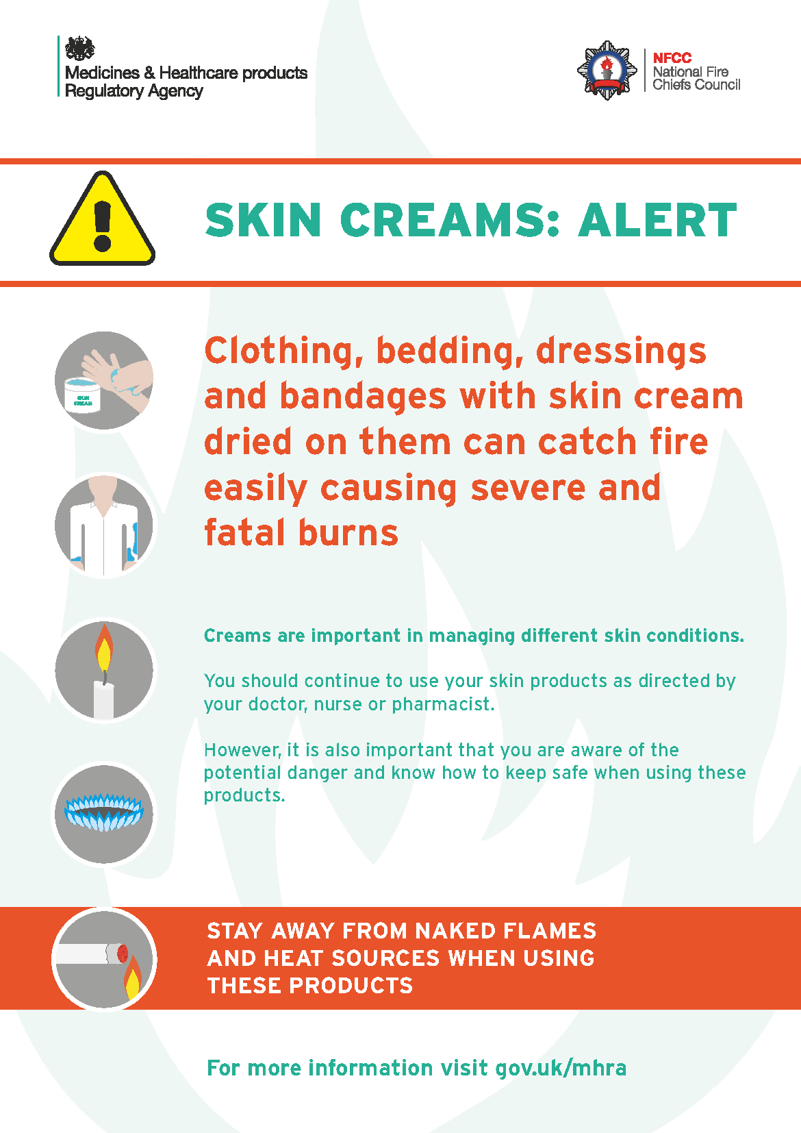
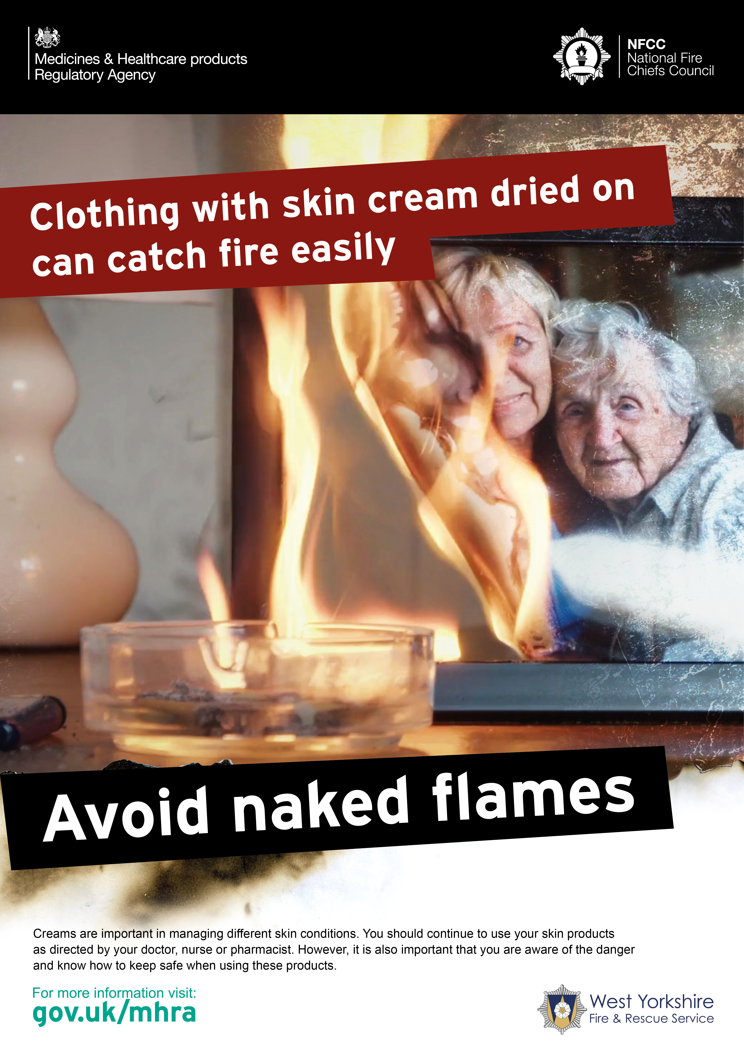
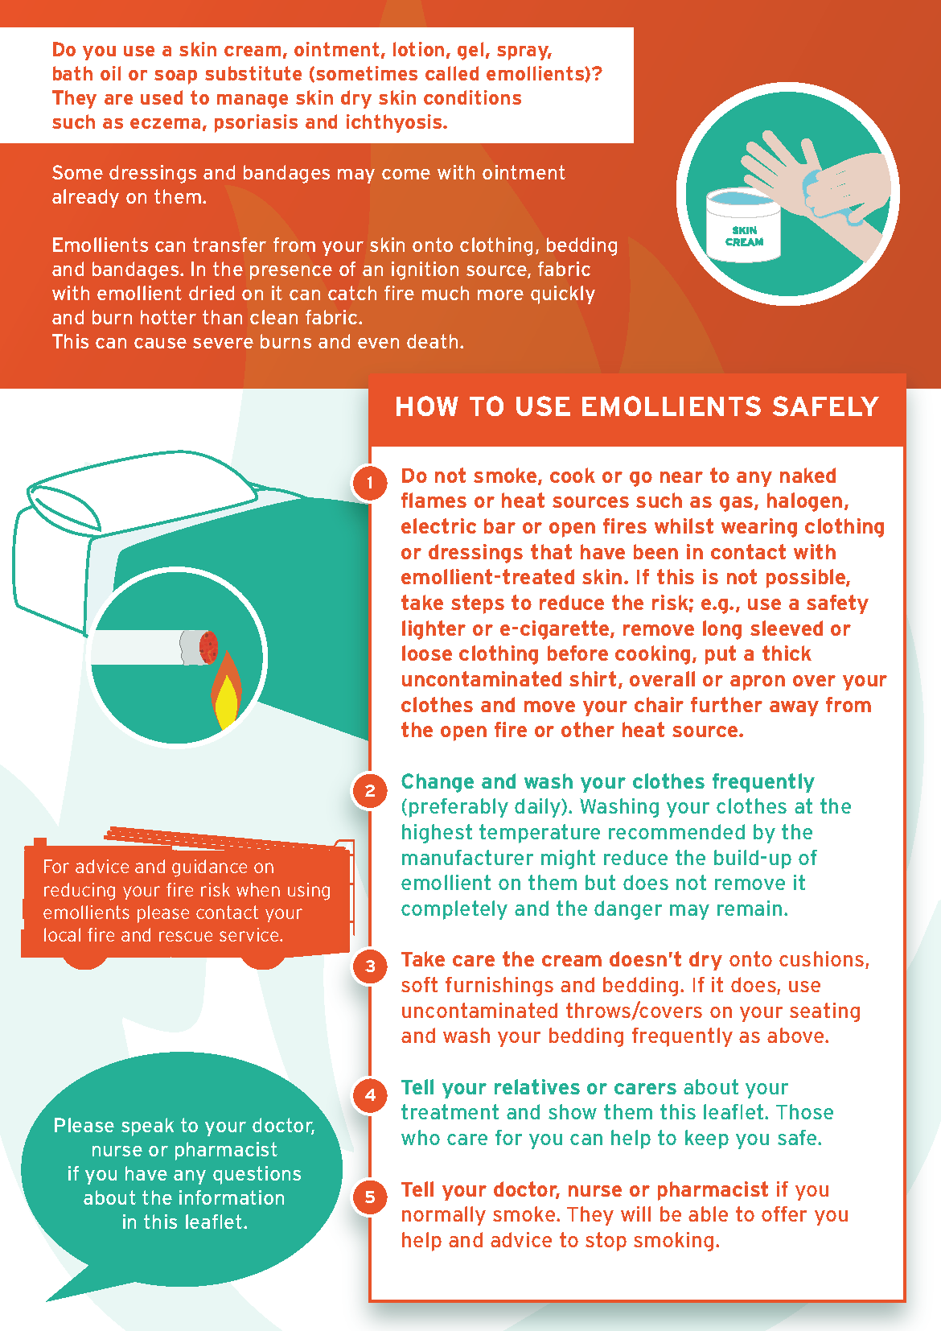
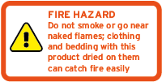
Awareness campaign and resources
Awareness campaign launched 29 July 2020
Joint campaign - MHRA, National Fire Chief’s Council, fire and rescue services and health charities
Toolkit of resources available for healthcare professionals and the public to use to support safe use of emollients
These resources are available to download for free from https://www.gov.uk/guidance/safe-use-of-emollient-skin-creams-to-treat-dry-skin-conditions
  60 second film
  Poster
  Information leaflet for patients
  Sticker​
  Social Media

Slide 22

What else can you do?
Share this information with colleagues
Use the emollients toolkit and encourage others to do so
Report any fire incidents associated with the use of emollients to the Yellow Card Scheme (www.mhra.gov.uk/yellowcard)

Slide 23
References and further reading
Hall, S. and Morrissey, J (2019) “The fire hazard associated with fabrics contaminated with skin care products” UK Association of Fire Investigators, 16th annual training conference: A fatal fire investigation master class, Leeds, U.K.
Hall, S., Franklin, L., Bull, J., Beard, A., Phillips, G and Morrissey, J. (2019) 'The flammability of textiles when contaminated with paraffin base products' Fire Safety Journal, 104, pp. 109-116
Hall, S., Morrissey, J. and Blackburn K. (2020) 'The awareness of emollient flammability and current research' International Fire Professional-The Journal of the Institution of Fire Engineers, 32, pp. 21-24.
Hall, S., Morrissey, J. and Blackburn K. (2019) 'Medical skin creams could be a lethal fire risk when soaked into fabric – here’s what you need to know' The Conversation
5. Drug Safety Update volume 12 issue 5: December 2018: 3

Slide 24


Acknowledgements
With thanks to the families of Pauline Taylor and Brian Bicat for allowing us to share their stories in this presentation
Thanks also to:
  ADC Chris Bell, West Yorkshire Fire & Rescue Service
  Claire Tabert, West Yorkshire Fire & Rescue Service
  WM Jamie Lister, West Yorkshire Fire & Rescue Service
  Dr Sarah Hall, De Montfort University (formerly of Anglia Ruskin University)
  Jo Morrissey, Anglia Ruskin University

