Slide 1


Safer Sleep Risk Assessment Tool webinar
The aims of the webinar are to:
Share key messages around safer sleep for babies and reducing the risks of Sudden Infant Death Syndrome (SIDS).
Explain and promote the safer sleep risk assessment tool, helping us embed safer sleep as ‘everyone’s business’.
Provide links to resources, support and information.
Hear your thoughts on the risk assessment tool, answer any questions and help promote its use in your work.

Slide 2

Sudden Unexpected Death in Infancy
& Safer Sleep
What are the local issues and how do we make a change
Lullaby Trust Video
Notes:
Its EVERYONES BUSINESS not just health - consistent messages to all family members and carers
Universal use of information – research based / updated and available in variety of formats and languages.
Will be showing a Brief video to emphasis what is universally shared – standard risk factors
Then will be asking ….. What are the local issues and challenges – what are we seeing on the front line ?
Safer Sleep Messages – need for consistency in information sharing
Risk factors for Sudden Unexpected Death In Infancy (SUDI)
What's happening in Nottinghamshire
Local challenges / issues ……….. How do we make change ?
How are you raising / discussing/ escalating concerns or unsafe sleep practice??
Do you use Professional curiosity ?
Consider escalating concerns
Changing the approach – different slant on information giving and assessment , . Not just preaching!

Slide 3
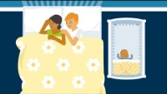

Slide 4
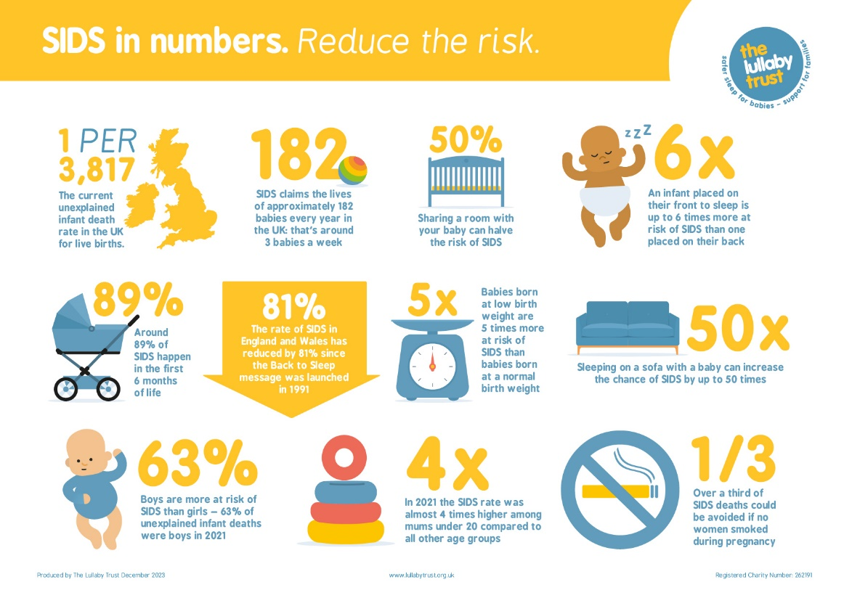
Increased Risk factors
Includes:
Prematurity
Low Birth Weight
Age of infant
Male Sex
Prone sleep position
Over heating
Maternal Age
Parental / Carer Drug Use
Parental /Carer Alcohol Use
Unsafe sleep environment
Co sleeping with known risk factors present
Unsafe use of products
Notes:
Smoking continues to be a significant risk factor found in local SUDI deaths. 50% of the cases from April 2023- March 2024 has smoking as a risk factor. In half of these cases mother smoked both in pregnancy and at time of death. In addition, someone else in the household smoked/vaped
Mental Health Issues: Maternal or close family / carers with mental health issues continue to be identified. Featured in 66% of last years cases (increase) where unsafe sleep was present
Domestic abuse a factor in 6% in latest period - Low numbers but not always known or captured consistently - we may see an increase as surveillance and support increases
Alcohol consumption has been a constant feature in previous SUDI deaths. For the second consecutive year no local SUDI cases have featured this as a risk factor
Drug abuse is recorded in a third of relevant cases -Prescribed medication which reduces the person’s awareness and decision making abilities need to be considered

Slide 5
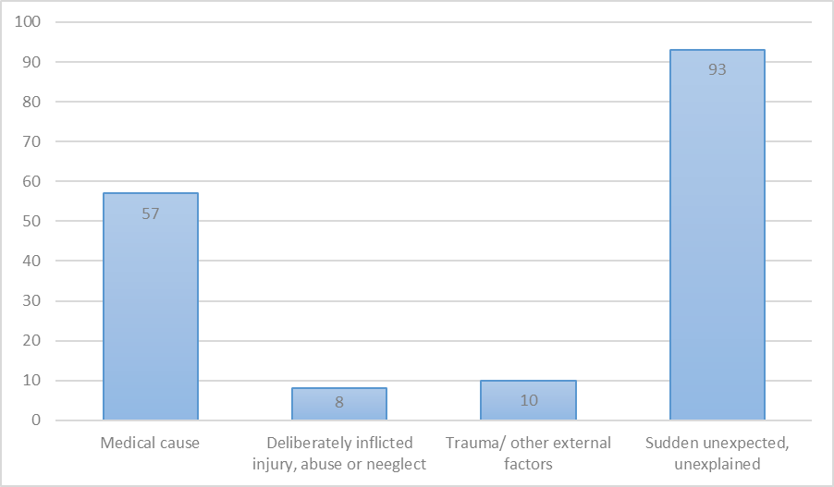
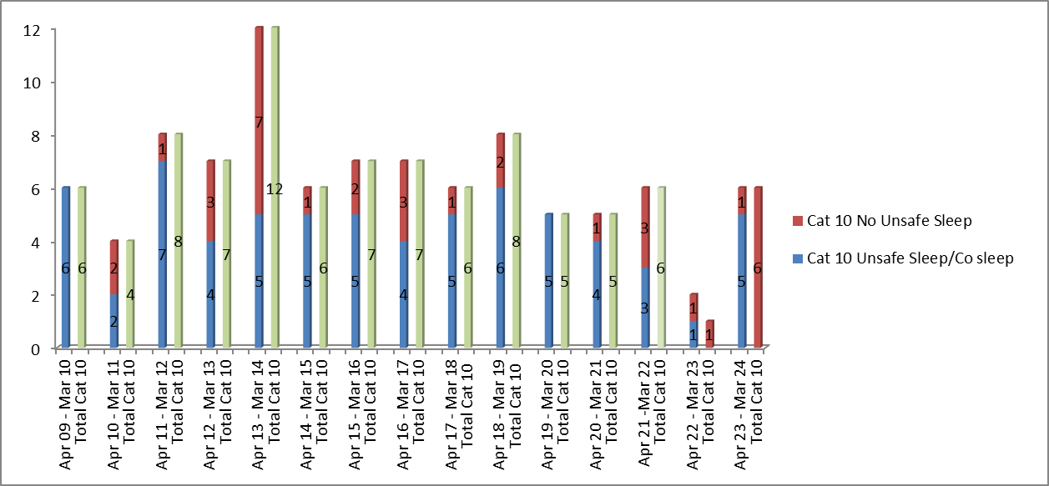
SUDI in Nottinghamshire
Notes:
Local Data is collated in respect to all child deaths in Nottinghamshire, Nottingham City and Bassetlaw Each case explored in detail, to identify modifiable factors which can influence and inform a co-ordinated multi agency plan in order to try to reduce modifiable factors and the risk of SUDI occurring.
Between 1st April 2009 and 31st March 2024,there have been 1223 expected and unexpected child deaths (0-18 years of age). Of these 398 were unexpected with 173 of these occurring in the age group of 15 months and under.
Often there is a pre existing medical cause but at time of death doctor is not able to write death certificate as unsure what caused death and could be unrelated to the medical condition
- such as an undiagnosed infection.
The number of deaths recorded as CAT 10 – SIDS, unascertained deaths. Remain constant with additional concerns re increasing % featuring modifiable factors and unsafe sleep practice.
In the year ending 31st March 2024 there were 4 out of 5 (Category 10) babies found in an unsafe sleep environment (75%).
6 unsafe SUDI cases in total in the latest period - multiple risk factors
1. Unsafe co-sleeping on a sofa with mother. Mother on medication due to mental health issues
2. Unsafe sleep co sharing in bed with mum and sibs at grandparents. Historical Social Care around alcohol and neglect, (but not with this child)
3. Unsafe co-sleeping in bed with mother. Mother on medication due to mental health issues
4. Found unresponsive in mother's arms, breast feeding in bed. . Maternal smoking. Paternal smoking and cannabis
5. Unsafe co-sleep on a sofa with father Parents vaped
6. Found collapsed in a cluttered cot. Mother vaped and father smokes and smokes cannabis (lives at different address – but has contact)

Slide 6
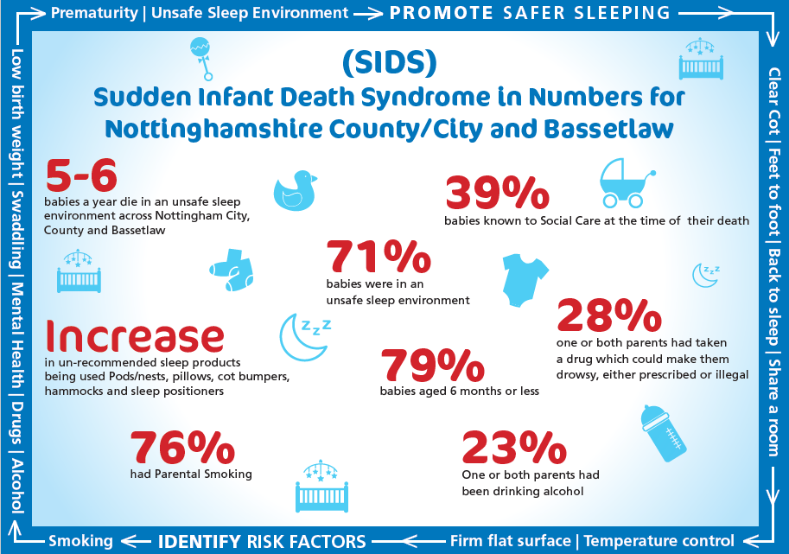
What’s happening locally – (update graph)
Notes:
On average the same number of babies die in unsafe sleep environments with Nottingham City and County (combined) since 2009 (average 5-6 a year)
Co sleeping with risk factors – planned or unplanned
Deaths involving sofa sleeping or sofa sharing continues to feature - There have been 2 sofa sharing in 2024.
There continues to be an increase in one or both parents being arrested at the scene or in ED for co-sleeping with their baby after consuming alcohol and/or substances. All parents are asked by the police for a blood sample when there is co-sleeping even when not arrested.
Smoking continues to be seen in the majority of families
Mental health is present in cases of unsafe sleep related deaths. In the majority of the cases the mental health issues relate to mother. In many of the cases a history of depression/postnatal depression, low mood, self-harm, panic attacks or anxiety is described. Medication is noted either in the past or currently.
Complex in respect to related risks – discuss
Domestic Violence may be present in unsafe sleep related deaths – indirectly increases risk .

Slide 7
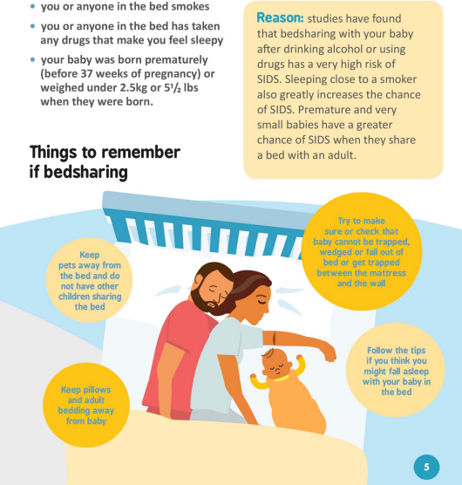
Co Sleeping with risk factors
Key Issues for Nottinghamshire -
You tube link – how to co sleep safely
Advice on co sleeping risks has not changed - If there are any risk factors then we should still advise not to co-sleep.
How we deliver the information is being challenged
Families need to be aware of when the risk increase so that they can make the safe decisions for their baby
Bedsharing with an adult who smokes, has been drinking alcohol or taking recreational drugs carries a high risk
Bedsharing on a sofa or armchair carries a high risk
The risk is higher for infants born prematurely or of low birthweight
Bedsharing with a breastfeeding mother with none of the above risk factors has NOT been shown to be a significant hazard in any study where these data have been collected.
Notes:
Reference : Blair, Sidebotham Pease and Fleming
Co-sleeping is complex and cultural. In the past as professionals we have been saying … Don’t do it
But it is recognised locally and nationally that it happens anyway, sometimes planned and sometimes accidental.
We now advise how to do it safer with emphasis of how to avoid accidental co-sleeping, as the unplanned occurrences seem to have more risks and worst outcomes
FLAG LATEST LULLABY TRUST VIDEO
If you decide to share a bed with your baby:
• Keep your baby away from the pillows
• Make sure your baby cannot fall out of bed or
become trapped between the mattress and wall
• Make sure the bedclothes cannot cover your baby’s face
• Don’t leave your baby alone in the bed, as even very young babies can wriggle into a dangerous position
• It is not safe to bed-share in the early months if your baby was born very small or pre-term
WARNING
• The safest place for your baby to sleep is in a cot by the side of your bed
• Do not sleep with your baby when you have been drinking any alcohol or taking drugs (legal or illegal) - affects awareness / responsiveness
• Do not sleep with your baby if you or anyone else in the bed is a smoker
• Do not put yourself in the position where you could doze off with your baby on a sofa or armchair
In the two years we have seen increased numbers of cases where one or both parents have been arrested due to the consumption of alcohol and/or use of substances alongside unsafe sleep practices, with charges upheld for criminal convictions

Slide 8
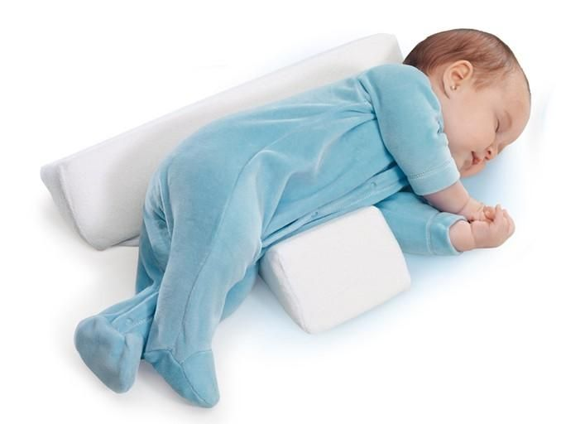
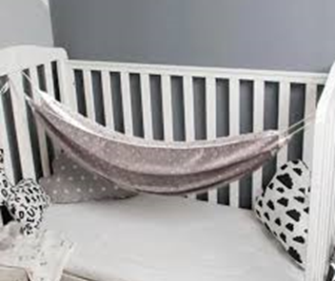

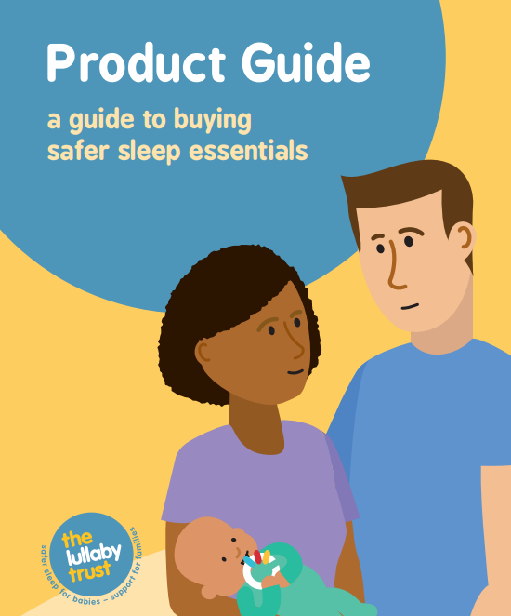
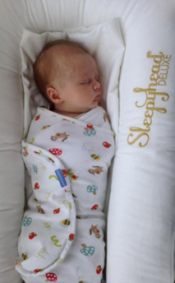
Local Issues: use of inappropriate products
Notes:
Regularly seeing unsafe use of an increasing variety of products - Numerous items or practices reported in – all should be challenging what we see.
Lullaby Trust stance – blanket statement ….. do not use ! So will not challenge individual companies . Lullaby Trust Leaflet available – Guide to Products
Have been individual good practice examples of stockists being challenged
But use of products is often driven by celebrity social media.
Do you monitor your social media sites / parent feedback - examples of unsafe sleep products seen on postings!
Discuss examples – use of pillows/ cot tilting & head moulders. Prop feeding / Adapted Soothers / Moulded cuddly toys/
Challenges : Early advice needed - often purchased before routine appointments
Latest guidance on swaddling - appropriate material – under arm – tucked in – not too tight around hips – guidance on Lullaby Trust Website
Barrier Carriers – Child Accident prevention Trust checklist -

Slide 9

The challenge
We have 5-6 deaths
each year that are
directly attributable
to unsafe sleep – how
can we identify the risks
and support families to
make change ?
Notes:
Smoking: Although the government and health organisations feel vaping is “ better” than smoking , Vaping is still an unknown entity for babies and the risks that may or may not be associated. Data continues to be gathered and new reports suggesting still a significant risk. Both with be captured as modifiable factors in respect to child deaths. Research is still on going.
Evidence suggests 30% of SUDI deaths could be avoided if mothers did not smoke when they were pregnant Risk x4 Increase if smoke between 1-9 per day
Whilst it is also recognised that smoking outside the home is making adjustments – it is still a risk where the smoker is significant carer for that infant
Increase in earlier referrals and availability of local initiatives for smoking cessation support and resources - flag maternity initiatives. Development of the brain- breathing centre so can forget to breath
Prematurity – number of reasons
Reduced ability to regulate temperature so can over heat.
Reduced muscle tone- less able to move into a safe airway position
Need to be consistent in information and demonstrate safe practice – families will replicate what they have seen – ie NICU
Mental Health The reason why is not fully known and everyone’s mental health affects them differently However, if a Mother or father is struggling this could reduce their awareness of their baby and risk potentially unwise sleep environment decisions.
Alcohol /Drug use: Not saying parents can’t have a drink or take their prescribed drugs but it is about increasing awareness.
To ensure there is a responsible adult who can be aware of the baby
Moderation and safety netting - No bed sharing after alcohol or drugs which affect awareness
Having discussions with the GP about medications that cause drowsiness or affect decision making
In the two years we have seen increased numbers of cases where one or both parents have been arrested due to the consumption of alcohol and/or use of substances alongside unsafe sleep practices, with charges upheld for criminal convictions
Lessons learnt in respect to documentation / advice given to families particularly around anti depressants – known impact re increased drowsiness

Slide 10
Safer Sleep Risk Assessment Tool and resources
Multi agency tool supporting practitioners to help keep babies safe and identify high risk.
The tool supports practitioners to:
Understand safer sleep advice –up to date and consistent messages.
Feel confident to talk to families and share information about safer sleep-as part of core role or when opportunity arises.
Understand risks.
Know when further advice/support should be sought.
Supporting safer sleep as ‘everyone’s business’

Slide 11


What parents tell us
322 parents/caregivers responded to a safer sleep survey spring 2024.
Most (98%) recalled receiving safer sleep advice.
Encouraging discussion around safer sleep
56% felt the advice was clear and they felt able to discuss and ask to ask questions
11% felt advice was clear but didn’t feel encouraged to discuss and ask questions,
28% said the advice was clear but given without any discussion.
Bed sharing/co-sleeping
59% said they their baby sometimes sleep is in an adult bed. 32% of those people said they always make a plan when this happens, 9% said they sometimes make a plan and 18% said they never make a plan.
Of all 322 respondents, 53% said they had a conversation with a health professional to help make an informed choice around bed sharing and hazards to avoid. 46% said they had not had that conversation. 73% felt confident or very confident about bed sharing with the remainder being less confident.

Slide 12
Evidence based approach
“It is vital that professionals understand safe infant sleeping arrangements and give families accurate evidence-based information.
Advice should be tailored to individual family circumstances with an explanation that bed-sharing is only a risk factor when in the presence of other factors such as smoking, alcohol and drug use, but that falling asleep on a sofa or an armchair with a baby is always dangerous.
Almost all parents sometimes fall asleep whilst feeding a baby at night, so even if they do not plan to routinely bed share, parents should be advised how to make their bed safe for the baby if they fall asleep unintentionally”
Professor Peter Fleming University of Bristol (The National Child mortality Database 2021)
Notes:
Emphasis it's the parent’s responsibility to keep babies safe whilst sleeping.
Professionals can support.

Slide 13
The risk assessment tool
Basic safer sleep information and links to up-to-date advice.
Local SIDS statistics and wider research.
Information on how to use the tool.
Risk factors, to help inform your assessment of risk.
Red flags, highlighting areas of greatest concern.
Information and advice for parents-links and QR codes. Can be printed and shared.
Links to threshold of need/pathways to provision for city and county if you have a concern about a child (safer sleep is embedded at all levels in these documents).
Safer sleep plan of care for parents.
Checklist for parents, linked to hazardous co-sleeping.

Slide 14
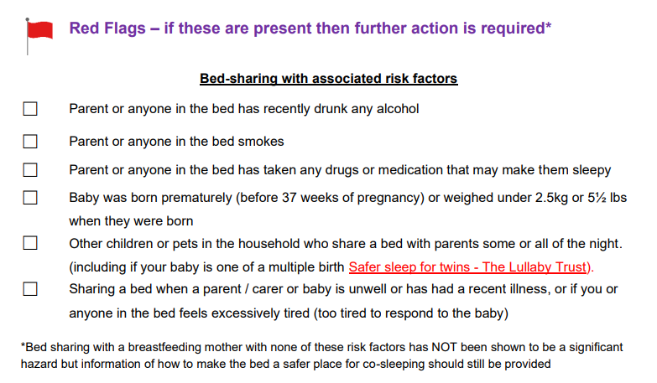
Red Flags

Slide 15
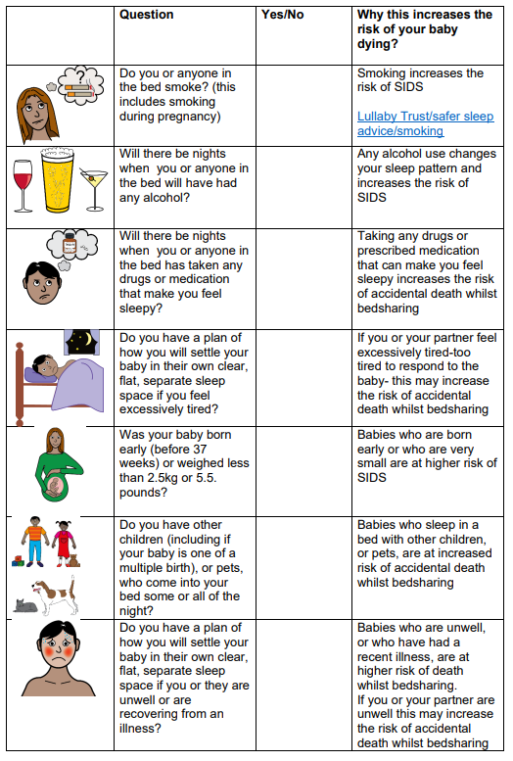
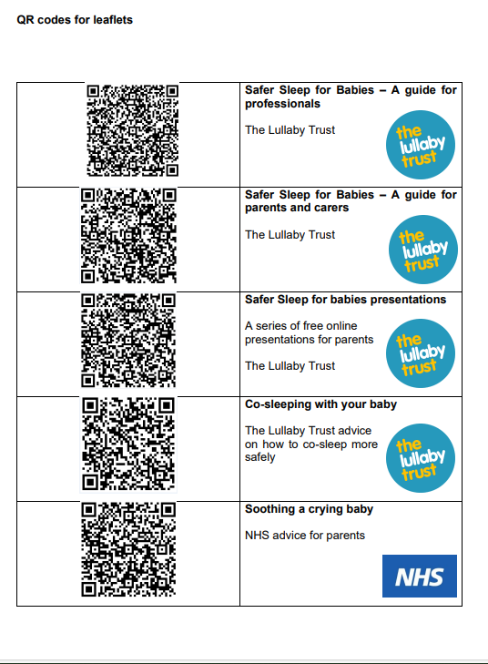

Slide 16
Use of the tool
Inclusion in red book
Embedding in assessment processes
Knowledge and awareness, supporting conversations and referrals
Use of parent tools and information
Notes:
CGL example
All staff trained and aware. Member of staff had moved form a different part of the country and became aware of this for the first time.
CGL able to speak to a da d who was not aware of the advice/information.
Sharing info such as safer sleep week and other comms.
Staff supervision-covered.
Work alongside other agencies, e.g. midwives.

Slide 17
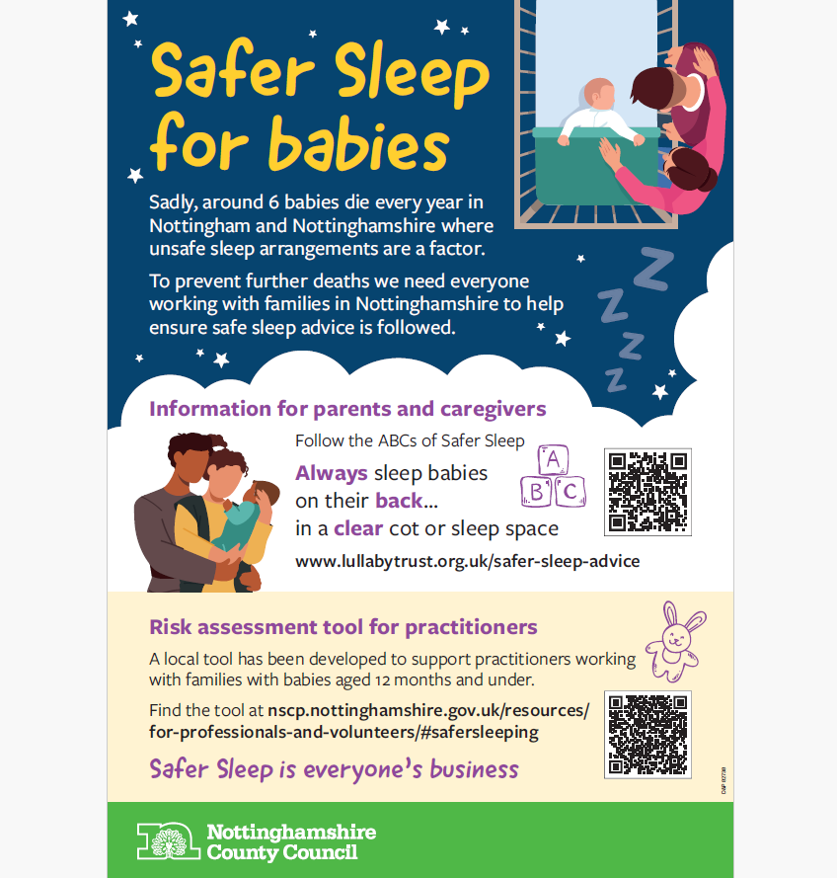
Safer sleep poster

Slide 18
Resources and support for parents
Lullaby Trust website and resources
The Lullaby Trust - Safer sleep for babies, Support for families
Apps-DadPad and Baby Buddy App
how to co-sleep more safely youtube video - Google Search
Notes:
Baby banks and support to obtain suitable equipment. HSF.
Domestic abuse providers and housing support e.g. homelessness support teams.
LT bedtime bundles.

Slide 19
How can you make use of the safer sleep tool?
You
You may notice/overhear something
Initiate non judgemental conversations.
All families and situations are different; encourage discussion about personal circumstances.
Involve dads, partners and wider family.
Ask what parents already know about safer sleep.
Provide links and information about safer sleep.
Your organisation
Where/how can the safer sleep tool be embedded?
Notes:
Different level of roles and responsibilities, e.g. maternity, HVs, early help, community services, families.
Some ‘asks’ e.g. promote the poster? (share image)

Slide 20
Where to find the risk assessment tool
Nottinghamshire safeguarding children partnership website
For professionals and volunteers (nottinghamshire.gov.uk)
Nottingham city safeguarding children partnership website
Safer Sleep - Nottingham City Council

Slide 21
We can all help to make sure that every sleep is a safe sleep
Safer Sleep is everyone's business

