Slide 1


Education inspection framework
Our renewed approach

Slide 2

Outline of session
Our journey so far
Moving forward: our new approach
What the changes mean for your setting
A steady and assured start
Measuring impact
Questions

Slide 3

Collectively, we want to achieve:
high-quality, inclusive education for every child
great outcomes for every child, including for those who are disadvantaged, those with SEND, those known, or previously known to children’s social care and those who face other barriers to their learning and/or well-being
better information for parents
a collaborative and transparent approach to inspection
high and rising standards of education and care.

Slide 4
Our journey so far

Slide 5
The journey so far
The case for change
2024 Big Listen
Taking action
Public Consultation
Introducing change

Slide 6
Summary of changes
New report card
A five-point grading scale​
A renewed focus on inclusion
New toolkits
New inspection methodology
Taking steps to reduce workload
More closely aligned to the EYFS
A sharper focus on regulation
New online insights platform

Slide 7
Moving forward: renewed approach

Slide 8




Our new approach
Breaking
barriers to learning
Improved reporting
More collaboration
More focus on well-being
Taking context into account
Consistent approach
Providing constructive next steps
Different by design

Slide 9



9
We have strengthened our approach to inclusion
Breaking down barriers to learning and/or well-being
Focusing on barriers
Understanding context
Woven throughout the framework
to learning and well-being especially for those who are disadvantaged, have SEND, or are known to children’s social care.
.
By using contextual information and discussions with leaders to understand their particular community and the opportunities and challenges this brings to their work.
Inclusion is woven through evaluation areas, as well as having a standalone inclusion area.

Slide 10

We will evaluate early years settings against the following:
Inclusion
Curriculum and teaching**
Achievement**
Behaviour, attitudes and establishing routines
Children’s welfare and well-being
Leadership and governance*
Safeguarding
* When there are no early years children present and/or on roll, we will only evaluate this evaluation area.
** These evaluation areas do not apply to out-of-school and holiday providers.

Slide 11
In early years we will look at inclusion by…
Observing
Discussing
Observing children's routines and experiences.
Speaking with leaders, staff and parents.
Considering
Case sampling
Considering the context of the setting.
Case sampling to evaluate how support works in practice.

Slide 12



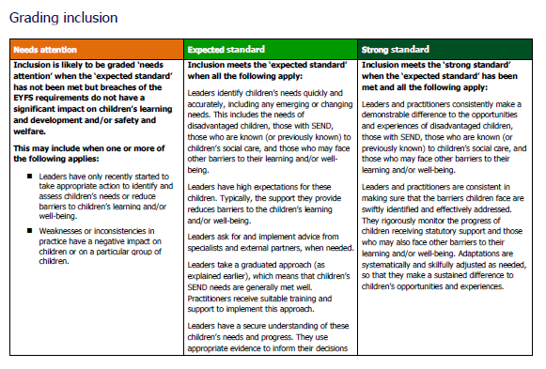
We will introduce toolkits
Toolkits replace the grade descriptors that are currently in our inspection handbooks.
Toolkits show providers and inspectors the evaluation areas that we’ll focus on and how we’ll evaluate and grade providers.
The general structure of the toolkit is the same whatever sector you are working in, but we have carefully reflected on how our evaluation areas should apply for different sectors.

Slide 13


13
Toolkit
The toolkit is broken down into different evaluation areas. Each evaluation area starts with a covering page.
1. A summative statement of what the evaluation area considers – to help leaders and inspectors to understand what the evaluation area is ‘at a glance’.
2. A reminder that our grading standards are based on research, inspection evidence, and statutory and non-statutory guidance set by the DfE.
3. Following that the toolkit sets out the most significant contributory factors that underpin our approaches to evidence gathering and grading

Slide 14

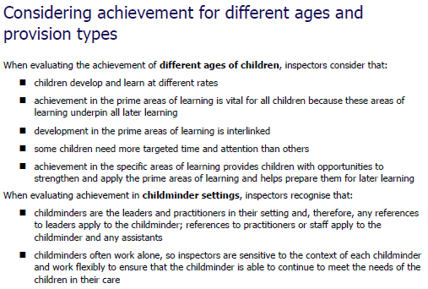
Toolkit
Each evaluation area then has a section to explain how this area is applied for different ages of children and provision types.

Slide 15
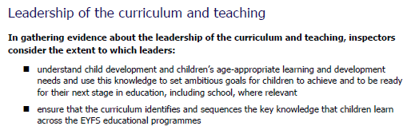
Toolkit
The next part of each evaluation area explains the evidence inspectors will gather.
Theme
Evidence gathering prompts

Slide 16
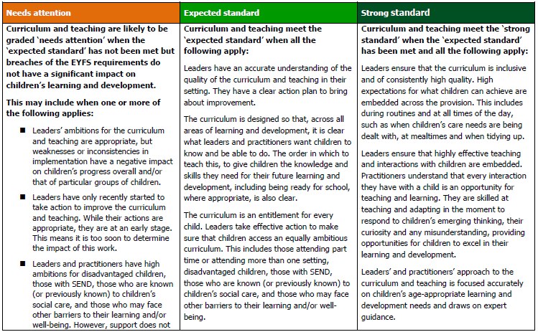
Toolkits
Grades we expect to see most frequently on inspection
Grades across a
5-point scale
Grading
standards
Indicators

Slide 17
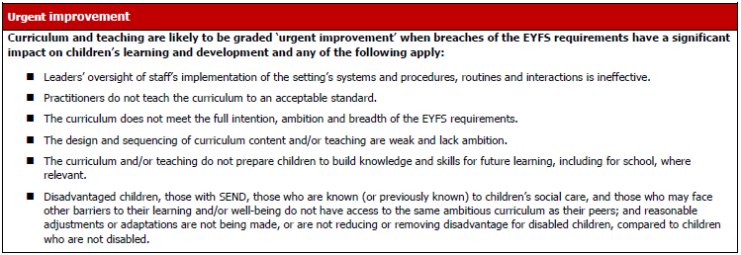
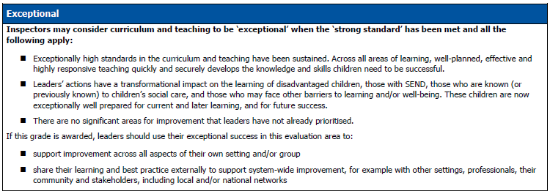
Toolkits
Grades we expect to see less frequently on inspection
Grades across a
5-point scale
Indicators
Standards

Slide 18

Inspections will look and feel different
Context taken into account.
A more collaborative approach.
A consistent approach to inspection.
Clear next steps on what to improve.
A continued focus on well-being.

Slide 19


What’s changing for registered early years settings
Inspectors will:
consider data in understanding the provider’s context
make the notification call before 10am
use an email for sharing information before the inspection
have a planning call with leaders ahead of the inspection
no longer complete a learning walk with leaders
make shared observations and have increased and ongoing professional dialogue with leaders throughout the inspection
inform childminders of the day they will be inspected
no longer grade out-of-school providers ‘met’ or ‘not met’.

Slide 20
Before an inspector arrives
Notification call
To notify the setting of
their inspection and arrange
the planning call
Timetable for inspection
To enable the inspector to gather evidence relevant to the areas of inspection focus.
Notification email
To give leaders helpful
information before the inspection
Planning call
The inspector will work collaboratively with leaders to identify any necessary reasonable adjustments and understand the context of the setting

Slide 21
What we will do on inspection
Celebrate
Begins with a brief introduction to leaders and staff.
Hold discussions with the practitioner designated to take lead responsibility for safeguarding.
Speak with practitioners and leaders.
Gather first-hand evidence of children's experiences through:
  shared observations with leaders
  discussions with parents
  case sampling of children.
Evaluative reflective discussions with leaders.
Concludes with a grading discussion followed by final feedback.
Validate
Highlight

Slide 22
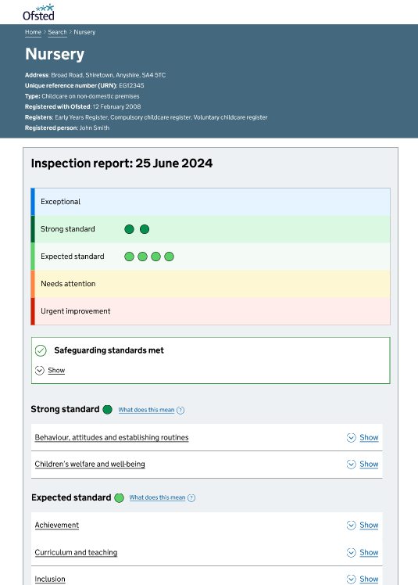
Report Cards
Our new report card will make findings clear and accessible.
The report card will provide a summary overview as well as a detailed explanation for each of the evaluation areas the setting has been evaluated against.
Colours ranging from red, for urgent improvement, to blue, for exceptional will provide a visual overview.
The next steps for improvement, including actions, will be written in a constructive way to make clear what the improvement priorities are for the setting.

Slide 23

After the inspection
Arrangements for publishing report cards will continue as before.
Draft report cards are usually shared within 18 working days of the inspection.
Providers have 5 working days to comment on the draft report card or submit a complaint.
Final report cards are usually published within 30 working days of the inspection (but may be longer where there is a complaint).

Slide 24
Steady and Assured Start

Slide 25
The timeline for change
February to April 2025
Spring and Summer 2025
September 2025
September to November 2025
November 2025
January 2026
Public consultation
Test visits
Response published
Engagement, training and pilots
Inspections
Inspections
Early years
State funded schools
Further education providers
ITE providers
Independent schools

Slide 26

Ensuring a steady and assured start to inspections
Fewer Inspections, initially led by our most experienced inspectors.
Random sample of providers invited to take part in ‘exit interviews’ with HMCI, the National Director, and senior Ofsted officials to hear about their inspection experience and reflect on the implementation of the reforms.
HMCI will also invite sector representatives to a series of roundtable meetings to share their feedback.

Slide 27
Ensuring a steady and assured start to inspections
During this time, all requests for an inspection deferral will be reviewed by Ofsted’s Deputy Chief Inspector.
Telephone helpline will be open before, during and after an inspection.
No routine inspections in the week before Christmas to allow for further training.

Slide 28
Measuring impact

Slide 29

Programme of evaluation
An externally commissioned evaluation of the renewed inspection framework.
Engagement with stakeholders about the implementation of the framework.

Slide 30

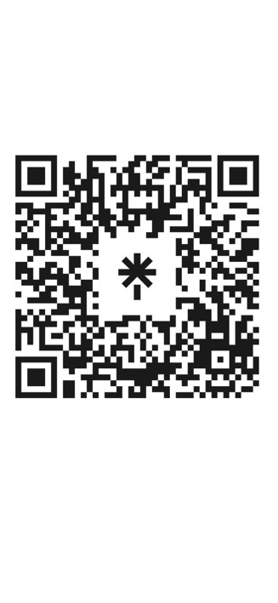
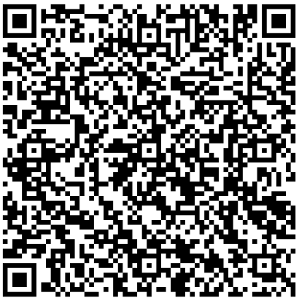
Scan me
Resources and further information
SCAN ME
Formal response to consultation
Toolkits for:
    early years
    Schools
    Further education and skills
    Initial teacher education
Supporting research and evidence
www.gov.uk/ofsted

Slide 31
Questions

