Slide 1



Welcome to the Early Years DSL Network
5th June 2024
Notes:
KB & JM
1

Slide 2
Welcome!
Ben Osifo
Business Manager NCSCP
John Matravers
Head of Safeguarding
Kathryn Bouchlaghem
Head of Early Years

Slide 3


Slide 4
Agenda
Time | Agenda Item | Presenter
9:30am – 9:40am | Welcome and Introductions | Ben Osifo, John Matravers Kathryn Bouchlaghem
9:40am – 9:50am | LADO Update | Caroline Hose, LADO NCC
9:50am – 10:30am | FGM - Nottingham City local picture & update, | Saida Barber: Mojatu Foundation
10:30 – 10:35am | Comfort break 5 min
10:35am – 11:25am | Prevent – Keeping Children Safe in Education: updated guidance | Louise Cox: Prevent Education Officer
11:25am – 11.50am | NCSCP: National and Local Updates | Ben Osifo: Business Manager, NCSCP
11:50am – 12:00pm | Questions and close | Ben Osifo, John Matravers Kathryn Bouchlaghem

Slide 5

The Role of the Local Authority Designated Officer (LADO)
Caroline Hose – LADO Nottingham City

Slide 6

Aims of the session
  To have an understanding of allegation and concerns processes in Nottingham City

Slide 7

What is the LADO?
The LADO is a statutory role which was introduced within ‘Working Together to Safeguard Children’ guidance in 2006 following the publication of the Bichard Report into the murders of Holly Wells and Jessica Chapman, murdered by the caretaker Ian Huntley.
The Bichard Report cited that agencies such as Children’s Services and the Police were not sharing crucial information which was required to safeguard children.

Slide 8
Role of Organisations
All organisations that provide services to
children, should operate a procedure for
handling allegations and concerns that are consistent with:
Working Together 2018
Chapter 5 of NCSCP Procedures
Section 11 Children Act 2004

Slide 9

Role of the Local Authority Designated Officer (LADO)
The LADO works within Children’s Services but reports directly to the Local Authority Safeguarding Partnership.
The main function of the role is Allegation Management and overseeing investigations, LADOs don’t undertake investigations.

Slide 10
LADO arrangements in
Nottingham City
All referrals to the LADO are to be made by submission of a LADO referral form to LADO@nottinghamcity.gov.uk

Slide 11
Allegations Criteria
A LADO referral should be made (within 24 hours of an allegation being made) to all cases in which it is alleged that an adult who works with children has:
behaved in a way that has harmed a child, or may have harmed a child
possibly committed a criminal offence against or related to a child
behaved towards a child or children in a way that indicates they may pose a risk of harm to children
behaved or may have behaved in a way that indicates they may not be suitable to work with children (newest criteria introduced in 2020)

Slide 12

Key Principles
Who does the procedure apply to?
  All staff/professional workers paid or unpaid
  Foster carers/adopters
  Volunteers
When do they apply?
  In all occasions
  Non-recent or contemporary or both
In what context?
  In deployment within an agency
  Personal capacity

Slide 13
Key Principles Continued
Allegations and concerns are resolved as soon as possible.
Actions and decisions are recorded.
The NCSCP oversees the allegations management processes and monitors the effectiveness of local procedures.

Slide 14
Referrals
The LADO will review and advise the referrer within one working day if there is a role for the LADO or if it is a matter that can be dealt with under an agencies disciplinary procedures from the outset or wait for outcome from police/social care where applicable.
Whether the police and children’s social care need to be involved.
How and by whom should the parents/carers of a child be informed of allegation if not already aware.

Slide 15
Referrals Continued
  How, when and by who the member of staff/volunteer concerned
  should be told about the allegation if not already aware.
  What support the child and their carer may require.
  What support the adult subject of the allegation may require.
  What immediate measures need to be put in place i.e. suspension, restricted duties – these are the employer’s decision ultimately.
  Ofsted notification requirements.
  If an Allegations Management Meeting is to be convened.

Slide 16

Three Strands for Allegations Management
There are up to three strands regarding possible next steps that the LADO will advise upon:
Police investigation of a possible criminal offence.
Children’s Social Care enquiries/assessment.
Consideration by an employer of safeguarding measures and/or disciplinary action.

Slide 17

Outcome Categories
Substantiated: there is sufficient evidence to prove the allegation;
Unsubstantiated: insufficient evidence to either prove or disprove the allegation. The term, therefore, does not imply guilt or innocence:
Unfounded: there is no evidence or proper basis which supports the allegation being made, or there is evidence to prove that the allegation is untrue. It might also indicate that the person making the allegation misinterpreted the incident or was mistaken about what they saw. Alternatively they may not have been aware of all the circumstances;
Malicious: sufficient evidence to disprove the allegation and show that there has been a deliberate act to deceive;
False – Education sector only: there is sufficient evidence to
disprove the allegation.

Slide 18
Potential Outcomes
Disciplinary Procedures – training, performance plan, verbal or written warning, dismissal
Referral to the Disclosure and Barring Service (DBS)
Referral to a professional or regulatory body e.g. Teaching Regulation Agency (TRA)

Slide 19
Resignations, settlement or compromise agreements
Compromise agreements by which a person agrees to resign;
the employer agrees not to pursue disciplinary action and;
both parties agree a form of words to be used in any future reference.
THESE MUST NOT BE USED IN ALLEGATION AND CONCERNS CASES

Slide 20

Timescales
It is reasonable to expect that;
80% of cases will be resolved within 1 month.
90% of cases will be resolved within 3 months.
most complex of cases will be resolved within 12 months or more
e.g. when there is an ongoing
police investigation.

Slide 21
Responding to Allegations/Concerns
Always treat them seriously.
Record EXACTLY what the concern is.
Do NOT discuss the allegation with anyone else.
Do NOT investigate without having referred to the LADO.

Slide 22
Reducing risk of allegations or concerns
Staff code of conduct, training, behaviour policies and safeguarding policies and procedures in place.
Have set personal and professional boundaries for staff.
Understand which behaviours need to be addressed directly and when the LADO should be contacted.
Safer Working Practices document in place.

Slide 23

Further information
LADO@nottinghamcity.gov.uk
LADO Referral Form
View NCSCP procedures/resources on:
www.nottinghamcity.gov.uk/ncscp
Any safeguarding concerns about a child need to be referred to City MASH CityMASH@nottinghamcity.gov.uk
If you consider a child is at immediate risk of harm, please call the Police on 999

Slide 24
Understanding Female Genital Mutilation
Saida Barbar
Mojatu Foundation Team
Notes:
DM 40 minutes total including q & A
MASH poster

Slide 25

Understanding Female Genital Mutilation
#NottsEndFGM
#EndFGM
@MOJATUF

Slide 26
Our Mojatu FGM Work
Awareness raising and community engagement
Survivors/ family support
Training-Community, Education, health etc
Research, resource development and publications
Consultancy
Advocacy-Zero tolerance & influencing of policy
Recognition & interest beyond Nottingham and other cities
Partnership development- Social services
Notes:
Since March 2014
More survivors, families and community members coming forward- KEY
Winner of Princess Royal Training Award 2021 based on the FGM Community Ambassador Training
Nottingham first zero tolerence to FGM city in the UK

Slide 27
Key learning objectives
Understanding FGM, global prevalence, reasons why it’s practiced and types of FGM
UK stats and impact on individuals
Understanding the law
Tackling FGM confidently and working with survivors and affected communities
How professionals and others can get involved
Potential referral pathways
Our work in the community and wider society

Slide 28
Note…
There is no easy way to talk about FGM – although there is no attempt to shock in this presentation, you may find some of the content difficult and may feel upset
Look after yourself - If you need to take a break please do
Our focus is safeguarding children and young people

Slide 29
Additional Support
:
:
Some of the contents covered during Schools and Society Sessions can be sensitive in nature. If you are at all worried about how the content of a particular session may affect you, please get in touch with your Schools and Society tutor (or with your personal university tutor if you would feel more comfortable with this). They will be able to advise depending on your individual needs and circumstances.
As always with our Schools and Society sessions and materials, if you feel the need to seek additional support, please do not hesitate to contact our Wellbeing Support Team: SS-Sup-ScSciences@exmail.nottingham.ac.uk

Slide 30
What do you already know about Female Genital Mutilation?

Slide 31

True or False
FGM is an African problem

Slide 32
True or False
There is a medical value in
FGM as long as it is done by a doctor in hospital using anaesthesia (pain killers) and in a clean environment

Slide 33

True or False
There are approximately
200 million women and girls worldwide who have undergone FGM

Slide 34
True or False
FGM is a religious practice

Slide 35
True or False
FGM affects British Girls and is performed in England

Slide 36
True or False
FGM should only be tackled and condemned by those affected by it

Slide 37
True or False
Female circumcision is similar to male circumcision and reduces the risk of infection and provides some protection against H.I.V.

Slide 38
What is Female Genital Mutilation?
  FGM is a procedure where the female genital organs are injured or changed and there is no medical reason for this.
  It is frequently a very traumatic and violent act for the victim and can cause harm in many ways.’
  (Multi-agency statutory guidance on FGM – HM Government 2021)

Slide 39
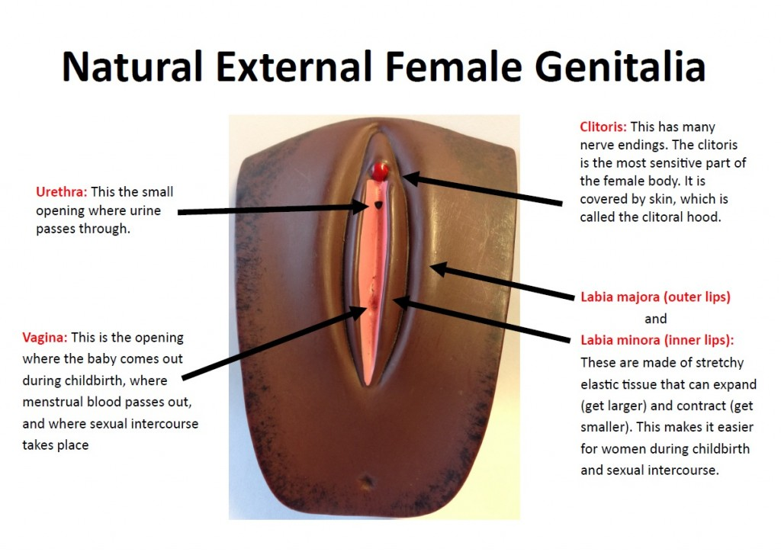

Slide 40
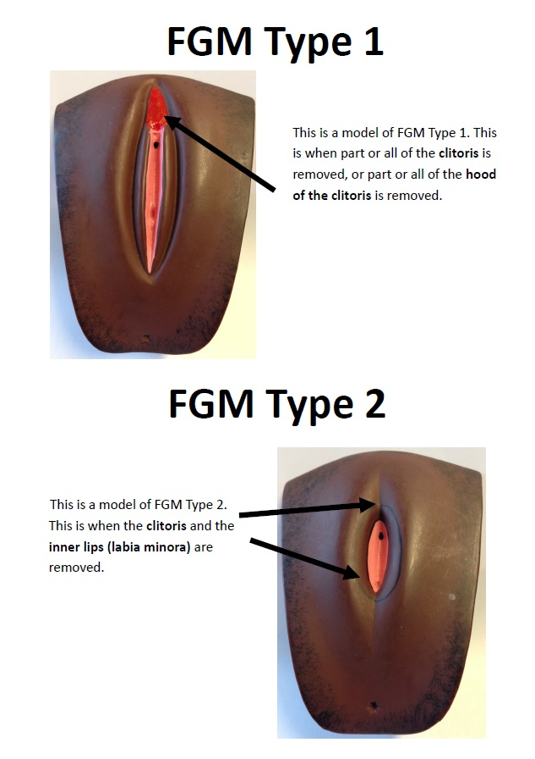
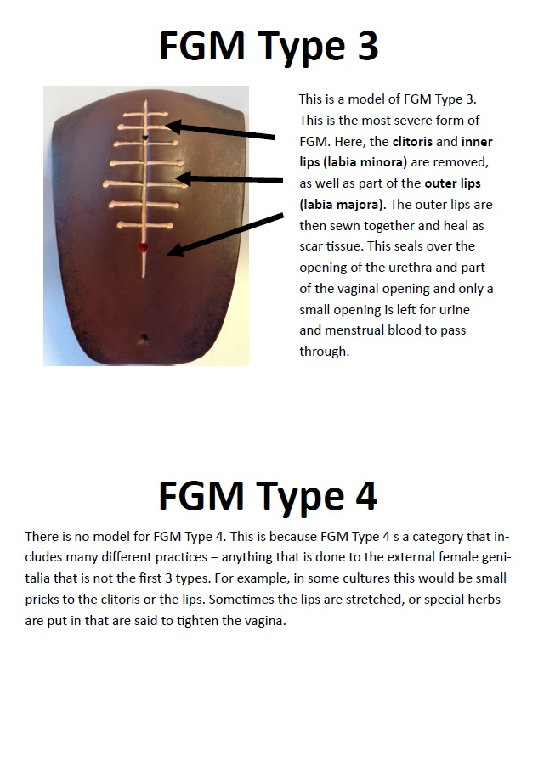

Slide 41
Scale of the Problem
It is estimated that up to 200 million women and girls worldwide have undergone FGM and an additional 68 million are at risk of undergoing FGM by 2030 (UNICEF,2021)
FGM occurs in over 90 countries globally Africa, Asia, the Middle East and within diaspora communities
Only 30 countries report nationally on the number of women & girls who have been cut
FGM remains a hidden practice that is underreported
<https://www.orchidproject.org/about-fgc/where-does-fgc-happen>

Slide 42
Why do people practice FGM?
It is not a religious practice - Bible or Koran has nothing to do with it
In sub-Saharan Africa as part of puberty rites. It is believed that non- circumcised women would not get husbands - valued as a rite of passage to womanhood
Medical evidence suggests US doctors practiced FGM until the 1960s. (Dr. James Burt, a physician from Ohio, performed a so-called "surgery of love" on over 170 women throughout the 1960s and 1970s
19th century British gynecologist, Isaac Brown advocated the cutting of Clitoris to cure insanity, epilepsy and an a number of illnesses
Overall, in the history, ensure women’s virginity and reduction in the female desire—a sign of an “Empowered Woman”

Slide 43
Common Presumptions: “It’s their culture”, It’s their religious requirement”
It is important to challenge FGM confidently because it is:
A form of child abuse and it affects girls and women physically, emotionally and psychologically
A human rights violation, a form of violence against women and girls
Not a religious requirement
A violation of bodily integrity-bodily harm
Illegal in the UK
Not an African problem alone, but it is a global problem
Important to recognize our duty of care in safeguarding women and girls at risk of FGM and acknowledge our mandatory reporting duty under law!

Slide 44
Where does FGM take place in the world?
According to available data from 30 countries where FGM is practiced in the Western, Eastern, and North-Eastern regions of Africa, and some countries in the Middle East and Asia. These countries include:
Somali
Djibouti
Egypt
Guineae
Mali

Slide 45

Prevalence of FGM in the UK
Approx 10,000 girls aged under 15 who have migrated to the UK are likely to have undergone FGM
(Multi-agency guidance on FGM HM government 2021)
In the UK, an estimated 60,000 girls under the age of 15 are at risk of FGM
GOV.UK, ‘Female Genital Mutilation (FGM) Migrant Health Guide’ (2021)

Slide 46
Breakdown of the statistics recorded in the UK
FGM Type (only 56.2% of cases is known)
Age when FGM was undertaken (only 36% of cases is known)
FGM Type | Type 1 | Type 2 | Type 3 | Type 4
No of individuals in % | 38.3% | 27.7% | 23.6% | 10.4%
Age | under 1 | 1-4 | 5-9 | 10-14 | 18 and over
No of individuals in % | 17.8% | 12.3% | 39% | 8.9% | 1.2%
Geographical area where FGM was undertaken (only 42.6% of cases is known)
Geographical Area | Africa | Asia | UK | Rest of the world
No of Individuals in % | 84.6 % | 10.0% | 5.0% | 0.5%
Source: NHS Digital (2022), ‘Female Genital Mutilation April 2015- June 2022’

Slide 47
Impact on girls and women
PHYSICAL
Complications in pregnancy and childbirth
Difficulties in menstruation
Bleeding/hemorrhaging
Sexual dysfunction depending on type of FGM
Severe pain and shock
Infection/urine retention
Cysts and abscesses
Death
EVERY SURVIVOR’S EXPERIENCE IS DIFFERENT!
EMOTIONAL & PSYCHOLOGICAL
Trauma
Betrayal
Anxiety
Anger
Embarrassment
Defensiveness
Fear of being disowned
Pride
A sense of belonging
Might not know how they feel
PTSD
EVERY SURVIVOR’S EXPERIENCE IS DIFFERENT!
Notes:
There will be an activity later on where we will look at these impacts and how they link to the different types of FGM

Slide 48
The UK law – main Act –FGM 2003 Act
FGM has been illegal in UK since 1985.
It is illegal to perform FGM (unless for medical reasons, eg. cancer)
It is illegal to assist a girl to carry out FGM on self
It is illegal to assist (from outside the UK) a non-UK person to carry out FGM outside the UK on a UK national or UK resident
Max 14 years Imprisonment
First successful prosecution- 2019

Slide 49
The UK law……
The Serious Crimes Act 2015 amended the 2003 act to also include:
An offence of failing to protect a girl from the risk of FGM (person who is responsible for the girl at the time the FGM occurred)
Lifelong anonymity for survivors
A mandatory reporting duty (U18) for regulated profession e.g. teacher, healthcare, social care… use 101 non-emergency crime number
FGM Protection Order(PO) - can be used to protect girls at risk

Slide 50
Possible Signs and Indicators
FGM may be about to take place
Unexpectedly absent from regular place of worship
You hear reference to FGM in conversation
Talk about a special procedure or that she is going to become a woman
A girl may request for help
Parents states that they or a relative will take the child out of the country for a prolonged period.
A girl may talk about a long holiday to her country of origin or another country where the practice is prevalent
Parents seeking to withdraw their children from learning about FGM
FGM may already have taken place
Difficulty walking, sitting or standing
Spending a long time in the toilet
Urinary, menstrual or stomach problems
Prolonged or repeated absence from their usual place of worship
Noticeable behaviour change
Requests to be excluded from physical activities
Girl or family member tell someone or ask for help
May talk about pain or discomfort between her legs
Increased emotional and psychological needs
A girl may request for help

Slide 51
Potential Risk Factors
A girl born to a woman who has been subjected to FGM
Any girl who has a sister or cousin has already undergone FGM
A girl whose father comes from an affected community
Belief that FGM is integral to cultural/religious identity.
Strong levels of influence and involvement of elders in family life
Limited level of integration within UK community
Family is not engaging with professionals (health, education or other)
Family is already known to social care in relation to other safeguarding issues
Limited access to information about FGM effects or UK law
A girl whose parent/family member expresses concern that FGM maybe carried out
A girl withdrawn from RSE at school may be at risk as a result of her parents wishing to keep her uninformed about her body and rights

Slide 52
Safeguarding
FGM is a serious child protection concern
We have a multi-agency responsibility to respond and protect
Follow multi-agency statutory guidance/your services safeguarding procedures
Check FGM is included in policies/procedures

Slide 53
Safeguarding Pathway
Girl discloses she has undergone FGM/you suspect a girl is at risk
Efforts should be made to establish the full facts from the child before any action is taken.
The member of staff should discuss it with the school’s designated safeguarding lead, following the procedures set out in the child protection policy
FGM should be treated as a child protection concern and referred to the relevant authorities as outlined in the school’s child protection policy

Slide 54
Survivor’s Story
I was about 7 or 8 years old when I first underwent the cut in Eritrea.
I was later cut in Sudan, at the age of 15 years old. The first procedure took place about 6 o’clock in the morning.
Preparations were made and food was prepared. It was like a celebration. The circumciser charged 20 Nafka (£1.10) to undertake the cut. I was laid on a wooden surface and my legs and hands were held apart on each side. Before the cut,the female circumciser applied ash on my genitalia, heated the blade on fire and cut me.
During this first procedure, a small cut was made on my genitalia. The circumciser then applied raw egg and alcohol on the wound and then tied my legs with a rope. Afterwards, I was carried to my room and stayed there for about a month in order to heal. During this time, I only ate small portions of food and drinks, to prevent me from going to the toilet too often. The rope on my legs was removed when I recovered.

Slide 55
How you can get involved with Mojatu Foundation
SIGN THE PLEDGE and join the global movement!
Community and Faith Leaders- Global Ambassadors
Adopt a tree
Engage in our community work
Advertise and share stories in our magazines
Awareness raising through your networks and promote our work
Book for a training session
Volunteer
Fundraise to support our work
FGM Awareness during February
Notes:
Mojatu Foundation Festive Fiesta

Slide 56
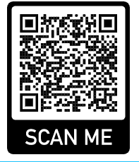
Take a Pledge Today!!
Sign our FGM Pledge
https://docs.google.com/forms/d/e/1FAIpQLScIaeL7x4TroHSr4EV4lJYdyeb6w4ssMC6282HZD29-ZhPifg/viewform

Slide 57
Contacts and More Information
Talk to us TODAY!
Websites: www.mojatufoundation.org
https://anchor.fm/mojatu-foundation
www.issuu.com/mojatu
Tel & M: 0115784 6666 / 07759 927671
Email: info@mojatufoundation.org
Facebook: Mojatu Foundation
Twitter: @MojatuF
Instagram: mojatu_foundation

Slide 58
Any Questions?

Slide 59
National and Local Safeguarding Updates
Ben Osifo
Business Manager NCSCP
NCSCP - National & Local Updates @NottinghamCSCP

Slide 60
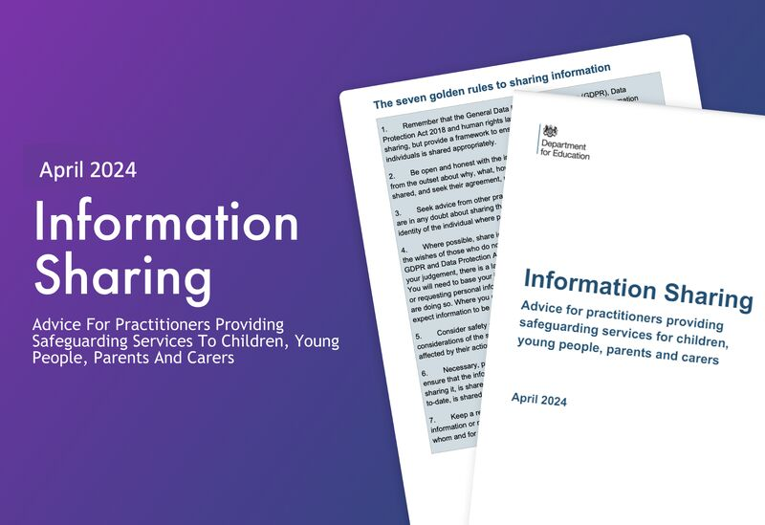
National Updates
Information sharing - advice for practitioners providing safeguarding services (publishing.service.gov.uk)
This advice outlines the importance of sharing information about children, young people and their families in order to safeguard children.
Legal frameworks like GDPR support responsible sharing. Spot signs of abuse, collaborate with relevant authorities, and adhere to key legislation. Follow clear principles for necessary, relevant, and secure sharing. Bust myths hindering effective communication.
.
The Child Safeguarding Practice Review Panel Annual Report 2022-23 (publishing.service.gov.uk) –
It looks at the child safeguarding system, based on serious child safeguarding incidents occurring between January 2022 and March 2023.
It sets out patterns in practice for national government and local safeguarding partners to better protect vulnerable children.
Notes:
This HM Government advice emphasises the critical role of sharing information about children, young people, and their families to ensure child safeguarding. It complements the statutory guidance "Working together to safeguard children 2023." The advice, though non-statutory, supersedes the previous guidance from July 2018.
The Seven Golden Rules to Information Sharing

Slide 61
Local Updates

Slide 62


Reminder About The Neglect Toolkit
The neglect toolkit and separate guidance document are for professionals to use in partnership with families when there is concern that the needs of a child are being neglected.
The toolkit is designed to enable honest conversations with families around areas of strength in their parenting and areas which need to change.
The language in the toolkit uses a strength-based approach, with additional sections on parental conflict and positive values.
The requirement to complete the whole toolkit has been removed, in acknowledgement that professionals are likely to have helpful information focused in only a few areas of the toolkit.
neglect-toolkit.pdf (nottinghamcity.gov.uk)
www.nottinghamcity.gov.uk/neglect/
Notes:
The section on the parents/carers ability to achieve change has also been expanded

Slide 63
Neglect Audit 2023
Cross authority Neglect audit 2023 looked at partnership responses to child neglect for ten children whose child protection plans for neglect had ended in the summer.
Areas of strength were identified.
Identified learning:
  Further work with partners to encourage the early and frequent use of the neglect toolkit as part of the assessment process and then as part of ongoing work with families. This is likely to help professionals to focus on the impact of neglect on the child and encourage progression in the work to assist the family.
  Any continuing barriers for the involvement of GPs in child protection processes to be addressed, both at S47 stage and in terms of child protection conferences.
  Some issues with the flagging of children’s child protection plans on health records were noted and processes are to be reviewed.
  The contribution of 0-19 services to child protection meetings to be clarified and improved.
Notes:
Areas of strength were identified as follows:
Good identification of neglect pre-birth for 4 children
Good identification of need for 9 out the 10 children audited
Good work by schools, prompt referrals and good support to children
Good work by police, involvement in strategy discussions, information sharing and Initial Child Protection Conferences.
Good partnership working in terms of communication and coordination

Slide 64
Mental Health and Exploitation Audits
Cross Authority Mental Health Audit
This was the second cross-authority audit. It was a retrospective, qualitative audit, with the purpose of assessing how the partnership responds to children and young people (CYP) experiencing a mental health (MH) crisis.
A selection of ten CYP were submitted for audit and had been selected through their case being heard at the Nottingham and Nottinghamshire CYP in inappropriate settings/crisis escalation meeting. The findings of this report are to be submitted for sign off and will be included as a further update at the August DSL meeting.
Cross Authority Exploitation Audit
Exploitation features within the NCSCP business plan (2023 – 2026) and it was decided to feature ten high risk cases within CCE and CSE to audit. The focus within this audit subject was to capture the voice of the child to fully understand their journey through services and identify how best to support our most vulnerable children within Nottingham City and Nottinghamshire County.
The findings of this report are currently being drawn up and an update will be given at the August DSL meeting.

Slide 65
Lunch and Learn: Safer Sleep risk assessment toolkit webinars
Wednesday June 19th 12-12.45
OR
Wednesday July 17th 12-12.45
On Microsoft Teams
Come and join us to learn more about the safer sleep risk assessment toolkit and how you can apply it in your work with parents-to-be and families with babies under 12 months.
The aims of the webinar are to:
Share key messages around safer sleep for babies and reducing the risks of Sudden Infant Death Syndrome (SIDS).
Explain and promote the safer sleep risk assessment tool, helping us embed safer sleep as ‘everyone’s business’.
Provide links to resources, support and information.
Hear your thoughts on the risk assessment tool, answer any questions and help promote its use in your work.
To register please contact Sarah Beet Sarah.Beet@nottscc.gov.uk

Slide 66
Rapid Reviews
There is a statutory requirement on safeguarding partners to conduct a ‘Rapid Review’ when serious child safeguarding cases are identified.
The reviews should be completed within 15 working days and a report provided to the National Child Safeguarding Practice Review Panel (NCSPRP).
The NCSCP remains committed to gathering as much learning as possible during the rapid review process and to only progressing to a Local Child Safeguarding Practice Review (LSCPR) where necessary
Notes:
Child Safeguarding Practice Review Panel: annual report 2022 to 2023 - GOV.UK (www.gov.uk) - • The age distribution within rapid reviews follows a similar pattern to the previous year with a predominance of babies under 1 (36%) with a second peak in the 11-15 age group. The most common causes of fatalities for girls were sudden unexplained death in infancy/childhood, suicide and accident/injury; for boys they were sudden unexplained death in infancy/childhood, extrafamilial child homicide and accident/injury.

Slide 67
Rapid Review’ Case Summary And Learning Points
Case summary 1:
3-year-old child presented to hospital having been found to be unresponsive by a sibling. Child was admitted to the intensive care unit, and noted to be underweight, dehydrated and severely malnourished. There had been no seeking of medical attention by the parents over many months and this represented extreme neglect. The child was part of a large family group (10 + children). Many of the children had not had statutory health reviews, a number of missed appointments were noted and neither the faltering growth nor the WNB policy were followed appropriately.
Identified Learning:
Working arrangements when working with large families (10+children)
Professional curiosity
Use of ‘was not brought’ policy/Use of faltering growth policy
Promotion of the revised threshold of need document & the Neglect Toolkit

Slide 68
Rapid Review’s Case Summary And Learning Points
Case summary 2:
A 10 year old was admitted to hospital with significant constipation and later deteriorated. The child was subsequently admitted to a paediatric intensive care unit for support and will need a stoma and colostomy bag for a considerable time (months). The clinical opinion was that this represented long standing constipation (years) and that the child had not received the appropriate treatment. In the context of appropriate treatment and advice being offered by health care professionals, this represented neglect. Had appropriate medication been given, this life altering event could have been avoided.
Identified Learning:
A lack of recognition that the condition was not being managed appropriately.
Neglect toolkit will be reviewed so that it prompts consideration of the factors regarding medical neglect
Improving information sharing between schools /education and primary care.

Slide 69
Information & Support
1- Nottingham City Safeguarding Children Partnership- www.nottinghamcity.gov.uk/ncscp
2- Early Years - Early Years - Nottingham City Council
3 - e-learning - Nottingham City Council - Includes DA, FGM etc.
4 - Consent Coalition About Us | Consent Coalition (nottssvss.org.uk)
5 - Equation | Domestic Violence Nottinghamshire
6 - Domestic Abuse - Nottingham City Council
7 - Domestic Abuse (proceduresonline.com)
8 - Radicalisation and Violent Extremism (proceduresonline.com)
9 - Female Genital Mutilation (proceduresonline.com)
Notes:
The Nottingham Schools website is where you can find key resources including the Nottingham City template Safeguarding and Child Protection Policy, training programme, DBS letter for all Nottingham City employees to allow access to your setting.

Slide 70

Nottingham City Safeguarding Children Partnership (NCSCP) Newsletter Spring Edition 2024

Slide 71

Questions
Notes:
JM &KB

Slide 72
Training Dates
Course | Date | Time | Venue | Fee
Prevent | 4th July | 1:30pm – 3pm OR 4.30pm – 6pm | Online | FREE
Designated Safeguarding Leads Training | 14th June | 9:15am – 12:30pm | Castle Cavendish | £30
An Intro to Safeguarding | 25th June | 10:00am – 12:00pm | Castle Cavendish | £15

Slide 73
Next DSL network :
Wednesday 13th November 2024
Start time 9:30am
Online

