Slide 1



Welcome to the Early Years DSL Network
28th February 2024
Notes:
KB & JM
1

Slide 2
Welcome!
Ben Osifo
Business Manager NCPCP
Kathryn Bouchlaghem
Head of Early Years

Slide 3


Slide 4
Agenda
Time | Agenda Item | Presenter
9:30am | Welcome and Introductions Is your Safeguarding Policy Robust? | Kathryn Bouchlaghem Ben Osifo
9:50am | Consent & Information Governance, MASH role and EMARF including Q & A | Susie Carter – Early Help Specialist MASH
10:30am 11am. Close of meeting. | NCSCP: National and Local Updates | Ben Osifo –Business Manager NCSCP

Slide 5
Is your Safeguarding Policy Robust?
When do you review your policy?
Who is involved?

Slide 6


LADO arrangements in
Nottingham City
All referrals to the LADO are to be made by submission of a LADO referral form to LADO@nottinghamcity.gov.uk

Slide 7
Training Dates
Prevent:
1st March 1:30pm – 3pm OR 4.30pm – 6pm
4th July 1:30pm – 3pm OR 4.30pm – 6pm
Designated Safeguarding Leads
14th March 9.30am – 12.30pm live at Castle Cavendish
14th June 9.30am – 12.30pm live at Castle Cavendish

Slide 8
City MASH Updates
Diana Millwood
Service Manager: City MASH and Emergency Duty Team (EDT)
Notes:
DM 40 minutes total including q & A
MASH poster

Slide 9

What Makes a Good Referral?
Susie Carter, Early Help Specialist
MASH

Slide 10
Aims of Objectives
To raise awareness of the Nottingham City’s MASH, Multi Agency Safeguarding (Children) Hub.
To offer tips and advice around completing a “good” Electronic Multi Agency Referral Form (E-MARF).
To enable you to feel more comfortable to complete a E-MARF and liaise with the City MASH.

Slide 11

Overview of the MASH
Nottingham City Multi Agency Safeguarding Hub is a service where, through integrated information sharing, risk is identified, and timely, proportionate interventions are made which keep children and young people safe.
What does that mean?
We accept referral’s regarding children who are in need of support, help, safeguarding and protection.
The team consists of 10 Social Workers and 7 Family Support Workers, large number of police staff and representatives from Health and CAMHS. We have virtual partnerships with other agencies like Probation, Fire Service, housing, CGL etc.

Slide 12
Electronic Multi Agency Referral Form
Nothing is more important than children’s welfare. Children who need help and protection deserve high quality and effective support as soon as a need is identified. (Working Together to Safeguard Children 2018 (publishing.service.gov.uk))
The EMARF is a form completed on line to advise/refer to Children Services when you are worried that child who needs help/support or protection/safeguarding’.
If a child is at immediate risk phone 999 and report to the police, the police will liaise with Children Services.
IF you are unsure, please call City MASH on 0115 876 4800
Please consult the ‘Threshold of Needs’ document when considering whether a child is in need or otherwise. final-version-6-19-05-2023-nottingham-city-threshold-of-needs.pdf (nottinghamcity.gov.uk)

Slide 13
Consent to share information
Consent to share information
We expect all professionals to follow consent guidance from the General Data Protection Regulation (GDPR) 2017, the Children Act 1989 and the Crime and Disorder Act 1998.
Information Sharing (proceduresonline.com)
To make a referral to children services, parents/carers must give their explicit and informed consent for information to be shared with other agencies to enable holistic support and access to services.
Recorded consent should be gained by the referring agency, with clarity about why and with whom information will be shared. The MASH cannot accept a referral without consent; unless there are safeguarding concerns whereby there is a statutory duty to intervene AND seeking consent may put the child at further risk or cause a delay.
In situations where there are concerns that a child is suffering, or is likely to suffer significant harm, information may be shared without consent.

Slide 14

Working Together To Safeguard Children
Working Together to Safeguard Children, 2018 states that ‘safeguarding children and protecting them from harm’ is everyone’s responsibility. Everyone who comes into contact with children and families has a role to play. Abuse is a form of maltreatment of a child.

Slide 15
Levels of need
Taken from Nottingham City Safeguarding Partnership - ‘Threshold of Needs document’.
This is located on Page 11 and under these headings are examples (not a definitive list) that will help practitioners to identify the level of need a child and/or young person and their family may be experiencing and respond with appropriate support that may be required.
 | Universal Support | Early Help | Targeted | Specialist & Safeguarding
 | Children and families are doing well and their needs are met within universal services including health development and achievement | Child and family are experiencing problems requiring universal services to work together with other support services to prevent problems increasing | Child and family are experiencing a range of increasing problems that require intensive multi- agency support to meet the needs of the whole family and crisis is likely to be prevented | Child in need of protection Child is suffering or likely to suffer significant harm

Slide 16
Accessing the E-MARF
The E-MARF is accessed via the City MASH webpage…..
https://www.nottinghamcity.gov.uk/marf
Google search – Nottingham City MASH Referral
Notes:
2: (NB when seeking consent please ensure that parents/carers understand that the information will be shared with services where considered appropriate to do so)
3: Expand on the details of the young person from the table

Slide 17
What is needed?
Has the referral been discussed with the parent and consent been made? If the answer is ‘no’ to any of the above please state reason why.
Is there any information contained in this referral/request that needs to remain confidential from the child or family? If yes, please outline specific information to remain confidential and why.
What are the parents/carers views about your concerns and this referral/request? What is the family/individual hoping to achieve?
What are the child/young person’s views about your concerns and what are they hoping to achieve?

Slide 18
Your details
Your Details
Name & Position
Email
response
Tel No
Address
Notes:
City council to any other council = Secure City council to school (e.g. academy) = NOT Secure
City council to NHS = Secure
City council to Police = Secure
City council to Probation = Secure

Slide 19
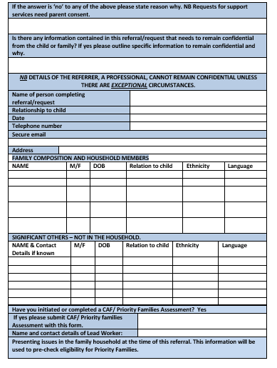
Families Information cont
Family Composition & Household Members
Up to date Contact Numbers, so we speak with the right person
We can complete appropriate checks and assess the whole risk
Has the Parent/Carer been consulted about the MARF
Significant Others
Individuals that are not in the home
Individuals that influence what is happening

Slide 20
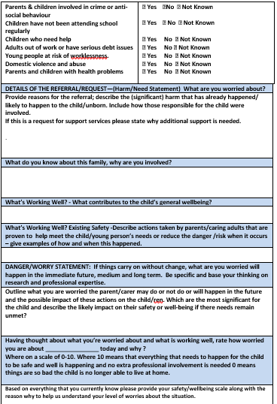
Ensuring your MARF is robust and informative
In the Actions section of the MARF, what action plan do you think would support this child/children and family? What could your agency and other agencies do to add to this plan?
Have you captured the voice of the young person through wishes and feelings
Have you initiated the Supporting Families Program
What other agencies are/have involved and what intervention has been implemented so far to support the family and improve the outcomes for the child/children?
Complete the other agencies involved section of the MARF

Slide 21
Signs of Safety
The SOS framework allows practitioners to critically think through and analyse the information gathered about a child and their family
What are the families strengths
What are the concerns
What can the family do to improve the risk
What can professionals do to improve the risk
How can we make the young person safe
0 10

Slide 22
After You Have Submitted a MARF to MASH
You should expect:
That you as the referrer are consulted as part of the screening process
That you are advised of the outcome of the referral made and receive an outcome letter for your records to reflect this
That if you are not confident that we have made the right recommendation, you are able to professionally challenge this or have further discussion with the worker or team manager

Slide 23
Any questions?

Slide 24
National and Local Safeguarding Updates
Ben Osifo
Business Manager NCSCP
NCSCP - National & Local Updates @NottinghamCSCP

Slide 25

Working together to safeguard children 2023. Updated statutory guidance. Published 15 December 2023.
Working Together to Safeguard Children. Statutory framework: legislation relevant to safeguarding and promoting the welfare of children. December 2023.
Children’s social care national framework. Statutory guidance on the principles behind children’s social care, its purpose, factors enabling good practice and what it should achieve. This is a document for those who work in local authority children’s social care; it shows what you must do to comply with the law. It includes relevant information for all safeguarding partners and agencies who work with children’s social care.
Children’s Social Care: Data and Digital Strategy. This strategy sets out the DfE’s long-term plan for transforming data in children’s social care.
Improving practice with children, young people and families. Advice for local areas to embed working together to safeguard children and the children’s social care national framework in practice. This consists of both:
DfE guidance: Supporting local areas to embed working together to safeguard children and the national framework
Background information for Working Together and the National Framework: Improving Practice with Children, Young People and Families (December 2023)
Future publications:
Information Sharing Advice for Practitioners will be published in the coming months and will provide further guidance to strengthen collaborative working between multi-agency practitioners.

Slide 26
Website Update
There are two main websites held by the local authority that will be key to support the role of the DSL (PVI) -
  1 - Nottingham City Safeguarding Children Partnership www.nottinghamcity.gov.uk/ncscp
  2 - Early Years - Early Years - Nottingham City Council

Slide 27


Neglect Toolkit
The neglect toolkit and separate guidance document were originally launched in 2021 across Nottinghamshire and Nottingham City for professionals to use in partnership with families when there is concern that the needs of a child are being neglected.
The toolkit is designed to enable honest conversations with families around areas of strength in their parenting and areas which need to change.
The language in the toolkit has been refreshed towards a strength-based approach, and additional sections have been added on parental conflict and positive values.
The section on the parents/carers ability to achieve change has also been expanded. The requirement to complete the whole toolkit has been removed, in acknowledgement that professionals are likely to have helpful information focused in only a few areas of the toolkit.
neglect-toolkit.pdf (nottinghamcity.gov.uk)

Slide 28
Neglect Audit 2023
Neglect audit 2023 saw the first joint Nottinghamshire and Nottingham City Safeguarding Children Partnership audit which looked at partnership responses to child neglect for ten children whose child protection plans for neglect had ended in the summer.
Areas of strength were identified as follows:
  Good identification of neglect pre-birth for 4 children
  Good identification of need for 9 out the 10 children audited
  Good work by schools, prompt referrals and good support to children
  Good work by police, involvement in strategy discussions, information sharing and Initial Child Protection Conferences.
  Good partnership working in terms of communication and coordination
Learning was identified and recommendations made as follows:
  Further work with partners to encourage the early and frequent use of the neglect toolkit as part of the assessment process and then as part of ongoing work with families. This is likely to help professionals to focus on the impact of neglect on the child and encourage progression in the work to assist the family.
  Any continuing barriers for the involvement of GPs in child protection processes to be addressed, both at S47 stage and in terms of child protection conferences.
  Some issues with the flagging of children’s child protection plans on health records were noted and processes are to be reviewed.
  The contribution of 0-19 services to child protection meetings to be clarified and improved.

Slide 29
Rapid Reviews
There is a statutory requirement on safeguarding partners to conduct a ‘Rapid Review’ when serious child safeguarding cases are identified.
The reviews should be completed within 15 working days and a report provided to the National Child Safeguarding Practice Review Panel (NCSPRP).
The NCSCP remains committed to gathering as much learning as possible during the rapid review process and to only progressing to a Local Child Safeguarding Practice Review (LSCPR) where necessary
Case summary - 3-year-old child presented to hospital having been found to be unresponsive by a sibling. Child was admitted to the intensive care unit, and noted to be underweight, dehydrated and severely malnourished. There had been no seeking of medical attention by the parents over many months and this represented extreme neglect. The child was part of a large family group (10 + children). Many of the children had not had statutory health reviews, a number of missed appointments were noted and neither the faltering growth nor the WNB policy were followed appropriately.
Learning –
  Working arrangements when working with large families (10+children)
  Professional curiosity
  Use of ‘was not brought’ policy
  Use of faltering growth policy
  Neglect Threshold of need

Slide 30
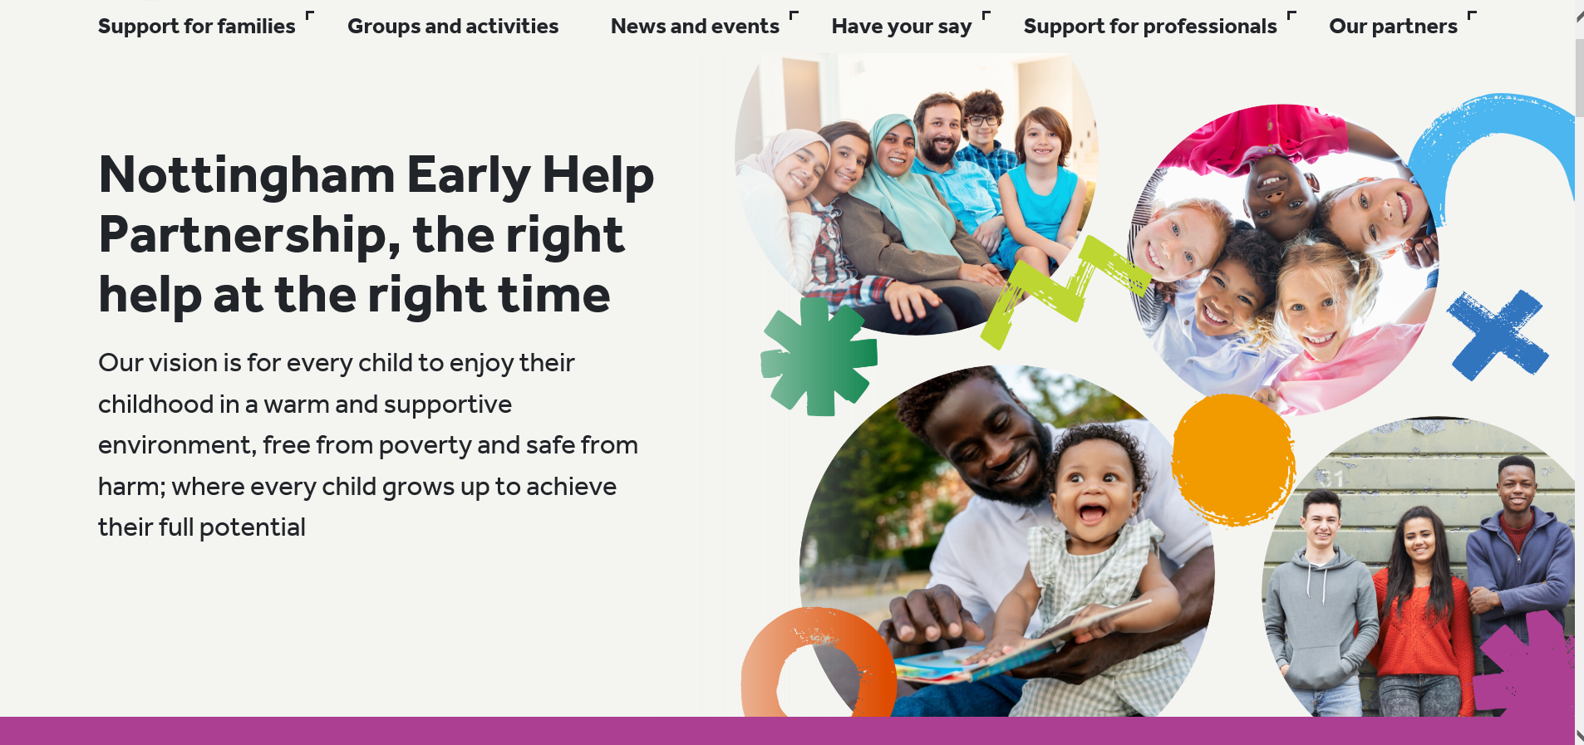
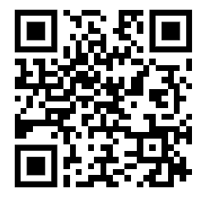
Early Help Partnership website
Family Hubs have funded a website for families and professionals with information, advice, activity details and links for whole family services through the Early Help Partnership that was launched on 30 October 2023
https://www.earlyhelpnottingham.org.uk/#

Slide 31
Family Hub services
Funded services
Start for Life Offer
Infant Feeding
Perinatal Mental Health & Parent Infant Relationships
Parenting Programmes (0-2yrs)
Home Learning Environment
Wider services – new offers
Department for Work and Pensions – weekly drop-ins (Better off calculations, Financial stability and debt advice)
Community Perinatal Mental Health assessment session
Oral Health packs
NSPCC – Pregnancy In Mind & Domestic Abuse Recovering Together– coming soon
Housing Solutions drop ins– coming soon

Slide 32
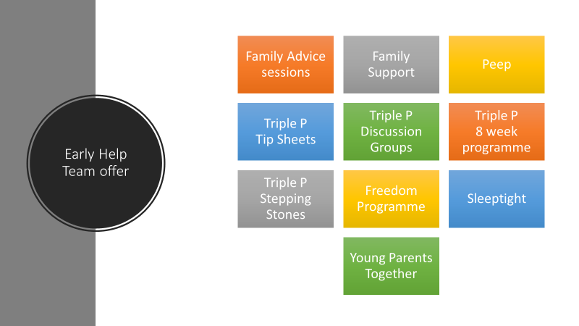

Slide 33
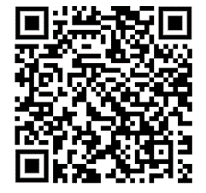
To access any of the Early Help group programmes, families can complete the Self Referral form via the following link or QR code:
https://www.earlyhelpnottingham.org.uk/downloads/Early_Help_Self_Referral_-_Sept._23_.docx
Families can contact / walk into any of the 4 Family Hubs in Nottingham:
Bestwood Family Hub: Southglade Access Centre, Southglade Road, Bestwood, Nottingham NG5 5GU Telephone 0115 8761890
Broxtowe Family Hub: 18 Strelley Road, Nottingham, NG8 3AP
Telephone 0115 8763888
Hyson Green Family Hub: The Mary Potter Centre, 76 Gregory Boulevard, Nottingham, NG7 5HY Telephone 0115 8838202
Meadows Family Hub: Kirkby Gardens, The Meadows, Nottingham, NG2 2HZ
Telephone 0115 8761320

Slide 34

Questions
Notes:
JM &KB

Slide 35
Next DSL network :
Wednesday 5th June 2024
Start time 9:30am
Online

