Slide 1
Autism Awareness Training

Slide 2
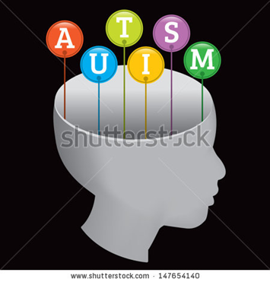
Autism Awareness
Welcome
Welcome to our Autism E learning Training Course. We designed this course in partnership with autistic people, and professionals from Nottinghamshire County Council, Nottingham City Council and Nottinghamshire Healthcare.
Our Autism E-Learning course is designed for anyone whose job may bring them into day to day contact with people with autism including practitioners working for our Local Authorities, Health, Housing, District Councils, Police and Education Services. We also hope that members of the public will also find it interesting and useful as a resource.
The Course is designed to raise the awareness of Autism Spectrum Conditions (ASC’s).
You can expect to learn about the characteristics of autism, relevant legislation and practical ways of supporting people with autism.

Slide 3

Autism Awareness
Learning Outcomes
The course aims: To cover the ‘basic awareness’ level of skills and knowledge as described in the Autism Skills and Knowledge list produced by Skills for Health, Skills for Care.
These are to:
Understand what autism is and how it might affect the individual’s social interaction, communication and imagination
Understand how having autism can impact on mental health
Be able to identify adults who may be on the autism spectrum
Understand different ways of supporting, interacting and communicating with autistic people
Reflect on your own working practices and the client population you support.

Slide 4
Autism Awareness
Feedback
There is a feedback form to complete following this training. Although this is completely optional for you to complete, it would be very useful if you did, especially if you provide services in Nottinghamshire.
This is because we can then track how many people have completed the training from different kinds of services, and we can also make changes/adaptations to the course where these are necessary, following your feedback.

Slide 5

Autism Awareness
What is Autism
Autism is a lifelong neurodevelopmental condition that affects how a person communicates and interacts with other people around them.
Autism is a ‘spectrum condition’, which means that while all people with autism share common areas of difference, their condition will affect them in different ways. This means that some people will need a lot of support to manage their everyday life, whilst others will be able to manage independently without requiring support.
Autism affects around 1% of the population (Brugha et al., 2011); that’s around 500,000 people in the UK.
People with autism can, and do, live happy and fulfilling lives.

Slide 6
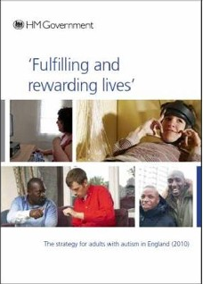
Autism Awareness
Autism Act 2009 and Adult Autism Strategy
The Autism Act is the first ever disability-specific law in England.
The introduction of the Act led to the first ever Adult Autism Strategy, which sets out how local services should be improved to meet the needs of autistic adults.
The strategy "Fulfilling and Rewarding Lives" was produced in April 2010.
The strategy addresses a range of issues including health, social care, employment and training.
The Act, and its accompanying guidance, also places a legal obligation on local authorities and NHS bodies to meet certain requirements to meet the needs of autistic adults
A link to this guidance is available in the Web Resources section on the course home screen.
Notes:
6

Slide 7
Autism Facts
History
Autism has probably always been around, but first came to our attention when it was described by Leo Kanner in 1943. He described a unique pattern of behaviours in a group of children in the USA he studied. Hans Asperger described a similar group of children in Austria in 1944, but because his work was not translated from the original German until much later, his work was less well known until the late 1970’s when it was taken up by Dr Lorna Wing and Dr Judith Gould in the UK.
Cause
We don’t fully understand the cause of autism. We do know there is a genetic component as autism often affects several different members within one family. There is no cure for autism, but individuals with autism can lead fulfilling and rewarding lives.
Gender
More males are diagnosed with autism spectrum conditions than women. The mostly commonly reported ratio is 4 males to every 1 female, but the differences are often greater. Autism can be harder to identify in women as the presentation can be more subtle, and the social and communication differences are masked or hidden.

Slide 8
Autism Facts Continued
Routines
Strict routines and structure can be an important part of daily life for autistic people. The world often seems confusing to the person as a result of the triad of impairments. Events, people, meanings and time can be difficult to understand or overwhelming in their detail and complexity. Routines and structure help the person with autism to make sense of the world and predict what is happening, reducing their otherwise often exceptionally high anxiety. Unexpected change in routines can be a cause of extreme anxiety and distress.
Ability
Autism affects people of all abilities, but around half of people with autism also have an intellectual disability (IQ 69 or below) (Baird et al 2006). The autistic person may have specific strengths in certain areas such as maths, or ability to identify patterns, and this may be related to their interests. Very few people with autism have what would be termed as ‘savant’ (exceptional and genius-like) abilities.
Sensory Sensitivities
Many autistic people have sensory differences which affect them on a day-to-day basis. The sense may be over (hyper) or under (hypo) stimulated. This can lead people to creating ways of coping and reacting that may seem inappropriate to the situation.

Slide 9

Autism Awareness
Core differences
The two core differences in autism are:
Social communication & Interaction
Restricted, or repetitive patterns of behaviour, interests, or activities.
Previously, we used the term ‘Triad of impairment’ but it is now not commonly used.
Notes:
9

Slide 10

Autism Awareness
Social Communication
Autistic people have difficulties with both verbal and non-verbal communication.
Some people have a literal understanding of language and will expect others to mean exactly what they say. This can result in a difficulty understanding jokes, sarcasm, and phrases (e.g. ‘cat’s got your tongue’).
Some people with autism do not understand why and how to communicate. This means they do not easily engage in conversation or respond to small talk. It can make us feel we are not building rapport with them as easily, but that is not always the case.
The autistic person may not know what to talk about, or only want to talk about subjects of interest to them. Some people with autism may not have any speech at all, but are able to communicate through vocalisations or use alternative forms of communication such as symbols, objects or photographs or behaviour that others find challenging.
In terms of nonverbal communication, some people with autism find it difficult to maintain eye contact. They might only make fleeting glances, or alternatively maintain eye contact for too long, particularly if they have learnt that eye contact is important, but do not know how to regulate this.
Notes:
10

Slide 11

Autism Awareness
Social interaction
Some autistic adults have limited interest in interacting with other people, or forming social relationships. Other people on the autism spectrum want to form relationships, but find this difficult.
It can be difficult for adults with autism to understand the hidden ‘social rules’ in interacting with others. Taking turns in conversation, waiting for pauses, listening to their conversational partner can be difficult. It can also be difficult to know what is a comfortable distance to stand from the person you are interacting with.
It can be difficult to know what to talk about or generate ‘small talk’. Often autistic people are more comfortable talking about subjects of interest to them. They may not be able to pick up on subtle social cues that the person is not interested, bored, or wants to talk about something else.
Autistic people may also lack the ability to understand that other people have beliefs, desires and intentions, and that these may be different from their own. This is described as lacking ‘theory of mind’. Often it can appear that the person lacks empathy, but usually the person hasn’t realised that they may have made a social mistake, and can be upset if this is explained to them.

Slide 12
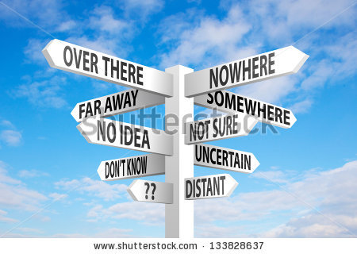
Autism Awareness
Restricted, repetitive patterns of behaviour, interests, or activities
A difficulty with imagination, doesn’t necessarily mean that the person lacks imagination or cannot think creatively. Some people with autism are very creative, and are accomplished artists, musicians, and designers. However, interests can sometimes be quite narrow and specific, and to the exclusion of other interests or activities.
Difficulties with imagination (also called flexibility of thinking) can also result in a difficulty predicting situations, considering possible outcomes and solving problems.
People with autism can find it difficult to :
predict what might happen next, prepare for change, plan for the future, cope with new or unfamiliar situations. This can mean that people with autism appear rigid in their thinking patterns over issues that a ‘neurotypical’ person (i.e. someone without autism) could think is trivial or insignificant.

Slide 13
Autism Awareness
Quiz
Which of the statements below relate to social differences
Lack imagination
May not understand jokes or sarcasm
Can appear to lack empathy
Find it easy to adapt to new situations
Can be highly creative
Are immune to mental health difficulties

Slide 14
Autism Awareness
Quiz Feedback
May not understand jokes or sarcasm - Does Apply: – Many people with autism have a literal understanding of verbal communication and find it difficult to understand non literal aspects of communication although some autistic people learn this and use it.
Can Appear to lack empathy - Does Apply: - Often it can appear that the person lacks empathy, but usually the person hasn’t realised that they may have made a social mistake, and can be upset if this is explained to them.
Can be highly creative - Does Apply:– Many people with autism are very creative and can be very accomplished writers, artists, and musicians.
Lack imagination - Does Not Apply:– People with autism can have good imagination, although their interests may be restricted.
Find it easy to adapt to new situations - Does Not Apply: – Many people with autism dislike change and have a preference for keeping to routines
Are immune to mental health difficulties - Does Not Apply:–Autism does not protect the individual from mental health issues, and in fact, some people with autism may be more vulnerable to mental health problems such as anxiety and depression.

Slide 15
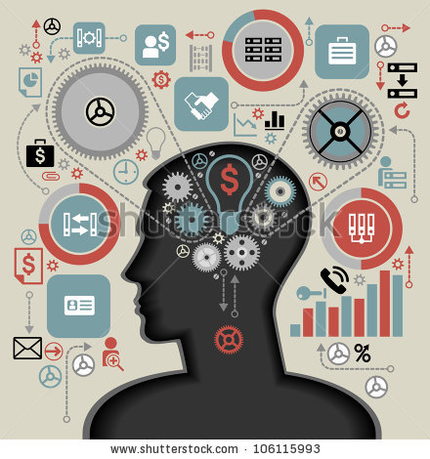
Autism Awareness
Cognitive Differences
The core differences of autism identified are often thought to be caused by underlying cognitive (i.e. thinking, processing, understanding) differences in the way people with autism view the world.
These Cognitive differences can include
Lacking theory of mind
Weak central coherence
Difficulties with executive function

Slide 16
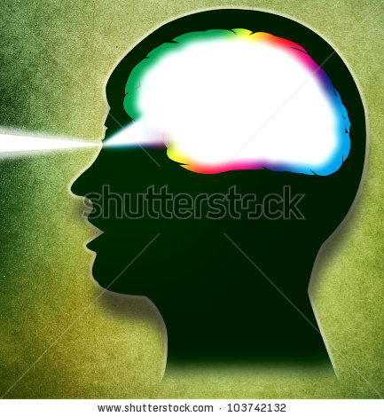
Autism Awareness
Theory of Mind
Autistic individuals often have difficulty understanding that other people have thoughts, beliefs and feelings and that these may be different to their own. Consequently, it can be difficult for the autistic person to make sense of another person’s behaviour. They are unable to ‘mind read’ the social situation. This is referred to as lacking ‘theory of mind’.
Typically developing children are able to understand this concept from around the age of 4 years. However, many people with autism are never able to understand this, even if they are intellectually able.
Some autistic people may learn how to work out non-autistic people’s thoughts, feelings and beliefs, but it can be effortful.

Slide 17

Consequences of a theory of mind deficit:
Autism Awareness
The social world may seem incomprehensible and unpredictable
Difficulty understanding what others may be thinking or feeling – leading to an impact on developing relationships
Appearing to lack empathy and may seem self absorbed or inconsiderate of others
Difficulty picking up on nonverbal social cues – impacting on interaction with others
Predispose to a literal interpretation of language (if you can’t imagine people having thoughts and feelings, their words appear as facts rather than opinions) - this can lead to social confusion
Lacking theory of mind also impacts on the person’s ability to recognise and understand their own emotions

Slide 18

Weak Central Coherence
Autism Awareness
Central coherence relates to the ability to process information and construct it within a given context. Autistic people have been found to have a strong ability to attend to minor details, and to see parts over wholes.
Weak central coherence is often the reason people with autism get stuck on details, can take language literally, may be perceived as ‘pedantic’, and find it harder to link information together into a meaningful whole.

Slide 19


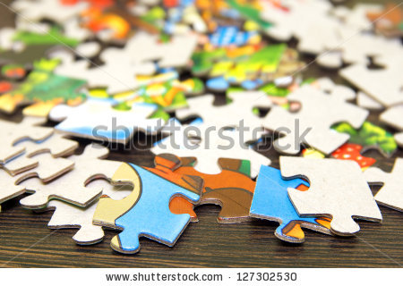
Executive Functioning
Autism Awareness
Executive functioning refers to high level cognitive tasks.
The executive functions are located in the frontal lobe of the brain. These are responsible for activities such as: Planning, Sequencing, Prioritising, Organising, Initiating tasks and activities, Inhibiting, Self monitoring activity and behaviour, Emotional control, Completing tasks.
Many autistic people can have significant difficulties with their executive functioning, even if they are very intelligent. This can impact on all aspects of daily life, including their ability to manage at home and work. For example people on the spectrum may be disorganised, forget appointments, lose track of time, find ordering of tasks very difficult, get overwhelmed and lose track of information easily, act impulsively, not know when a task is finished.
Notes:
Resposible for:
Goal
Plan
Sequence
Prioritise
Organise
Initiate
Inhibit
Pace
Shift
self-monitor,
emotional control
completing.
Cake:
Making a cake:
Choosing which one – setting goal
Planning when, what ingredients, utensils
Doing the activity – initiate activity, plan, sequence, organise, completing
Inhibiting response – eating all of pre coked cake mixture, not eating cake when on diet – automatic response conflicts with internal plan – EF engaged to inhibit response.

Slide 20
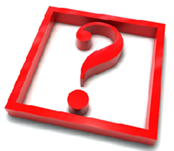
Autism Awareness
Cognitive Differences Quiz
Do people with autism have difficulties understanding other peoples thoughts, feelings and beliefs?
Are people with autism good at putting pieces of information together?
Are people with autism good at organising themselves?

Slide 21

Autism Awareness
Cognitive Differences Quiz
Do people with autism have difficulties understanding other peoples thoughts, feelings and beliefs?
Are people with autism good at putting pieces of information together?
Are people with autism good at organising themselves?
Answers
Yes some autistic people do have difficulties with this, leading to confusion during social interaction.
No – many autistic people struggle putting pieces of information together leading to confusion and increased anxiety
No – many autistic people find it difficult to organise themselves.

Slide 22


Autism Awareness
Vision
Sense of “vision" in short, is simply beams of light bouncing off an object and into your eye which then sends messages to the brain to interpret an image.
"Hyper" and “hypo" sensitivity of the visual sense could be:
Hypersensitive - avoiding bright lights and sunlight, looking down most of the time or finding focusing on particular detail (e.g. sand grains) more pleasurable than looking at something as a whole
Hyposensitive - seeing things darker than they are. If the person enters an unfamiliar room, they may have to walk around it touching everything before settling down.

Slide 23


Autism Awareness
Hearing
Sense of “hearing" involves the auditory nerve carrying vibratory noise messages from 25,000 receptors in your ear to your brain. The brain then makes sense of the messages and tells you what sounds you are hearing.
"Hyper" and “hypo" sensitivity of the hearing sense could be:
Hypersensitive - making repetitive noises to block out disturbing sounds, being unable to screen out sounds, finding unpredictable sounds frightening (e.g. telephone ringing, baby crying, people coughing), hearing sounds that others filter out, being able to hear conversations that are less audible to others
Hyposensitive - leaning their ear against electric equipment, creating sounds to stimulate their hearing e.g. loud clapping or shouting, not responding to others’ requests.

Slide 24


Autism Awareness
Touch
Sense of “touch" is found all over your body and works on receptors sending messages to your brain.
"Hyper" and “hypo" sensitivity of the sense of touch could be:
Hypersensitive - a dislike of having anything on hands or feet, difficulties in brushing and washing hair, only liking certain types of clothing or textures, not able to tolerate brushing of teeth. Touch, even a very light touch, can be painful and uncomfortable, and will cause people to withdraw from aspects of touch.
Hyposensitive - enjoying heavy objects on top of them, holding others tightly, having high pain threshold - temperature/pain and self harming behaviours.

Slide 25


Autism Awareness
Smell
Sense of "smell" - the receptors that sense smells are called olfactory receptors. They occupy a stamp-sized area in the roof of your nasal cavity, the hollow space inside your nose. You are able to detect thousands of different smells.
"Hyper" and “hypo" sensitivity to the sense of smell could be:
Hypersensitive - finding smells intensified and overpowering, feeling physically sick when smelling certain odours, difficulties using shared or public toilets, finding perfume or toiletries on others repellent.
Hyposensitive - eating anything regardless of how it smells, failing to notice extreme smells (e.g. food gone off. Some people may lick things to explore the object.

Slide 26


Autism Awareness
Balance
Balance (vestibular) – our vestibular gives us information about where our body is in space. It tells us whether we or the surrounding area are moving, as well as speed and direction. The vestibular is activated by movement of the head.
"Hyper" and “hypo" sensitivity balance could be:
Hypersensitive - expressing fear and anxiety of having their feet leave the ground. Being poor at sports.
Hyposensitive - enjoyment in rocking back and forth, or moving in circles while rocking their body. Seeking and enjoying all sorts of movement.

Slide 27

Autism Awareness
Body Awareness
Body awareness (proprioception)
The brain gathers information from our wide range of senses and then processes this information in order to compare it with a virtual body map, or body schema, stored in our memory.
For example:
May not be aware of how much has been eaten.
May not have an awareness of needing to go to the toilet.
Lots of people with autism seek ‘deep pressure’ – as this has a calming effect on the nervous system.

Slide 28
Autism Awareness
Sensory Differences Quiz
Which of the statements below are hypersensitive and which are hyposensitive?
Keeps being woken in the night by noisy neighbours
Doesn’t brush her teeth
Breaks ankle but does not report it
Patient / service user is found using sour milk
He plays music very loud
She closes the curtains throughout the day

Slide 29
Autism Awareness
Sensory Differences – Quiz Feedback
Keeps being woken in the night by neighbours - Hyper - This could be due to hypersensitivity to noise as even slight noises may wake them up
Doesn’t brush her teeth – Hyper - Even having the toothbrush in her mouth may be too much to tolerate. Not brushing teeth is a classic sign of being over sensitive to the feel of the brush or toothpaste in the mouth.
She closes the curtains throughout the day – Hyper - This suggests an over sensitivity to light that others would find pleasing and natural. If someone displays this problem in one area of their life, there is a good chance you will see it in other aspects of their life too.
Breaks ankle but doesn’t report it as a problem – Hypo - Some autistic people don’t register pain or sensations as strongly as other people, and it can result in them not noticing pain, or cold weather for example. Others are hyper-sensitive and feel pain at the lightest of touches.
She is found using off milk – Hypo - If their sense of taste and/or smell is less sensitive (hypo) then they may not notice tastes or smells that others would. They must be hypo (under) sensitive to taste or smell and not be noticing the sourness/bitterness.
He plays music very loud – Hypo - If he is not registering sounds as loudly, he may have to turn them up to really notice and appreciate them. If he was hyper-sensitive, he might have to have it lower volume, as it would sound too loud or even painful otherwise.

Slide 30
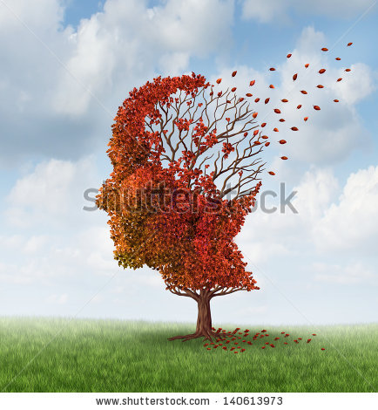
Autism Awareness
Autism and Mental Health
Adults on the autism spectrum appear to have increased vulnerability to mental health difficulties (Ghaziuddin, 2005). Difficulties with communication and social interaction can result in increased stress and development of mental health problems. Often adults with autism have fewer social ‘buffers’ to help them to manage life stressors (Groden, 2006)
Due to difficulties with communication, autistic people often find it difficult not only to identify their distress, but to communicate it to others (Howlin, 2004). Presentation of mental health difficulties may be different for adults with autism compared to others in the general population.
Common signs to look out for include:
Increased social withdrawal
Increased obsessionality
Increased perseveration (talking on and on about the same subject, repeating questions)
Changes in social behaviour (such as placing increasing demands on services: police, A&E, GP surgeries, walk-in clinics, social care offices, helplines etc.)
Increased self harm and suicidal ideation / catastrophic thinking.

Slide 31
Autism Awareness
Common Mental Health conditions
Depression
Anxiety
Sleep Difficulties
Eating Disorders
Substance Misuse
Adults on the autism spectrum can experience all kinds of mental health difficulties. They can be most vulnerable to anxiety and depression in particular, and it is important to be aware of changes in presentation which may indicate these. It is also important to be aware of sleep difficulties in autism, and vulnerability to conditions such as substance misuse and eating disorders (which may be related to undiagnosed autism).

Slide 32
Autism Awareness
Common Mental Health conditions
Depression
Anxiety
Sleep Difficulties
Eating Disorders
Substance Misuse
  Depression is the most common co-occurring mental health condition for adults on the autism spectrum. This can be related to awareness of being different from other people, difficulties developing and maintaining social and intimate relationships, due to a history of harassment or bullying.
  Other causes can include under stimulation, lack of opportunity to engage in activities of interest, social isolation, lack of routine and predictability in life.
  The presentation of depression in a person with autism might be quite different to that of other people. This can make the identification of depression in a person with autism difficult. Often vocal tones can be low and flat typically so it is difficult to detect a change in their speech (Tantam, 1991). The person may not usually display a range of facial expressions, so a reduction in these can be difficult to notice. If the individual typically does not interact with other people on a regular basis, social withdrawal can also be difficult to identify.
  It is important to understand what is usual for the person, in order to identify whether there has been a change in their presentation.

Slide 33
Autism Awareness
Common Mental Health conditions
Depression
Anxiety
Sleep Difficulties
Eating Disorders
Substance Misuse
  Many autistic people experience high levels of anxiety and stress. Anxiety can be triggered by trying to understand non-autistic social communication and manage social situations.
  Anxiety can also be caused by changes in routines, new people, and new situations, or confusing and inconsistent information. If a person is not able to engage in routines, rituals, interests or activities which usually help them to cope, this can also be a source of stress (Ghaziuddin, 2005).
  It is important to recognise any strategies the autistic person may have to manage their stress and anxiety, such as their routines and activities. However, this does not mean that routines need to remain the same at all costs. In the world we live in change is inevitable. However, adjustments often need to be made to accommodate the person enough to reduce their anxiety to a manageable level.
  It is important to try to help the person develop the skills to cope with change.

Slide 34
Autism Awareness
Common Mental Health conditions
Depression
Anxiety
Sleep Difficulties
Eating Disorders
Substance Misuse
  Sleep difficulties are common for people on the autism spectrum. This can include difficulties settling to sleep, night time waking, and difficulties waking in the morning. Circadian rhythms can often be out of synch, with the person staying up until the early hours of the morning, and sleeping well into the next day.
  For some people this is deliberate as they find it easier to be up late at night when there are fewer social demands and less sensory stimulation, such as external noise. Some individuals with autism do not appear to need very much sleep.
  There are currently no NICE guidelines for the treatment of insomnia, so symptoms should be treated according to NICE guidelines for depression or the guidance on use of hypnotics for insomnia.

Slide 35
Autism Awareness
Common Mental Health conditions
Depression
Anxiety
Sleep Difficulties
Eating Disorders
Substance Misuse
Many individuals with autism eat only specific foods, and have rituals related to eating such as eating at specific times, using specific crockery and cutlery. This is part of their autism.
However, some people with autism do develop eating disorders, including anorexia and bulimia. Though certainly not all men and women with an eating disorder have autism, where there are other indicators for autism, such as difficulties with communication and interaction, it is useful to consider whether the eating disorder may be indicative of autism.
There is increasing evidence that a significant proportion of women receiving eating disorder services, particularly so-called “treatment resistant” anorexia nervosa, show signs of having Asperger’s syndrome (Wentz, 2005).

Slide 36
Autism Awareness
Common Mental Health conditions
Depression
Anxiety
Sleep Difficulties
Eating Disorders
Substance Misuse
  Some people on the autism spectrum will misuse substances. Common substances include cannabis, alcohol, prescription drugs, amphetamines, and solvents. Some individuals with autism appear to be more vulnerable to misusing substances Hofvander et al. (2009).
  Reasons for substance misuse in autistic adults include:
    Coping with mental health problems
    To increase social confidence
    A way to interact with other people
    To dampen sensory overload
    To ‘block out’ difficult emotion
    A misunderstanding of social norms (e.g. drinking alone in a pub).

Slide 37

Autism Awareness
Identification of autism
Autism can be diagnosed in early childhood. Early intervention has found to be invaluable in the management and self-management of autism. Symptoms can often be identified from around 3 years of age when social and communication skills typically develop.
However, for many, characteristics of autism are not identified or considered until much later in life. People have been diagnosed in their 60’s, 70’s and 80’s even.
Many adults remain undiagnosed, but adult diagnosis is on the increase due to media coverage and increased public awareness.

Slide 38

Some red flags for autism
Autism Awareness
Takes what is said too literally (misses humour, irony, and sarcasm)
Speaks in an unusual tone of voice, or with an unusual rhythm or pitch, or copies speech (echolalia)
Unusual eye contact (too little, too much, indirect such as focusing on people’s cheeks)
Doesn’t pick up on other people’s facial expressions, tone of voice, and gestures
Preoccupation with a narrow topic of interest
Follows a rigid routine or has difficulty adapting to changes in routine or environment
Reacts unusually to sights, smells, textures, and sounds. May be especially sensitive to loud noises.

Slide 39
Autism Awareness
Red Flags Continued
Uses facial expressions that don't match what they are saying
Makes very few gestures (such as pointing)
Differences in reciprocal communication often characterised by either passivity in communication or overbearing manner
Excessive anxiety, often seemingly unresponsive to reassurance or consolation
Unusual attachments to objects such as childhood toys, or unusual items such as sink plugs or stones
Unusual posture, clumsiness, or eccentric ways of moving (e.g. walking exclusively on tiptoe)
Obsessively lines things up or arranges them in a certain order
Repeats the same actions or movements over and over again, such as flapping hands, rocking, or twirling
Repeats the same words or phrases over and over (echolalia)
Refers to themselves in the third person

Slide 40
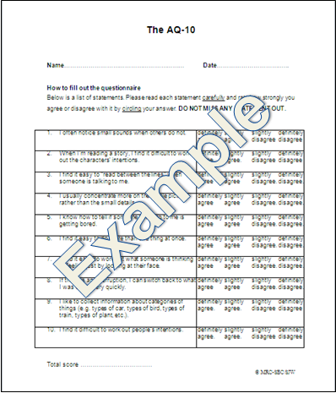
Autism Awareness
Diagnosing autism
Identifying and diagnosing autism is often important for the individual and others in their lives. This can help them to understand why they are the way they are, and to access appropriate support.
Diagnosing autism in adults can be complex, particularly where there are additional mental health issues which may mask or mimic characteristics of autism.
Where autism is suspected, it can be useful to complete a screening assessment. The NICE guideline for autism recommends the AQ-10 (Allison et al., 2011) which is available freely online.
Screening alone is not sufficient to diagnose an adult with autism. Diagnostic assessment should be undertaken by a clinician trained in the diagnosis of autism. Where possible, this should include a developmental history, observation of the individual and assessment of the core characteristics of autism.

Slide 41

Autism Awareness
Supporting a person on the autism spectrum
It is important to consider how having autism can affect the individual you are supporting and how this might impact on the way you give that support.
Key things to remember when supporting a person on the autism spectrum
Verbal communication
Nonverbal communication
Environment
Use of Touch
Predictability and Routines
Emotions

Slide 42
Autism Awareness
Key things to remember when supporting a person on the autism spectrum:
Verbal communication - Keep verbal communication as clear as possible as autistic people can be very literal and may not understand your humour, or indirect comments
Nonverbal communication – Be mindful of how you use non-verbal communication as the person may not always make sense of it
Environment – consider potential sensory overload such as noise and bright lights. These can increase anxiety and make it harder for the person to engage in communication
Use of Touch – there are times when it may be necessary to touch the autistic person. At these times give the person some warning that you are going to touch them, and where you are going to touch them.
Predictability and Routines – change can be inevitable so it is important to consider when and how you communicate change with the autistic person, give them time to process this change, and think with them ways they can cope with the change
Emotions - People with autism can find it difficult to empathise with the feelings of others. It can be helpful to explain an elicited emotion to the person, rather than relying on their ability to read nonverbal clues. Equally, people with autism can find it difficult to identify and label their own emotions, and this needs to be taken into consideration when giving emotional support to the person.

Slide 43
Autism Awareness
Summary
Autism is a lifelong neurodevelopmental condition
Autism can affect individuals of all ability levels
More men than women are currently diagnosed
The core areas of impairment are:
    social communication
    social interaction
    social imagination
Autistic people also often display rigidity in their interests and routines
Sensory difficulties are common
People on the spectrum can be susceptible to mental health problems, particularly anxiety and depression
Autism is often diagnosed in childhood, but many adults remain undiagnosed
Diagnosis can help the person make sense of their own behaviour and can usefully inform treatment.

Slide 44
Autism Awareness
Further Reading and Support
Further Information
Further Information, including a list of policies, guidelines and useful websites can be found under the “web resources” part of slide 46.
Support
We have provided a list of local contacts to link you to the support you may need. This is also available on slide 46.
Thank you for taking the time to complete the course and we would ask you to please fill in the evaluation form on the next slide.

Slide 45
Autism Awareness
Feedback
Thank you for taking the time to complete this e learning
What follows is a feedback form. As originally stated, this is entirely optional but we would appreciate it if you would take the time to complete it. We would like to ensure that all professional groups in Nottinghamshire access this training course as a first step towards becoming knowledgeable about autism so we are particularly interested in what professional group you come from and whether or not you think this training has been useful to you. It would also be useful for you to tell us how you heard about the course and any suggestions you may have on how we can improve it.
If you are interested in receiving more information about the work that Nottinghamshire County Council or Nottingham City Council is doing with regard to Autistic Spectrum Disorders please let us know on the feedback form and we will keep you up to date of any opportunities which arise.
https://www.surveymonkey.co.uk/r/autism-evaluation

Slide 46
Trust Internet
Adult Neurodevelopmental Services
http://www.nottinghamshirehealthcare.nhs.uk/our-services/local-services/specialist-services/neurodevelopmental-services/adult-neurodevelopmental-services/?locale=en
Nottingham City Asperger Service
http://www.nottinghamshirehealthcare.nhs.uk/our-services/local-services/specialist-services/neurodevelopmental-services/adult-neurodevelopmental-services/nottingham-city-asperger-service/
Web Sites (External)
National Autistic Society
http://www.autism.org.uk/
NICE Guideline: Autism: recognition, referral, diagnosis and management of adults on the autism spectrum (GC142; 2012)
http://publications.nice.org.uk/autism-recognition-referral-diagnosis-and-management-of-adults-on-the-autism-spectrum-cg142
Fulfilling and rewarding lives: the strategy for adults with autism in England
https://www.gov.uk/government/uploads/system/uploads/attachment_data/file/216129/dh_122908.pdf
http://videohigh.learningpool.com/f9d73676bc76870adb91bb6279d39d90_mp4
Training evaluation and feedback
Survey
https://www.surveymonkey.co.uk/r/autism-evaluation

Slide 47
References
Allison, C., Auyeung, B. & Baron-Cohen, S. (2011). Toward Brief “Red Flags” for Autism Screening: The Short Autism Spectrum Quotient and the Short Quantitative Checklist in 1,000 Cases and 3,000 Controls. Journal of the American Academy of Child & Adolescent Psychiatry, 51 (2), 202-212
Archer, N. & Hurley, E.A. (2013): A justice system Failing the Autistic Community”. Journal of Intellectual Disabilities & Offending Behaviour, 4, No. 1/ 2, 53-59
Baird, G., Simonoff, E., Pickles, A., et al. (2006). . Prevalence of disorders of the autism spectrum in a population cohort of children in South Thames: the Special Needs and Autism Project (SNAP). The Lancet, 368, 210–215.
Brugha et al., (2011). Epidemiology of Autism Spectrum Disorders in Adults in the Community in England. Arch Gen Psychiatry. 68(5), 459-465
Chaplin, E. McCarthy, J. &Underwood, (2013). Autistic Spectrum Conditions and Offending: An introduction to the special edition. Journal of Intellectual Disabilities and Offending Behaviour, 4,/1/2, 5-8
Ghaziuddin, M. (2005). Mental Health Aspects of Autism and Asperger syndrome. London: JKP
Baron, G., Groden, J., Groden, G. & Lipsitt, L.P. (2006). Stress and Coping in Autism. New York: OUP
Hofvander, B. et al., (2009). Psychiatric and psychosocial problems in adults with normal-intelligence autism spectrum disorders. BMC Psychiatry, 9 (35), 984-989
Howlin, P. (2004). Autism and Asperger syndrome. Preparing for adulthood. London: Routledge
Wentz,E., Lacey J.J., Waller, G., Rastram, M., Turk, J. & Gillberg, C. (2005). Childhood onset neuropsychiatric disorders in adult eating disorder patients. European Child and Adolescent Psychiatry 14 (8), 431-437

