Slide 1





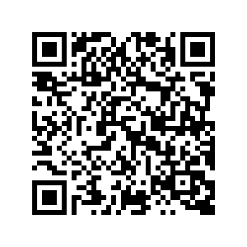
Helping build strong relationships between parents/carers and their baby
Healthy Little Minds work with mums, dads and primary caregivers in Nottingham City from pregnancy up to the age of 2
You can self refer at
www.asklion.co.uk/healthylittleminds
or scan our QR code

Slide 2
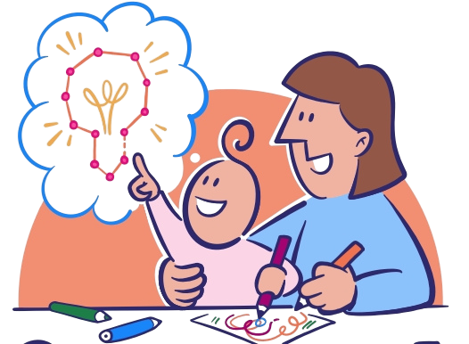
Healthy Little Minds is here for you and your baby...
Parenting can feel overwhelming, we offer a safe space to talk through challenges and build confidence.
Together, we’ll focus on your strengths and find the best ways to support your baby’s healthy development.
You can self refer at
www.asklion.co.uk/healthylittleminds
or scan our QR code

