Slide 1
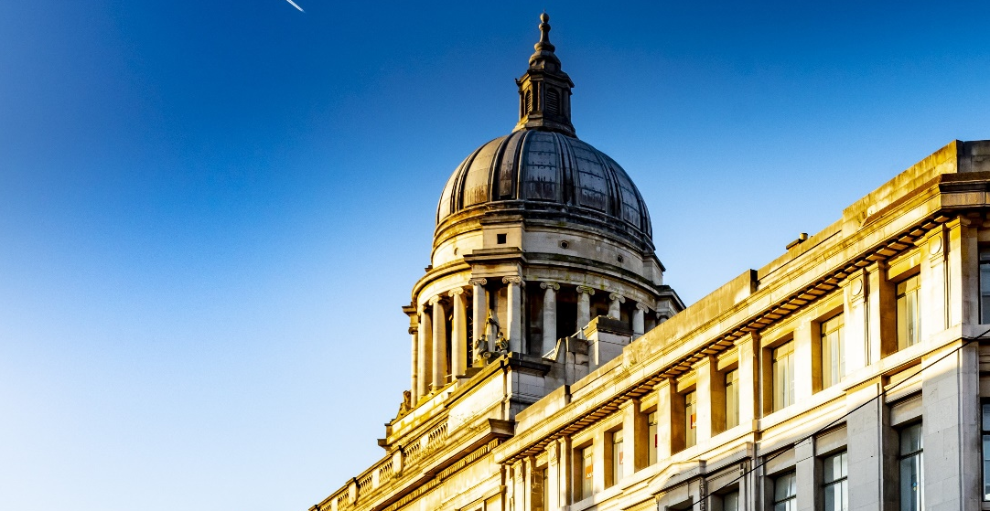

Nottingham City Council
Budget Consultation 2025/26

Slide 2
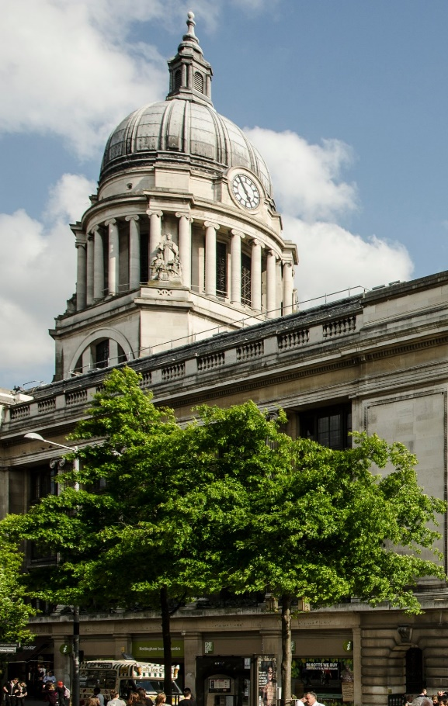
Our budget for 2025/26
This year’s budget is about getting our house in order and putting the Council on a sustainable financial footing.
We have been honest about the financial challenges we have faced, and we will continue to be open with you.

Slide 3
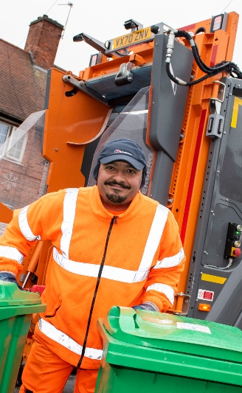
Our vision
A renewed council that delivers for local people and leads Nottingham forward.
A council that gets the basics right and delivers the best local services we can afford.
A council that is ambitious for the future and helps our city reaches its full potential.

Slide 4
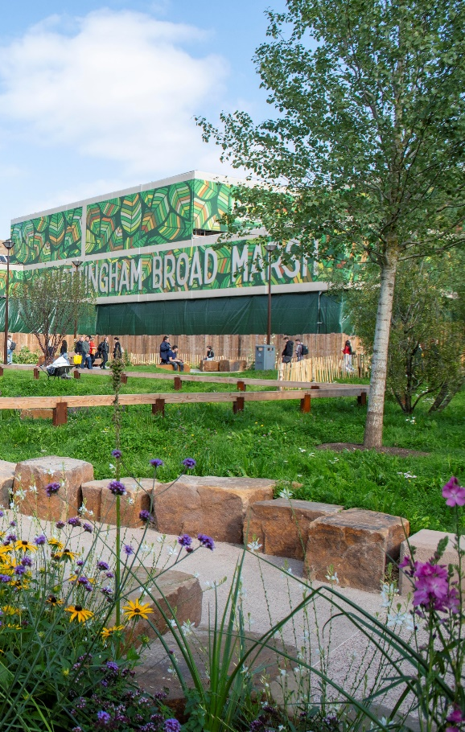
Our pledges
We will use our resources better to meet people's needs more effectively.
We will work with our citizens and our partners to make sure the council is the best it can be.

Slide 5
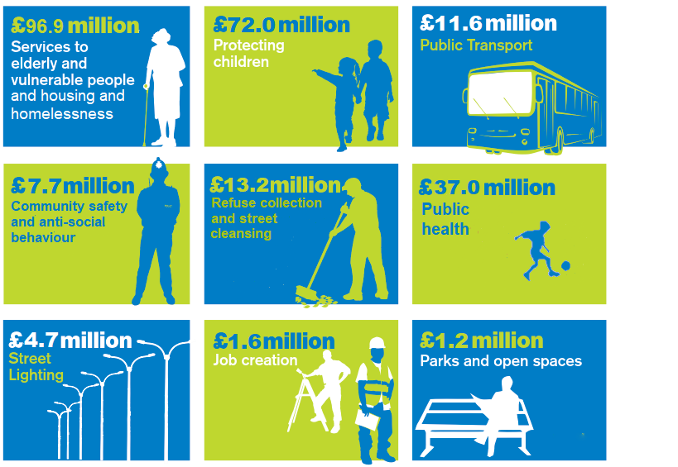
How we spend our money
The Council spends around £245 million of its annual revenue on services.

Slide 6
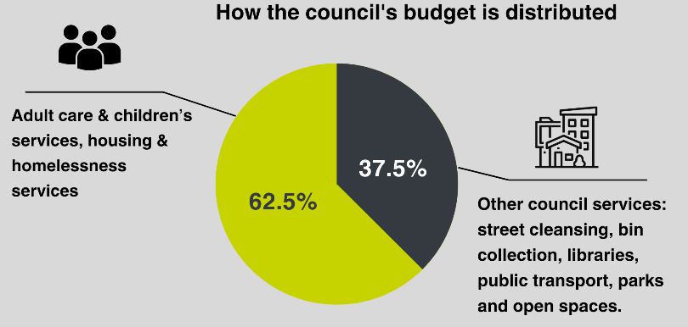
Pressures we face
The demand for vital services in Nottingham has never been greater while, like all households, we must also deal with rising costs.
We spend nearly two-thirds our budget looking after older people, protecting children and helping people who are homeless.

Slide 7
Budget proposals
There are 20 proposals, totalling £17.91m next year and £24.19m over four years.
We are consulting the public on six savings proposals totalling £10.78m next year.
There are a further 14 proposals totalling £7.12m in the first year. These proposals have been deemed not for public consultation because they are about internal processes.

Slide 8
Budget proposals for consultation (1)
DIGITAL RESIDENT EXPERIENCE Proposed saving = £29,000
Improving digital access through development of the website and digital forms, shifting demand to more efficient service delivery.
FIT-FOR-PURPOSE TECHNOLOGY Proposed saving = £100,000
Conduct a council-wide IT review to rationalise applications, systems, licenses, and subscriptions, ensuring business continuity and cost savings.
CONSOLIDATING SPANS, LAYERS & FUNCTIONS Proposed saving = £4.009m
Reduce costs and improve efficiency by streamlining layers of management and team sizes.

Slide 9
Budget proposals for consultation (2)
IMPROVING PRODUCTIVITY & PERFORMANCE Proposed saving = £1.222m
Effective management of vacant posts through an initiative to manage vacancies more prudently.
STRENGTHENING WORKFORCE MANAGEMENT Proposed saving = £4.928m
Improve productivity and manage staffing budgets by reducing sickness rates and enhancing performance management.
REDUCING THIRD PARTY SPEND Proposed saving = £500,000
Introduce commercial expertise to reduce third-party spending and improve procurement processes.

Slide 10
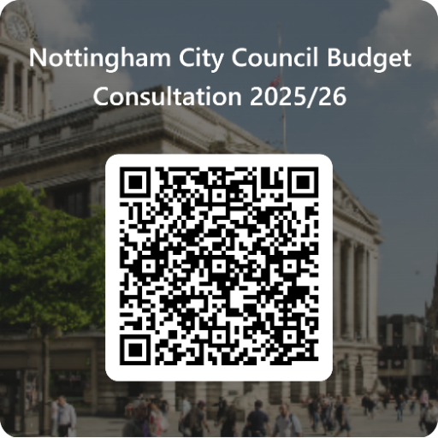
Next steps
The budget consultation takes place until 13th January.
The draft Budget and Medium-Term Financial Plan will be considered by the council’s Executive Board in January and February 2025.
www.nottinghamcity.gov.uk/engage-nottingham-hub

Slide 11
Other engagement events
Voluntary & Community sector organisations
8th January 12:30pm to 1:30pm. Hybrid on MS Teams & at Loxley House
Businesses & Partners event
8th January 2025 - 2pm until 3pm. Online on MS Teams
Public engagement event
8th January 2025 - 6pm until 7pm. Online on MS Teams
Disability Involvement Group & deaf and hearing-impaired citizens
9th January 2025 - 3pm until 4pm. Hybrid on MS Teams & at Loxley House
Joining instructions and links on the budget survey webpage

