Slide 1

Prevent Awareness Training
Early Years Education
Louise Cox - Prevent Education Officer
Nottingham City Council

Slide 2
Aim of the session today
To provide DSL’s information with regards to the Prevent Duty and their responsibilities as outlined in KCSIE 2023
To provide an update on the local risk picture as per the 2024 CTLP
To provide an update on any other extremist groups or activity that may impact young people

Slide 3
What we will cover
Refresh our knowledge about what prevent is, what it aims to achieve and why the need for it
The Prevent Duty and Early Years
Local context/Key messages
Vulnerabilities/Signs a child is at risk
Channel
NOTICE, CHECK and SHARE
What do if concerned
NOTE some content may seem school relevant

Slide 4
THE PREVENT DUTY GUIDANCE
Implementing the Prevent Duty within an Early Years Framework
203 -The Education Inspection Framework sets out how Ofsted inspects maintained schools, academies, non-association independent schools, further education and skills provision, and registered early years settings in England. Ofsted’s current inspection framework for early years provision reflects the requirements in the early years foundation stage statutory framework. ISI’s inspection framework sets out how it inspects independent schools in England, including residential (boarding) schools and registered early years settings.
Children and young people continue to make up a significant proportion of Channel cases, and in recent years there have been concerns regarding increased numbers of learners being arrested for terrorism-related offences.
Settings should not only be alert to violent extremism but also non-violent extremism, including certain divisive or intolerant narratives which can reasonably be linked to terrorism. Educate Against Hate and GOV.UK Prevent duty training provide further information on extremist narratives.37, 38

Slide 5
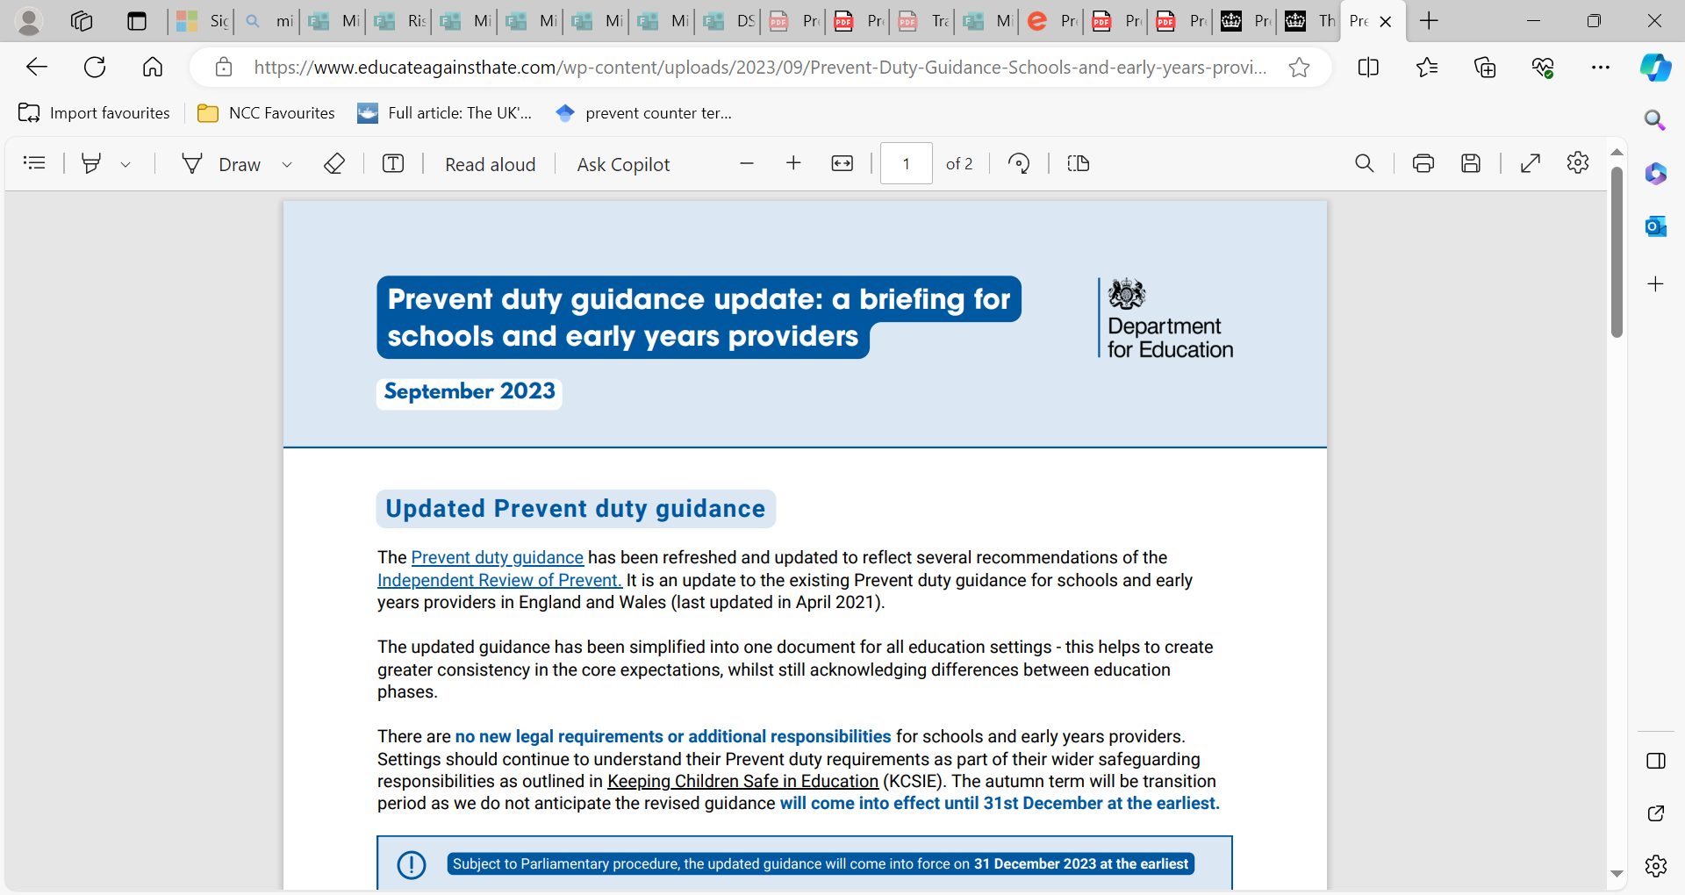
Prevent Duty Stakeholder Pack
CLICK LINK HERE: Prevent Duty Guidance - Schools and early years providers final2 (educateagainsthate.com)
Compliance with the Prevent duty reflects existing good practice on safeguarding. It will ensure susceptibility to radicalisation is incorporated into safeguarding training, policies and risk assessments.

Slide 6
Prevent Duty – What does it look like in practice?
Clear procedures in place for protecting children at risk of radicalisation: does not require a separate risk assessment but should be built into existing policies and procedures
Do those risk assessments accurately reflect and account for the local risk and 2023 Contest priorities
Working in partnership with Nottingham Safeguarding Children’s Partnership , local authorities, the police and others in the community, including parents
Appropriate staff training including general Prevent awareness, WRAP, and when and how to refer to Channel
DSL – must be trained in Prevent and able to advise staff
IT- procedures for access to online material covered in policies, appropriate filters.

Slide 7
PREVENT OBJECTIVES
Early intervention to tackle the causes of radicalisation and respond to the ideological challenge of terrorism.
To safeguard and support those most at risk of radicalisation through early intervention, identifying them and offering support to divert them away.
To enable those who have already engaged in terrorism to disengage and rehabilitate.
Working online and offline to empower communities and individuals.
There are falsehoods and misconceptions around PREVENT being spread by people with ill intentions – it is important to reiterate that it is safeguarding.

Slide 8
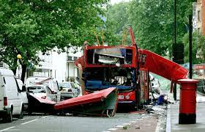
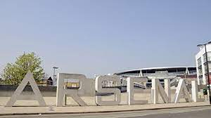
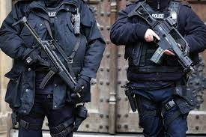
PREVENT
CONTEST is the name of the UKs Counter Terrorism Strategy and is the UK’s response to terrorism.
CONTEST Strategic Framework consists of four work strands which are known within the Counter Terrorism community as ‘the four P’s’:
PREVENT
PURSUE
PROTECT
PREPARE
The aim of CONTEST is to reduce the risk of terrorism to the UK (and overseas) and its citizens so that people can go about and live their lives freely and with confidence. #
Counter-Terrorism & Security Act 2015, Counter-Terrorism & Security Act 2015, Prevent Statutory Duty “requires all education providers ‘to help prevent the risk of people becoming terrorists or supporting terrorism’. The guidance introduces a new theme - ‘Reducing Permissive Environments’ to tackle the ideological causes of terrorism. For schools and early years, this includes the existing considerations of building resilience through the curriculum and having effective IT and visiting speaker policies to reduce exposure to radicalising influences. The Prevent duty: an introduction for those with safeguarding responsibilities - GOV.UK (www.gov.uk)

Slide 9
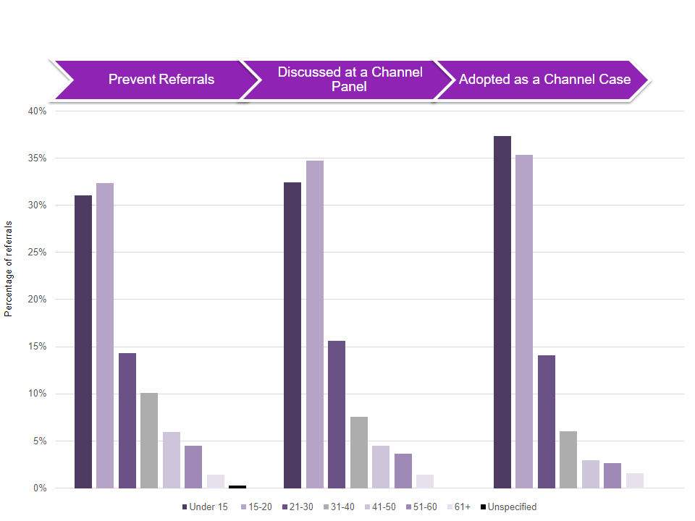
NATIONAL STATISTICS - Year ending March 2023
In the year ending 31 March 2023, individuals aged 15 to 20 accounted for the largest proportion of the 6,796 referrals to Prevent (2,203; 32%)
Under 14 accounted for the second largest proportion of referrals (2,119; 31%)
88% Male

Slide 10
The Counter Terrorism Local Priorities for 2023 in Nottinghamshire are:
• AQ/ISIS Inspired Terrorism
• Extreme Right Wing Terrorism
• Online Extremism
• Self-Initiated Terrorists (S-ITs)
Prevent referrals have increased by 27% on the previous year.
The age group with the highest rates of referrals are individuals aged 12-16 (37% of total referrals)
The highest proportion of referrals originate from the Education/Police Sectors
45% online predominant methodology of those INVESTIGATED- Children can be exposed to extremist material associated with terrorist groups & can share with peers

Slide 11
















The online space
Extremists and radicalisers use ALL forms of social media, and they cater for everyone. They use popular topics to attract YP to their content which often links to extremist content
We teach children and young people about online safety, but do WE know enough ourselves? What socials are they using? How familiar are we with their workings?
Parent engagement?
Instagram is the most popular news source among young people and is now used as the main news source by 29 percent of teens, with TikTok and YouTube close behind on 28 percent
Two things that platforms such as GAB and 8Kun have in common…Anonymity and zero accountability! Essentially NO censorship – Also presence of Incel movement
Use of these platforms is not illegal but should be considered in context when there is a concern
Gaming spaces can be problematic- first person shooter games immersive and realistic. A good spaces for individuals to find common ground with YP. Convenient for creating and sharing propaganda (flames of war video)

Slide 12
Vulnerabilities/Susceptibility not exhaustive list
(Referrals – context is key)
Struggling with a sense of identity and belonging
Becoming distanced from their cultural or religious background
Questioning their place in society
Family issues/Family Breakdown/Bereavement
Adverse Childhood Experiences-Experiencing a traumatic event
Difficulty in interacting socially and lack of empathy
Difficulty in understanding the consequences of their actions
Mental Health/Special Educational Needs/Learning difficulties
Low self esteem
Period of transition/confusion
Misinterpretation of religion
Isolation
Anger
sense of injustice
Anger at government policies- Both Nationally and Internationally
Notes:
No one journey is the same!!
Important not to make automatic linkages between vulnerabilities and extremism
This is why NOTICE CHECK SHARE is Important! Look at bigger picture
Important to notice how the vulnerabilities that could lead to radicalisation are very similar/the same as vulnerabilities that lead to CSE/County Lines/CCE etc….Again, this is why the bigger picture and NOTICE CHECK SHARE is so important!!

Slide 13
‘Push’ and ‘Pull’ factors
What causes an individual to be radicalised
Push factors are the vulnerabilities that push someone away from mainstream society, protective factors, things they enjoyed doing or people they enjoyed spending time with etc
Pull factors are the things that make engaging with an extremist group or individual appealing or worthwhile for the vulnerable person
Groups and individuals will usually offer someone ‘an answer to their problems’ or a ‘solution’ to the things making them vulnerable-pulling them towards an extreme narrative or ideology

Slide 14

What signs might we see to indicate a younger child is being influenced?
Behaviour – Has the child’s behaviour deteriorated with no apparent explanation? May not always be radicalisation/extremist influences, perhaps is another safeguarding issue
Role Play – Have you noticed the child acting out violent/inappropriate behaviour at playtimes?
Vocabulary – Different/inappropriate language used towards other children or staff.
Talking positively about dangerous groups or people who promote hate, or make it seem like these groups are OK
Tolerance – Has the child expressed intolerant views or behaviour towards other children? Refusing to talk to people from a certain country or who have a different sexuality or belief
Being rude, aggressive or violent towards a particular group of people, for example, Jewish, Muslim or gay people
Pieces of Writing or drawings that give you cause for concern

Slide 15
And remember, its not always just the children who are vulnerable…….
New to an area/Country
Domestic violence
Financial hardship
Housing issues
Language barriers
Unemployment
Alone without support

Slide 16
What should I do if I am concerned?
NOTICE, CHECK, SHARE
Speak to the child you are worried about
Share this information with your DSL or a manager
Speak to the Prevent team, if necessary
Follow it up! Trust your instinct
Record Accurately
Set up a time and space to talk
  Try to find a time when you can speak to the person in a private, safe place, free from interruptions.
Ask open questions not leading
  How are you getting on at the setting?
  How are things at home?
  How are you finding your exercise group?
Explain why you’re asking.
NOTE: It is good practice to be open and transparent with parent/carers UNLESS it adds risk.

Slide 17

WHAT HAPPENS IF REFER?
Referral is assessed for information gathering
Channel support not needed: might be signposted to other
forms of support
Channel support needed: setting may be invited to attend Channel panel
Agencies include: Probation/prisons
Health
YOS
Mental Health
Local authorities
Social Services
Parental consent needed if under 18 (BY CHANNEL)
Channel support:
Does NOT lead to a criminal record
It is NOT disclosed on a DBS
It’s about getting the right help at the right time
Monthly Channel meetings assess progress with interventions

Slide 18
Prevent Continuum
Equalities legislation and mainstream Police activity
Suitable for Channel
Police-led space
Prejudice and intolerance
Hate Crime
Interest in violent extremism
Engagement with violent ideologies
Deeply radical beliefs in violence as a solution
Encouraging or inspiring acts of terror
Committing acts of terror
Criminality - Pursue
There is not a “conveyor belt” towards terrorism, but Prevent should be used for those susceptible to a CT risk

Slide 19
Ofsted specify that
75. Early education funding regulations in England have been amended to ensure that providers who fail to promote the fundamental British values of democracy, the rule of law, individual liberty and mutual respect and tolerance for those with different faiths and beliefs do not receive funding from local authorities for the free early years entitlement.
76. Ofsted’s current inspection framework for early years provision reflects the requirements in the Statutory Framework for the Early Years Foundation Stage.
Notes:
This is what the Ofsed say.

Slide 20
Reducing Permissive Environments
175 - Settings should have measures in place to prevent their facilities being exploited by radicalisers. This includes seeking to ensure that any event spaces or IT equipment are not being used to facilitate the spread of extremist narratives which encourage people into participating in or supporting terrorism. Such measures will help to limit access to platforms that can be used to radicalise others.

Slide 21
What does building resilience look like in your setting?
Consider what you do to promote children's resilience against unhealthy influences – keep in mind FBVs
How do you promote an understanding of difference?
Are these values embedded in your setting?
Think about the things you do to create a strong foundation – these all go towards building resilience and making them well equipped human beings who are less likely to use violence towards those who are different or disagree with them!
Think outside the box – its not just the obvious stuff!
How could you improve?

Slide 22

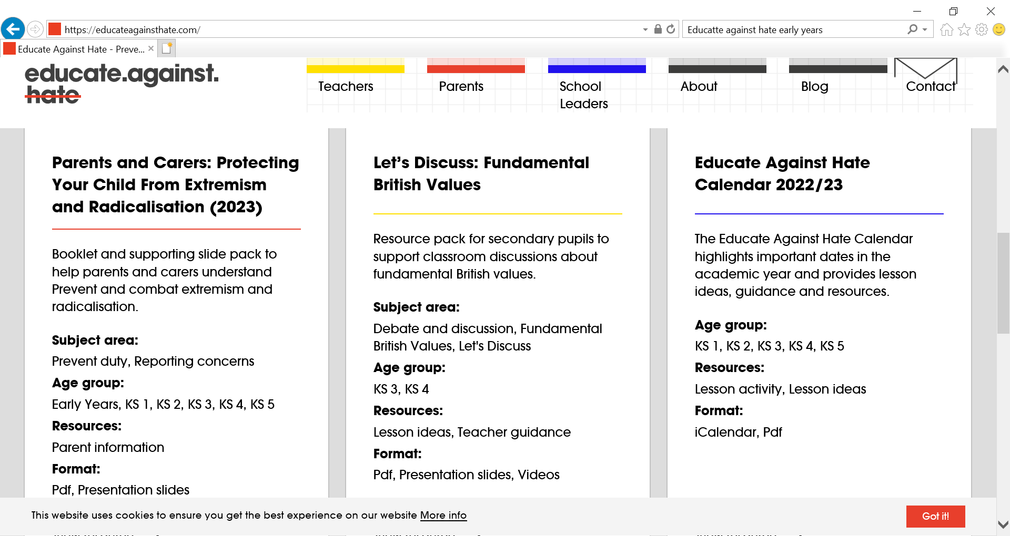
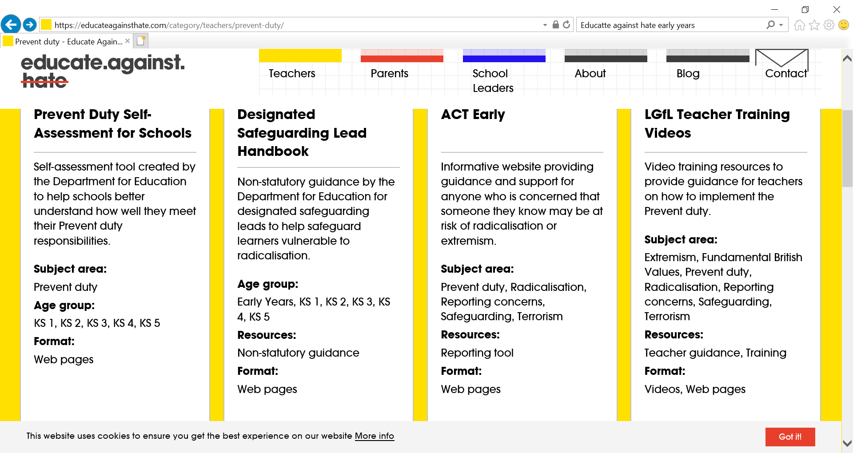
What does this look like in Practice?

Slide 23

Democracy
Children have the opportunity to have their voices heard through setting Council, circle times, class discussions and questionnaires.
Pupils are encouraged to share their thoughts and opinions whilst understanding the importance of allowing others to have their say.
Developing their ability to work and play co-operatively and fairly together
Understanding and respecting the democratic process and the importance of taking part

Slide 24

Rule of Law
Children are continuously taught the importance of making the right choices in relation to their behaviour both in and out of the classroom.
Distinguishing right from wrong and encouraging them to take responsibility for their behaviour
High expectations which are reinforced through class codes of conduct, Golden Rules, assemblies, PSHE and home-school agreements.
Rewards and sanctions systems are clear and embedded across the setting. Children are taught right from wrong and the importance of honesty and taking responsibility for their actions.
Visits from authorities such as the Fire Service help to reinforce the message that laws/rules are there to protect us and that there are consequences when laws are broken

Slide 25

Individual liberty
Children are actively encouraged to make choices, knowing that they are in a safe and supportive environment.
Throughout the curriculum and during structured PSHE sessions, opportunities given for all children to develop an understanding of their rights and freedom to make choices, whilst respecting the choices of others.
Children being encouraged to think for themselves and take ownership of their learning.
Enabling children to develop their self knowledge, self esteem and self confidence
Distinguishing right from wrong and encouraging them to take responsibility for their behaviour

Slide 26


Mutual respect and tolerance for those with different faiths and beliefs
Children are encouraged to recognise, accept and respect cultural diversity through assemblies, PSHE sessions and RE curriculum.
Having an understanding and tolerance of different faiths and beliefs outside their own communities
Different faiths and beliefs within the wider community celebrated through theme days and circle times, where children have the opportunity to develop their understanding of “difference”.

Slide 27
To consider…
What have you done in your setting to evidence to Ofsted the Prevent agenda and British Values has been embedded into practice?

Slide 28
Group exercise
You notice a four-year-old boy playing with another boy and he enacts a scene where he makes the boy kneel down and slides his hand across the boy’s throat. You have also noticed that the boy is becoming more violent and aggressive during play times with other children. He refuses to play with any child that does not share his cultural background.
What behaviours concern you and what would you do?

Slide 29
CONTACT FOR SUPPORT IN CONFIDENCE:
Louise Cox – Prevent Education Officer, Nottingham City Council
Louise.cox@nottinghamcity.gov.uk
Police Prevent Team: Referral form - police website :
Refer someone to the Prevent Team | Nottinghamshire Police
For confidential advice: email prevent@nottinghamshire.pnn.police.uk or call 101 ext. 800 2963/2965 or ask to speak to the Prevent Team.
If you have a concern about an adult you can speak advice/refer/
National Police Prevent advice line 0800 011 3764, in confidence. The line is open 9-5pm daily.
Report Extremism in Education - Start

Slide 30
Who else can help?
Prevent Coordinator
Prevent@nottinghamcity.gov.uk
Home Office Prevent Online Prevent Duty Training
What Prevent is | Prevent duty training (support-people-vulnerable-to-radicalisation.service.gov.uk)
Homepage - UK Safer Internet Centre – Helping children and young people stay safe online
ACT Early | Prevent radicalisation
short info videos and contacts
Information, Advice and Support to Keep Children Safe Online (internetmatters.org) (advice for parents)
Going Too Far? (lgfl.org.uk
Tackling Hate Crime and Inequalities - Communities Inc- Hate Crime Training & Bystander Awareness
The National Holocaust Centre and Museum The National Holocaust Centre and Museum
Tackling misogyny and violence toward women https://equation.org.uk

Slide 31
TO SUMMARISE
Notice, Check, Share
Follow local Safeguarding procedure- ‘Notice, Check, Share’
Speak with DSL and share information, checking the settings systems for previous incidents of note
Look at the situation in context and at the whole picture
A holistic overview of the young person’s behaviour, attendance, performance and past incidents should all be considered
Speak to child and Speak to the parents (unless risk of harm)
Would you refer? If unsure consider conversation with PEO or Police- ultimately though, the decision to refer is made by the DSL
“All professionals should make sure their approach is child-centred. This means that they should consider, at all times, what is in the best interests of the child.”

