Slide 1

Safer Sleeping
Guidance for practitioners
Self-Directed Learning Session

Slide 2
Introduction
This is a self-directed learning session which you can work through at your own pace
In this self-directed learning session you will learn about:
  what guidance to give carers to ensure they are putting babies to sleep safely
  Sudden Infant Death Syndrome (SIDS)
  the risk factors for SIDS
Please complete this self-directed learning session and then use the ‘Safer Sleeping – risk assessment tool for practitioners’ when working with families. It can be found here - www.nottinghamcity.gov.uk/children-and-families/safeguarding-children-board/inter-agency-procedures-and-practice-guidance/
This session has been developed in line with the guidance from the Lullaby Trust - https://www.lullabytrust.org.uk/

Slide 3
Terminology
The Lullaby Trust provides expert advice on safer sleep for babies, emotional support for bereaved families and raises awareness of Sudden Infant Death Syndrome (SIDS). They state that –
‘Sudden Infant Death’ is the term used to describe the sudden and unexpected death of a baby where no cause is found. While SIDS is rare, it can still happen and there are steps parents can take to help reduce the chance of this tragedy occurring.
The usual medical term is ‘Sudden Unexpected Death in Infancy’ (SUDI) or Sudden Unexpected Death in Childhood (SUDC), if the baby was over 12 months old.
Some sudden and unexpected deaths can be explained by the post-mortem examination revealing, for example, an unforeseen infection or metabolic disorder. Deaths that remain unexplained after the post mortem are usually registered as ‘Sudden Infant Death Syndrome’ (SIDS) or SUDC in a child over 12 months. Sometimes other terms such as SUDI or ‘unascertained’ may be used.
‘Cot death’ was a term commonly used in the past to describe the sudden and unexpected death of an infant. It has largely been abandoned, due to its misleading suggestions that sudden infant death can only occur when a baby is asleep in their own cot, which we know to be untrue.

Slide 4
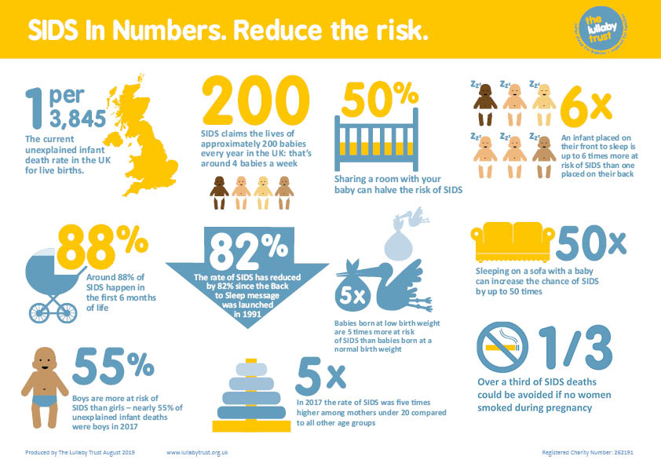
National statistics

Slide 5
Nottinghamshire
In Nottinghamshire there are, on average, 6 deaths each year of babies (up to 15 months old) where an unsafe sleep environment may have been a factor. These deaths are potentially preventable.
Safe sleep advice is given out to all new parents in pregnancy and the first few days and weeks of a baby’s life by universal health services.
To prevent further deaths we need everyone working with families in Nottinghamshire to help ensure safe sleep advice is followed.

Slide 6
Nottinghamshire
A review of the deaths in Nottinghamshire over the last 6 years has identified these key characteristics/risk factors of Sudden Unexpected Infant Deaths where unsafe sleeping was a factor:
maternal smoking in pregnancy (74% of deaths)
mental ill health (46% of deaths)
substance misuse (35% of deaths)
alcohol misuse (24% of deaths)
young mother under 20 (11% of deaths)

Slide 7
Nottinghamshire
(continued)
Smoking in the household (67% of deaths)
domestic violence (46% of deaths)
co-sleeping (35% of deaths)
unsafe sleep environment e.g. position, sofa, cluttered cot, excess covers (65% of deaths)
low birth weight (<2.5kg) (30% of deaths)
premature (26% of deaths)
These mostly mirror the national evidence about who is most at risk.

Slide 8
There is no advice that guarantees the prevention of Sudden Infant Death Sydrome or Sudden Unexpected Death in Childhood, but parents should be informed that, by following the safer sleep advice, it is possible to significantly lower the chance of this tragedy occurring.

Slide 9
Quick Tips on Safer Sleep
Always place your baby on their back to sleep
Keep your baby smoke free during pregnancy and after birth
Place your baby to sleep in a separate cot or Moses basket in the same room as you for the first 6 months
Breastfeed your baby, if you can
Use a firm, flat, waterproof mattress in good condition
Never sleep on a sofa or in an armchair with your baby
Avoid letting your baby get too hot
Avoid co-sleeping with your baby
Some parents choose to share a bed (also known as co-sleeping) with their babies. It is important for you to know that there are some circumstances in which bed-sharing with your baby can be very dangerous: if you
  Smoke
  Have drunk alcohol
  Have taken drugs
  Are extremely tired
  Your baby was born prematurely
  Your baby was of low birth-weight
Don’t cover your baby’s face or head while sleeping or use loose bedding
To avoid accidents remove all pillows, soft bedding, cot bumpers, sleep positioners, pods and soft toys from the cot.

Slide 10
Advice on Safer Sleep
The Lullaby Trust have written a handy guides on safer sleep – one for professionals and one for parents and carers.
  Safer Sleep for babies: a Guide for Parents
  Safer Sleep: Saving Babies Lives a Guide for Professionals
Both guides can be downloaded from this page - https://www.lullabytrust.org.uk/professionals/publications/
There are also leaflets on Safer Sleeping written in over 20 languages, available from the same web page

Slide 11
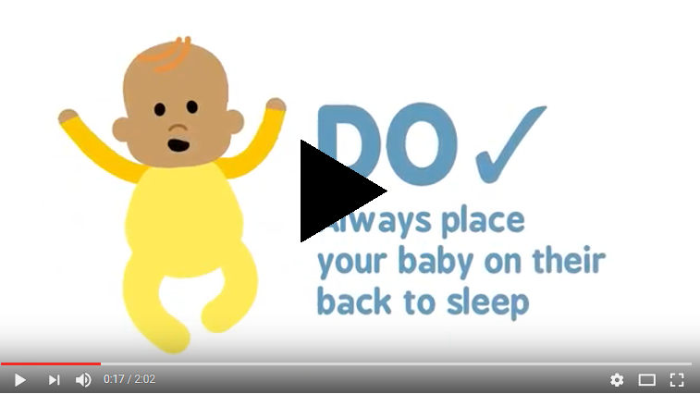
Working with Families
https://youtu.be/NO2vbtjNk2c
The Lullaby Trust have made a 2-minute video animation to present safe sleeping advice
It is a useful resource for watching with parents and carers to ensure they know, and are following, the safer sleeping advice for every sleep

Slide 12
Working with Families
When asking carers about how they put their baby to sleep, it is worth acknowledging that this is a difficult subject because you are questioning how safely they care for their child. However, it is better to have a difficult conversation now, and to promote safer sleeping, and to potentially reduce incidences of SIDS occurring
Every contact is an opportunity to promote safer sleeping
Be curious about who cares for the baby at different times – remember that every sleep needs to be a safe sleep so whoever looks after the baby needs to know and follow the safer sleep guidance

Slide 13
Young Parents
Nationally, in 2017, the risk of SIDS was 5 times higher in babies born to younger parents under the age of 20 than those born to parents aged 20+
Young parents can access advice and support at https://littlelullaby.org.uk/

Slide 14
Safer Sleeping – risk assessment tool for practitioners
Now that you understand the risk factors for SIDS and the advice to give carers on safer sleep, you can start using the ‘Safer Sleeping – risk assessment tool for practitioners’, which can be found here –
https://www.nottinghamcity.gov.uk/information-for-residents/children-and-families/nottingham-city-safeguarding-children-board/inter-agency-procedures-and-practice-guidance/
The tool has information on safer sleep, and an assessment triangle which you complete to ascertain if there are any risk factors present within the family that could impact on safe sleep. It also contains information on what to do next if you do identify risk factors

Slide 15
Remember, every sleep needs to be a safe sleep – whether baby is napping or sleeping:
  at night or during the day,
  at home or away from home (staying with grandparents, Dad, friends, babysitters),
  when your baby is unwell
They are safer in their cot

Slide 16
Lullaby Trust
The Lullaby Trust has lots of information and resources on safe sleeping – you can find out more by visiting: www.lullabytrust.org.uk
This includes resources in over 20 languages
Their resources include the following, which can be downloaded from https://www.lullabytrust.org.uk/professionals/publications/
  Safer Sleep for babies: a Guide for Parents
  Safer Sleep: Saving Babies Lives a Guide for Professionals
  Safer Sleep Advice for Premature Babies booklet
  Easy read card on safer sleep
  Many more besides, which you can use when working with families…

Slide 17
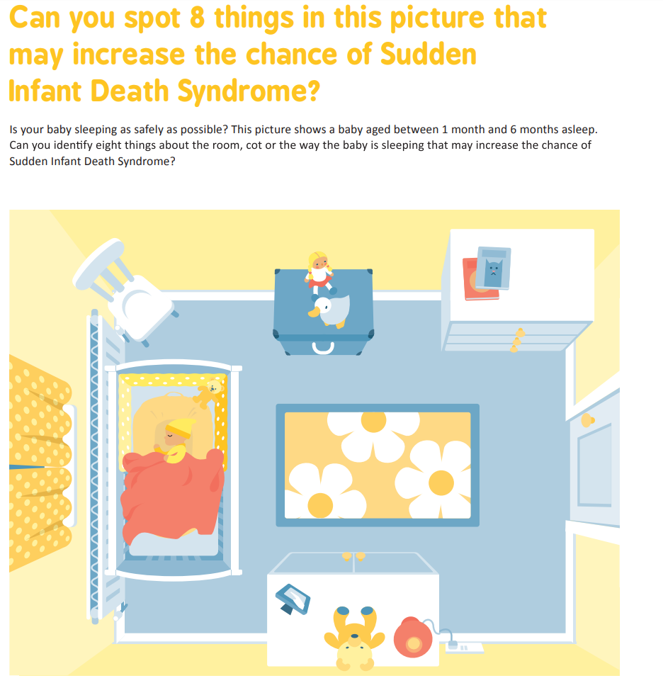
Test your knowledge
Answers on the following slide…

Slide 18
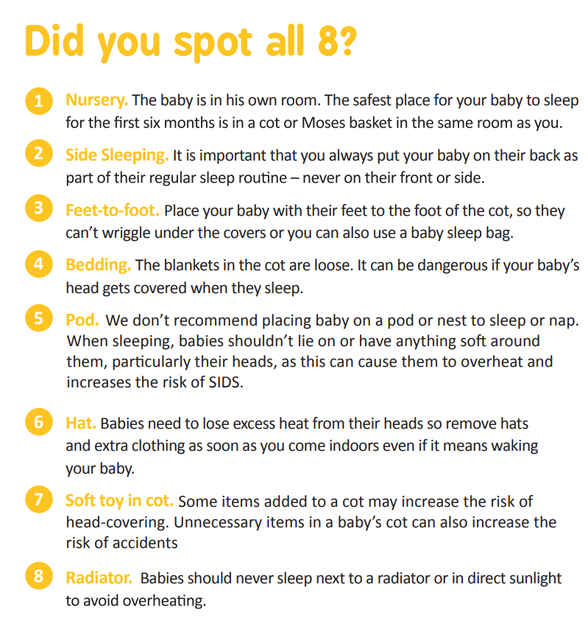
Please note this Spot the Risk game was taken from the Lullaby Trust website - https://www.lullabytrust.org.uk/wp-content/uploads/game-spot-risk.pdf

Slide 19
True or False?
1. In winter babies should wear a hat to go to sleep because it is cold.
True
False
2. If you think parents and carers will get upset about you asking how they put their baby to sleep, do not ask them.
True
False
3. Babies should be put to sleep on their backs.
True
False
4. Babies born to parents under 20 years old are less at risk of Sudden Infant Death Syndrome
True
False
5. You should not sleep in the same bed as your baby if you have drunk alcohol or taken drugs
True
False
6. It is safe to sleep or have a nap on a sofa with your baby
True
False
7. It is fine to put a cuddly toy in the cot with a baby to comfort them.
True
False
8. If grandparents only infrequently look after the baby then it doesn’t matter as much how they put the baby to sleep
True
False
Answers on next slide…

Slide 20
Answers
1. In winter babies should wear a hat to go to sleep because it is cold.
This is false – babies do not need to wear hats indoors and there is a risk that they will get too hot.
2. If you think parents and carers will get upset about you asking how they put their baby to sleep, do not ask them.
This is false. Every contact with parents and carers is an opportunity to discuss safer sleep and ensure that every sleep is a safe sleep. It may be difficult to have the conversation but following safer sleep guidance significantly lower the chance of SIDS occurring so we must talk to parents and carers about it.
3. Babies should be put to sleep on their backs.
This is true. You should always place your baby on their back to sleep and not on their front or side (unless your doctor has advised you of a medical reason to do so). An infant placed on their front to sleep is up to 6 times more at risk of SIDS than one placed on their back.
If a parent finds that their baby has rolled onto their stomach, the baby should be turned onto their back again, but parents should not feel that they have to get up all
night to check. Babies will learn at some point to roll onto their front. When the baby can roll from back to front and back again, on their own, then they can be left to find their own position.

Slide 21
Answers continued…
4. Babies born to parents under 20 years old are less at risk of Sudden Infant Death Syndrome
This is false – the risk of SIDS is 3 times higher in babies born to young parents under the age of 20, than those born to parents aged 20 years and over
5. You should not sleep in the same bed as your baby if you have drunk alcohol or taken drugs
This is true - the risk of SIDS has also been found to be higher where the bed sharer has used alcohol or drugs
6. It is safe to sleep or have a nap on a sofa with your baby
This is false. Sleeping on a sofa with a baby can increase the chance of SIDS by up to 50 times.
7. It is fine to put a cuddly toy in the cot with a baby to comfort them.
This is false. To avoid accidents remove all pillows, soft bedding, cot bumpers and soft toys from the cot.
8. If grandparents only infrequently look after the baby then it doesn’t matter as much how they put the baby to sleep
This is false. Every sleep needs to be a safe sleep – whether baby is sleeping at home or away from home (staying with grandparents, Dad, friends, babysitters) and so all people that care for the baby must follow safer sleep guidance, at night and during the day.

Slide 22
Hopefully you are now feeling more confident in your understanding of safer sleep guidance.
But don’t worry if not….just go back through this self-directed learning session and read the Safer Sleep: Saving Babies Lives a Guide for Professionals (https://www.lullabytrust.org.uk/professionals/publications/ ) until you are more confident

Slide 23
Thank you for completing this self-directed learning session – you can now start using the Safer Sleeping Risk Assessment Tool when you are working with families with babies
If you need any support with using the tool then please ask you line manager for help, or get in touch with the Nottingham City Safeguarding Children Board by calling 0115 876 4762 or emailing safeguarding.partnerships@nottinghamcity.gov.uk

Slide 24

Thank you
If you would like a certificate of completion for your records; please email Jennifer.Burton@nottinghamcity.gov.uk

