Slide 1

Safer Sleep Risk Assessment Tool and resources
Multi agency tool supporting practitioners to help keep babies safe and identify high risk.
The tool supports practitioners to:
Understand safer sleep advice –up to date and consistent messages.
Feel confident to talk to families and share information about safer sleep-as part of core role or when opportunity arises.
Understand risks.
Know when further advice/support should be sought.
Supporting safer sleep as ‘everyone’s business’

Slide 2


What parents tell us
322 parents/caregivers responded to a safer sleep survey spring 2024.
Most (96%) recalled receiving safer sleep advice.
Encouraging discussion around safer sleep
57% felt the advice was clear and they felt able to discuss and ask to ask questions
11% felt advice was clear but didn’t feel encouraged to discuss and ask questions,
28% said the advice was clear but given without any discussion.
Bed sharing/co-sleeping
59% said they their baby sometimes sleep is in an adult bed. 33% of those people said they always make a plan when this happens, 9% said they sometimes make a plan and 18% said they never make a plan.
Of all 322 respondents, 53% said they had a conversation with a health professional to help make an informed choice around bed sharing and hazards to avoid. 46% said they had not had that conversation. 73% felt confident or very confident about bed sharing with the remainder being less confident.

Slide 3
Evidence based approach
“It is vital that professionals understand safe infant sleeping arrangements and give families accurate evidence-based information.
Advice should be tailored to individual family circumstances with an explanation that bed-sharing is only a risk factor when in the presence of other factors such as smoking, alcohol and drug use, but that falling asleep on a sofa or an armchair with a baby is always dangerous.
Almost all parents sometimes fall asleep whilst feeding a baby at night, so even if they do not plan to routinely bed share, parents should be advised how to make their bed safe for the baby if they fall asleep unintentionally”
Professor Peter Fleming University of Bristol (The National Child mortality Database 2021)
Notes:
Emphasis it's the parent’s responsibility to keep babies safe whilst sleeping.
Professionals can support.

Slide 4
The risk assessment tool
Basic safer sleep information and links to up-to-date advice.
Local SIDS statistics and wider research.
Information on how to use the tool.
Risk factors, to help inform your assessment of risk.
Red flags, highlighting areas of greatest concern.
Information and advice for parents-links and QR codes. Can be printed and shared.
Links to threshold of need/pathways to provision for city and county if you have a concern about a child (safer sleep is embedded at all levels in these documents).
Safer sleep plan of care for parents.
Checklist for parents, linked to hazardous co-sleeping.

Slide 5
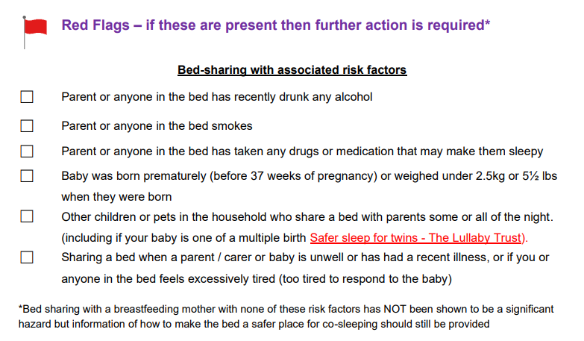
Red Flags

Slide 6
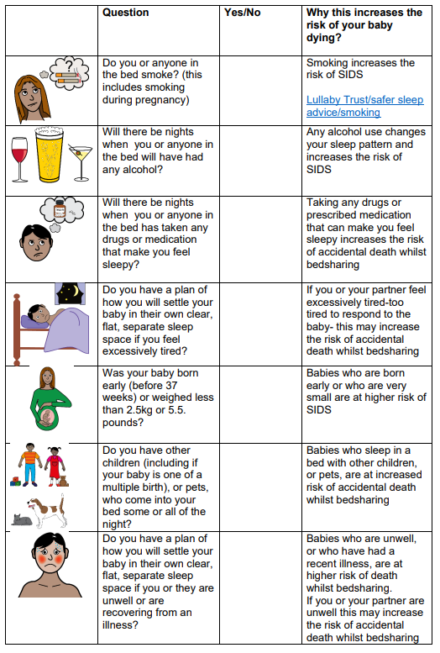
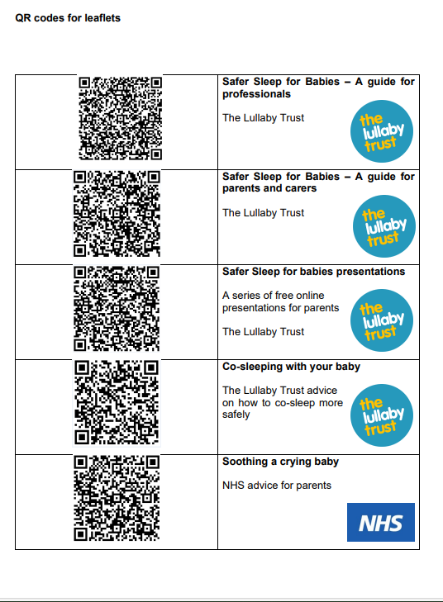

Slide 7
Use of the tool
Inclusion in red book
Embedding in assessment processes
Knowledge and awareness, supporting conversations and referrals
Use of parent tools and information
Notes:
CGL example
All staff trained and aware. Member of staff had moved form a different part of the country and became aware of this for the first time.
CGL able to speak to a da d who was not aware of the advice/information.
Sharing info such as safer sleep week and other comms.
Staff supervision-covered.
Work alongside other agencies, e.g. midwives.

Slide 8
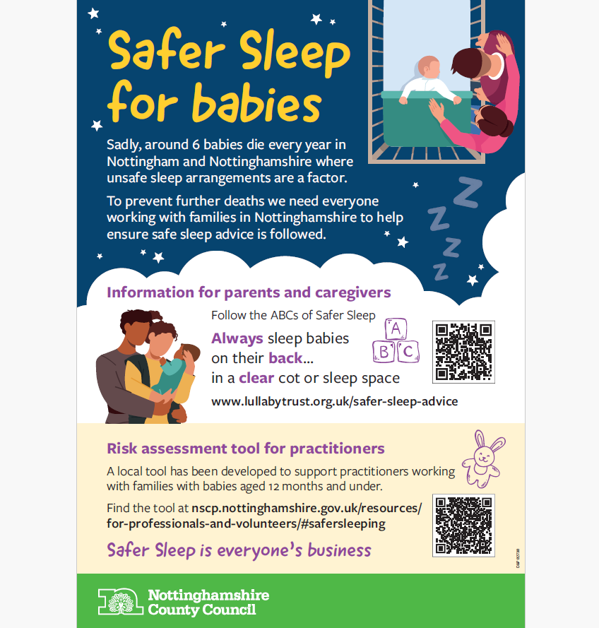
Safer sleep poster

Slide 9
Resources and support for parents
Lullaby Trust website and resources
The Lullaby Trust - Safer sleep for babies, Support for families
Apps-DadPad and Baby Buddy App
how to co-sleep more safely youtube video - Google Search
Notes:
Baby banks and support to obtain suitable equipment. HSF.
Domestic abuse providers and housing support e.g. homelessness support teams.
LT bedtime bundles.

Slide 10
How can you make use of the safer sleep tool?
You
You may notice/overhear something
Initiate non judgemental conversations.
All families and situations are different; encourage discussion about personal circumstances.
Involve dads, partners and wider family.
Ask what parents already know about safer sleep.
Provide links and information about safer sleep.
Your organisation
Where/how can the safer sleep tool be embedded?
Notes:
Different level of roles and responsibilities, e.g. maternity, HVs, early help, community services, families.
Some ‘asks’ e.g. promote the poster? (share image)

Slide 11
Where to find the risk assessment tool
Nottinghamshire safeguarding children partnership website
For professionals and volunteers (nottinghamshire.gov.uk)
Nottingham city safeguarding children partnership website
Safer Sleep - Nottingham City Council

Slide 12
We can all help to make sure that every sleep is a safe sleep
Safer Sleep is everyone's business

