Slide 1


Nottingham Early Help Partnership

Slide 2
Early Help Partnership Steering group
Following an initial Early Help Partnership workshop in March 2023, the Early Help Partnership Steering group was established in June 2023, bringing together services who deliver Early Help services for Nottingham families.
Steering group membership includes:
    Local Authority
    Integrated Care Board & Nottingham University Hospitals
    Education
    Public Health
    Police
    CityCare
    Voluntary and community services
    Housing & Department for Work and Pensions

Slide 3
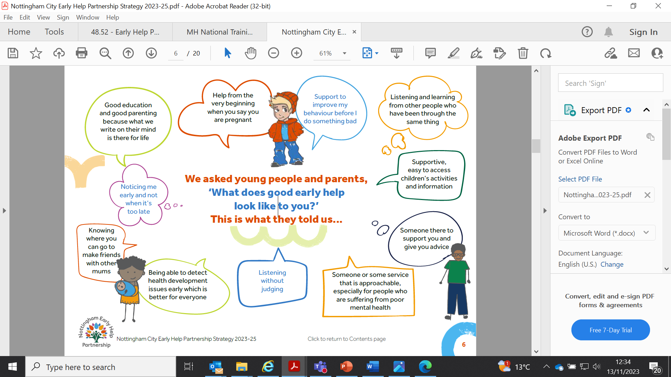
Consultation

Slide 4
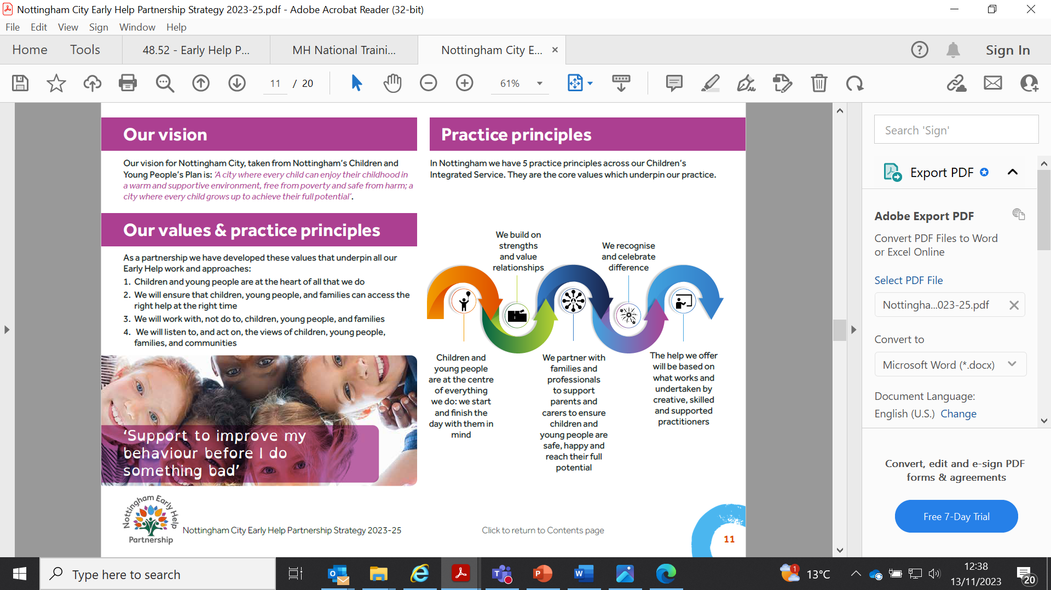
Practice Principles

Slide 5

Early Help Partnership agreed priorities
Priority 1
Embedding a whole system approach to facilitate Early Help being an integral part of a city-wide service
Priority 2
Partnership working
Priority 3
Partnership workforce development and structure
Priority 4
Measure the impact of Early Help
Priority 5
Pool funding and identify sustainability opportunities with the Family Hub and from external funding sources

Slide 6
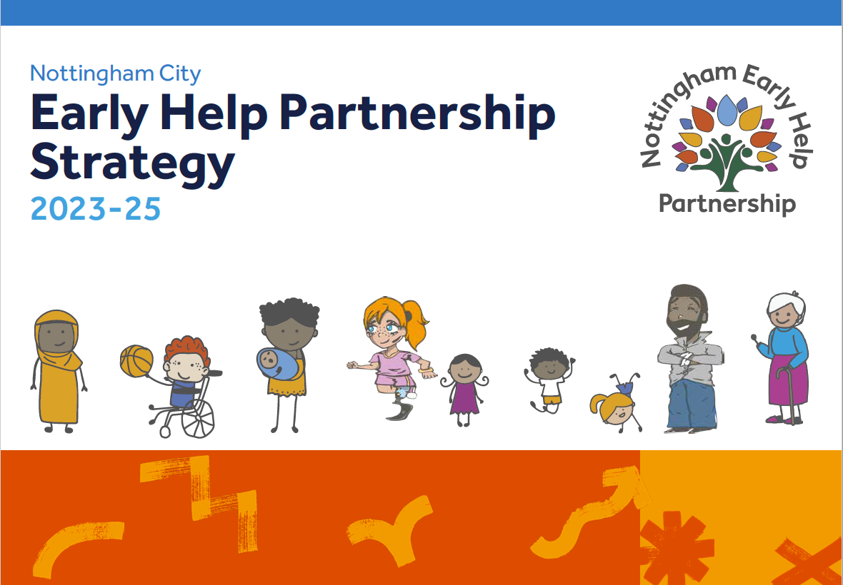
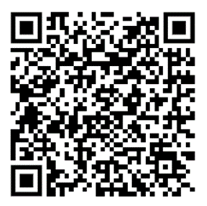
Early Help Partnership Strategy
https://www.earlyhelpnottingham.org.uk/downloads/Nottingham_City_Early_Help_Partnership_Strategy_2023-25.pdf

Slide 7

Family Hubs

Slide 8
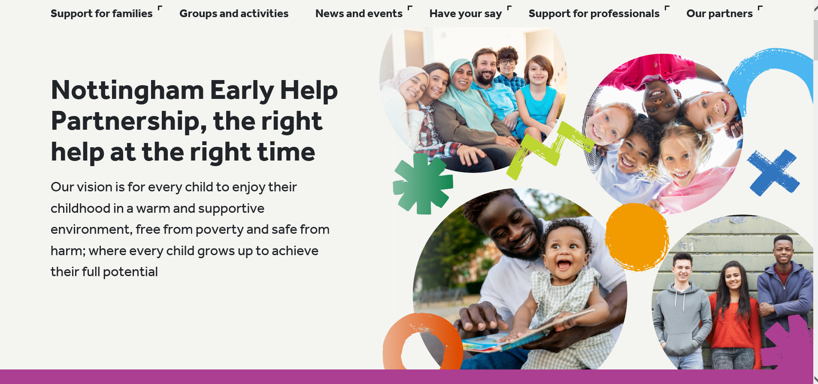
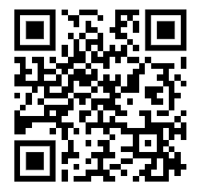
Early Help Partnership website
Family Hubs have funded a website for families and professionals with information, advice, activity details and links for whole family services through the Early Help Partnership that was launched on 30 October 2023
https://www.earlyhelpnottingham.org.uk/#

Slide 9
Family Hub services
Funded services
Start for Life Offer
Infant Feeding
Perinatal Mental Health & Parent Infant Relationships
Parenting Programmes (0-2yrs)
Home Learning Environment
Wider services – new offers
Department for Work and Pensions – weekly drop-ins (Better off calculations, Financial stability and debt advice)
Community Perinatal Mental Health assessment session
Oral Health packs
NSPCC – Pregnancy In Mind & Domestic Abuse Recovering Together– coming soon
Housing Solutions drop ins– coming soon

Slide 10
Early Help Team offer
Family Advice sessions
Family Support
Peep
Triple P Tip Sheets
Triple P Discussion Groups
Triple P 8 week programme
Triple P Stepping Stones
Freedom Programme
Sleeptight
Young Parents Together

Slide 11
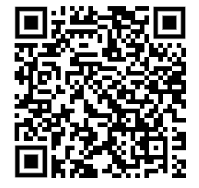
To access any of the Early Help group programmes, families can complete the Self Referral form via the following link or QR code:
https://www.earlyhelpnottingham.org.uk/downloads/Early_Help_Self_Referral_-_Sept._23_.docx
Or they can contact / walk into any of the 4 Family Hubs in Nottingham:
Bestwood Family Hub: Southglade Access Centre, Southglade Road, Bestwood, Nottingham NG5 5GU Telephone 0115 8761890
Broxtowe Family Hub: 18 Strelley Road, Nottingham, NG8 3AP
Telephone 0115 8763888
Hyson Green Family Hub: The Mary Potter Centre, 76 Gregory Boulevard, Nottingham, NG7 5HY Telephone 0115 8838202
Meadows Family Hub: Kirkby Gardens, The Meadows, Nottingham, NG2 2HZ
Telephone 0115 8761320

