Slide 1
National Updates
@NottinghamCSCP

Slide 2
Over the last 12 months there have been many publications which you may find useful and particularly relevant to your role and organisation:
Independent Review of Children’s Social Care (May 2022) Josh MacAlister. Final Report - The Independent Review of Children's Social Care (childrenssocialcare.independent-review.uk)
  This review is the most wide-ranging rethink of children’s social care in more than a generation. The review launched in March 2021. It prioritised hearing the voices of children, young people and adults that have received the help or support of a social worker, or who have been looked after.
Child Protection in England. National review into the murders of Arthur Labinjo-Hughes and Star Hobson (May 2022) Child Safeguarding Practice Review Panel. National review into the murders of Arthur Labinjo-Hughes and Star Hobson - GOV.UK (www.gov.uk)
  This review sets out recommendations and findings for national government and local safeguarding partners to protect children at risk of serious harm. It examines the circumstances leading up to the deaths of Arthur Labinjo-Hughes and Star Hobson and considers whether their murders reflect wider national issues in child protection.
The government published its response to the above 2 reports : Children's social care stable homes built on love consultation (publishing.service.gov.uk) which included a wide-ranging consultation ‘open to all those who receive or provide children’s social care services in England, and those who have an interest in it’. This was open until May 2023. The recommendations from this and the findings from the review/consultation of Working Together to Safeguard Children will inform practice moving forward.

Slide 3
The Independent Inquiry into Child Sexual Abuse (IICSA) 2022. The Independent Inquiry into Child Sexual Abuse | IICSA Independent Inquiry into Child Sexual Abuse
  The Independent Inquiry into Child Sexual Abuse (IICSA) published its final report into child sexual abuse and exploitation in institutions in England and Wales. The report draws on evidence from public hearings, the Inquiry’s research programme and submissions to the ‘Truth Project’ from people who were sexually abused as children.
Keeping Children Safe in Education (KCSIE) DFE,2023. Keeping children safe in education - GOV.UK (www.gov.uk)
  This is the updated statutory guidance for schools and colleges on safeguarding children and safer recruitment, which came into force on 1st September. Some changes include: clarification around the roles and responsibilities of education staff in relation to filtering and monitoring, clarification that being absent, as well as missing, from education can be warning sign of a range of safeguarding concerns, including sexual abuse, sexual exploitation or child criminal exploitation, additional information on online pre-recruitment checks for shortlisted candidates, and information on responding to allegations related to organisations or individuals using school premises.
Learning for the future: Final analysis of serious case reviews 2017-2019. Research In Practice.
2022. Serious Case Reviews | Serious Case Reviews (researchinpractice.org.uk)
  Research in Practice published briefings summarising findings from the Department for Education’s (DfE) triennial and biennial analyses of Serious Case Review reports (1998-2019) in England. It analyses 235 serious case reviews (SCRs) relating to incidents between April 2017 and September 2019. There are separate briefings for: Social Work, Health, Police & Criminal Justice, and Education & Early Help.

Slide 4
The Domestic Abuse Act 2021
  On April 29th, 2021, the Domestic Abuse Bill passed becoming the Domestic Abuse Act. For the first time the DAA recognises children themselves as victims of domestic abuse when they see, hear or experience domestic abuse. Recognising and acknowledging the experience of a child helps to validate that experience.
  New statutory guidance came out July 2022 Domestic Abuse Act 2021 - GOV.UK (www.gov.uk)
Organisations will not be reprimanded for sharing information to protect children and young people at risk, promises ICO
The Information Commissioner’s Office (ICO) has published new guidance to address concerns from organisations and frontline workers that may be scared to share information for fear of falling foul of data protection law. The document offers a 10-step guide on data protection considerations when sharing personal information for child safeguarding purposes.
  A 10 step guide to sharing information to safeguard children | ICO
  ICO guidance is aimed at multiagency professionals feeling anxious about sharing information because they are worried about a child. The evidence base being the national panel report on child protection in England. Think, Check, Share!
Notes:
DAA: The first part deals with the relationship between the abuser and the abused. The second part defines what constitutes abusive behaviour. The definition emphasises that domestic abuse is not just physical or sexual violence, but can also be emotional, coercive or controlling, and economic abuse. It is a framework document designed to support organisations to identify and respond to domestic abuse and promote best practice.

Slide 5
Local Updates

Slide 6
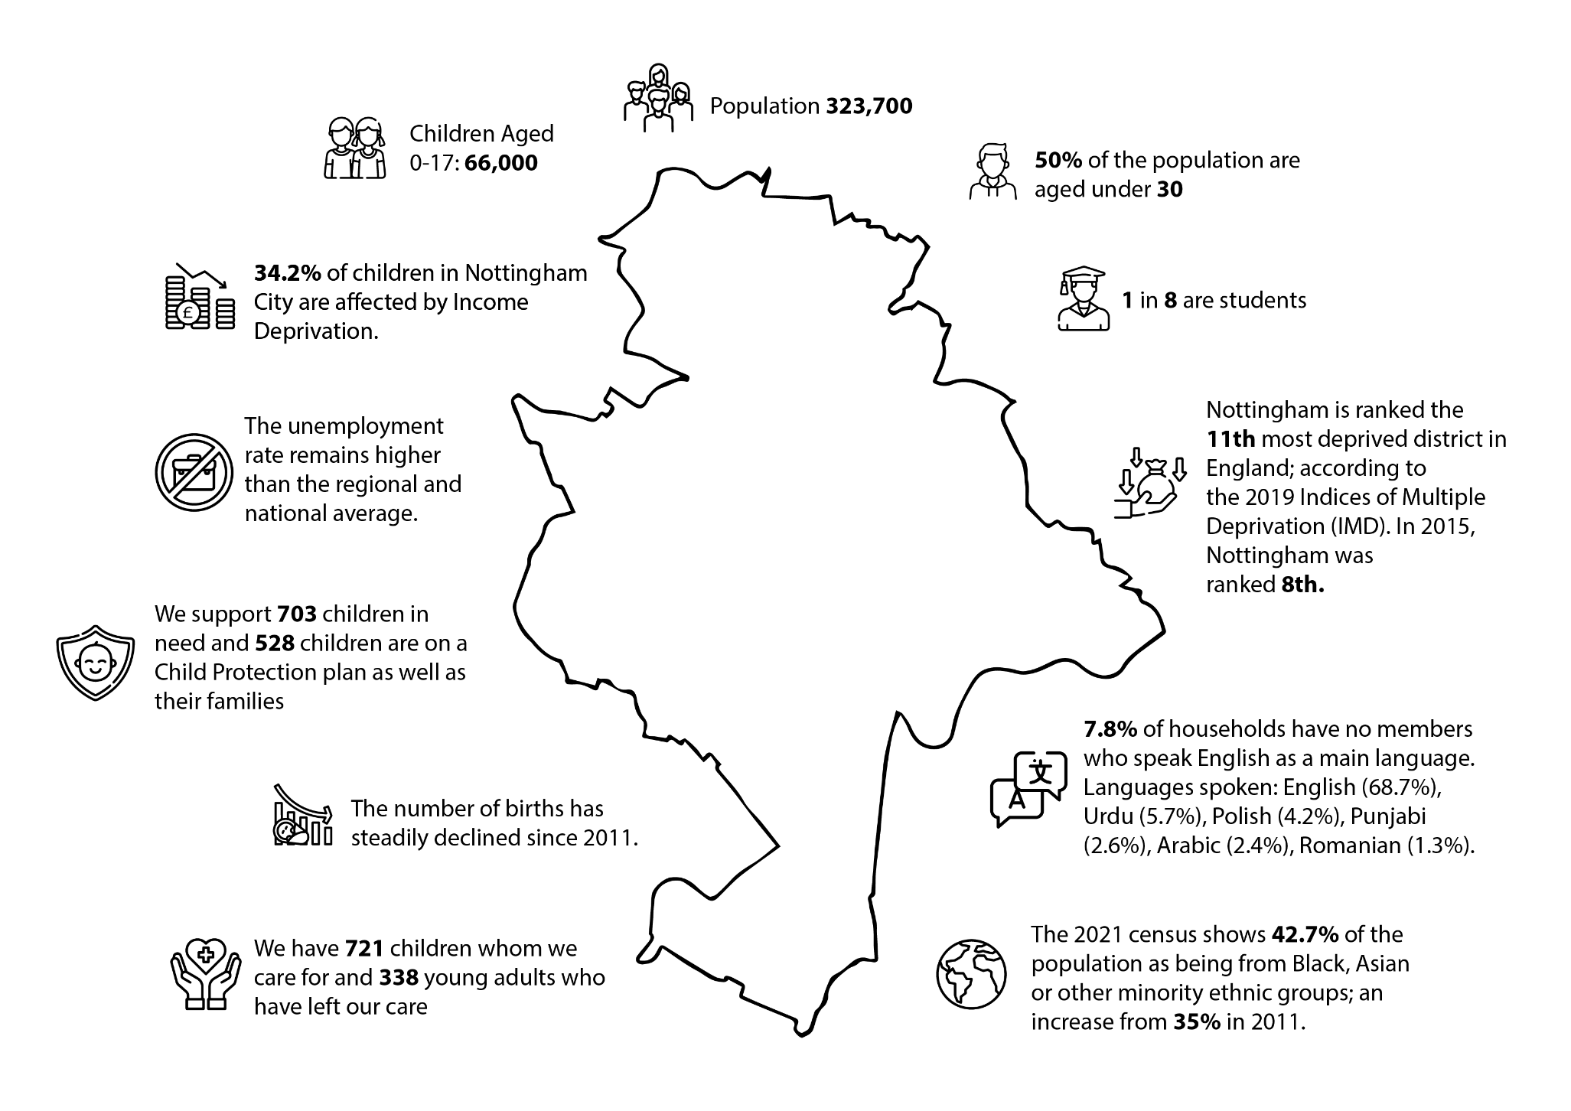
Local Context

Slide 7
Staffing changes – New Business Manager (Ben Osifo) and Independent Scrutineer (Steve Edwards)
Threshold of Need – Refresh, launch event 23rd Nov and animation video
E-MARF
Child and Young Person’s Neglect Toolkit & Neglect animations
Learning from Rapid Reviews and LCSPR’s – Working with large families-the invisible voice; key development milestones in children; Was Not Brought guidance; Learning briefings to be circulated.
Partnership Newsletter – Autumn Edition
Business Plan - 4 Priorities (Exploitation; Making The System Work; Enhancing Cultural Competency & Confidence and Domestic Abuse).
NCSCP Social media – YouTube & X (formerly Twitter)
Early Help Partnership – Right help at the right time.
Notes:
There are a few references to concealed pregnancies in the existing guidance – in the Safeguarding Unborn Babies' chapter, https://nottinghamshirescb.proceduresonline.com/p_sg_unborn.html?zoom_highlight=concealed

Slide 8
NCSCP Education Subgroup

Slide 9
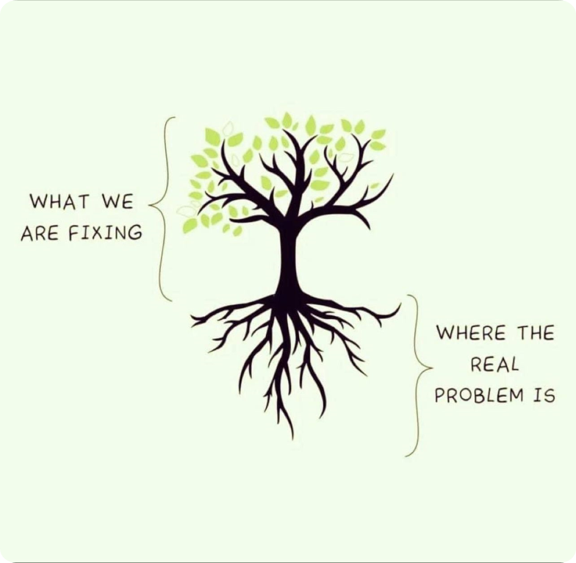
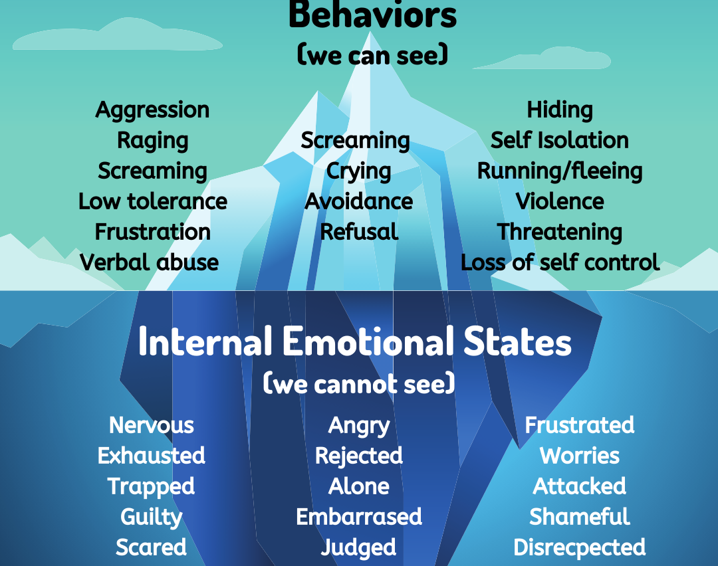

Slide 10
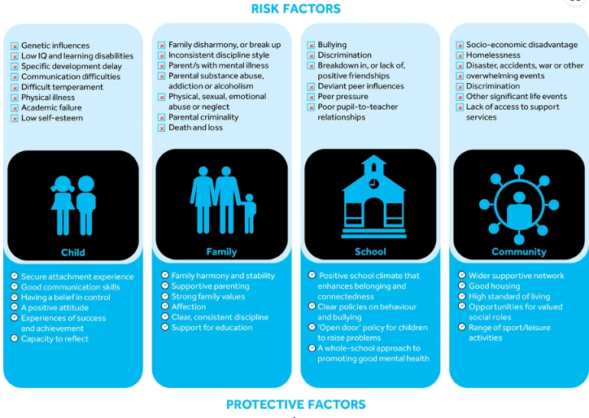
Notes:
So with all these influences

Slide 11
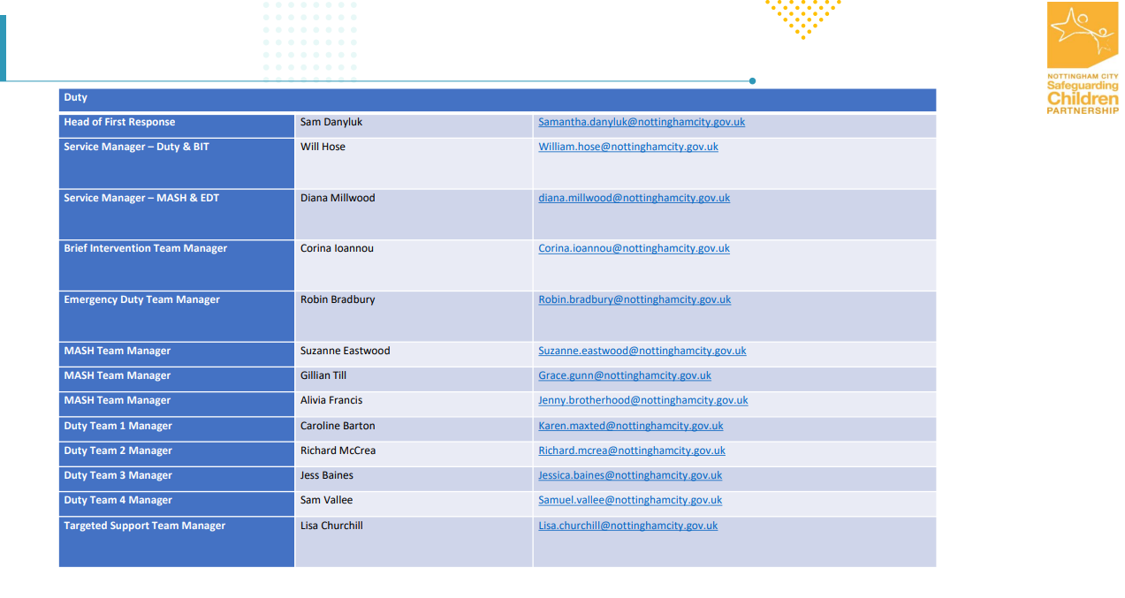
MASH

Slide 12

Closing
Think family
Evidence informed practice
Safety net
Your community
Safety Mapping
Importance of relationships
Notes:
Rita Pierson: Every kid needs a champion TED Talk - https://youtu.be/SFnMTHhKdkw?si=xyWT-Sf3vVyuKX-U

Slide 13
Resources
Information & resources
Practice Guidance
Interagency procedures – Updates
NCSCP Resources for Professionals
NCSCP
Topics | Research in Practice
Contact: safeguarding.partnerships@nottinghamcity.gov.uk

